Slide 1
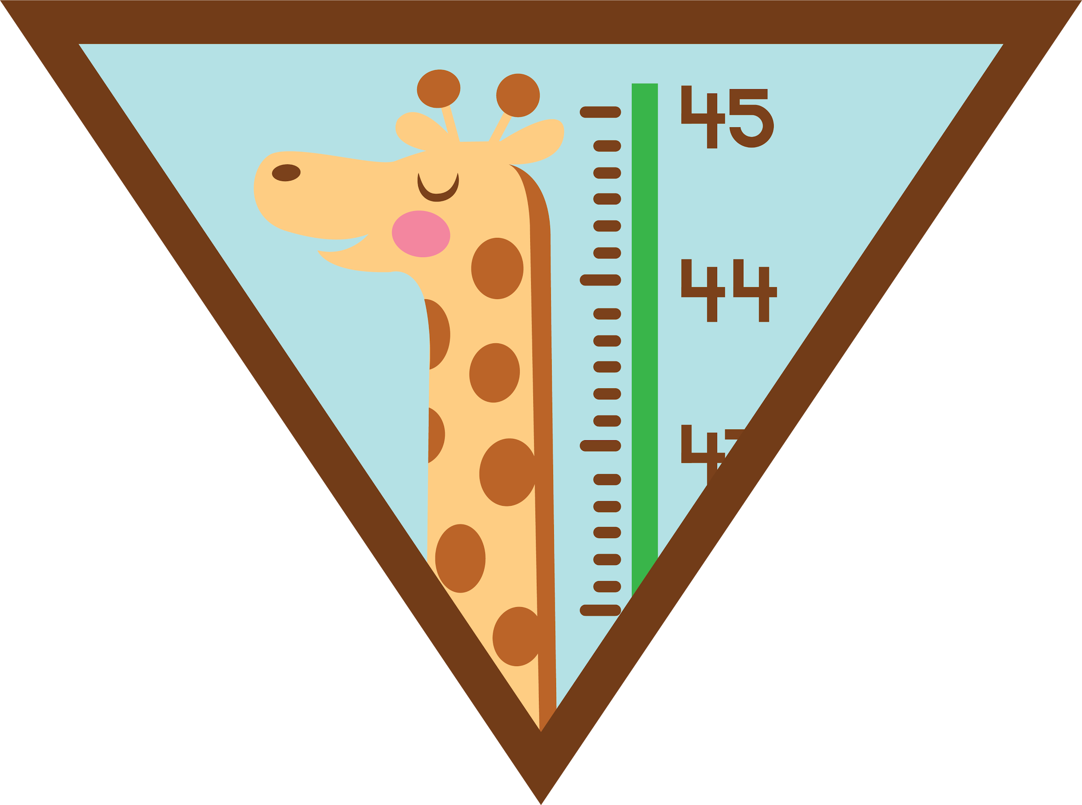

Leader Instructions & Meeting Prep:
Brownie My Best Self Badge
Brownie My Best Self Badge: :meeting plan supply list::
Drawing Paper
Crayons, Pencils, Markers
Cut up, cleaned fruits or vegetable pieces to make edible art. Anything you have on hand, such as carrots, broccoli, grapes, apples, raisins, nuts, etc.
The following slides will walk your troop through a virtual meeting to earn the Brownie My Best Self Badge. When you share your screen during your meeting, be sure to click “Present” so girls see the full screen. Also, when you are sharing your screen in zoom, google meet, or another meeting app, please make sure you are sharing both picture and audio. For more information on using Zoom, visit gsnw.gl/VirtualMeetingHowTo
Many of the interactive activities included are shared through YouTube videos. Just click on the arrow in the center of the image to play the video, and the girls can see it too! You should try to review the slides before your meeting if possible, so you are familiar with the activities and any supplies needed.
This meeting will typically take approximately 60-90 minutes as written, depending on participation level and number of girls. As always, Girl Scouting is flexible, and troops may select the activities interest them most, add their own activities, or have girls do some of the steps afterward as “homework”.
When you send out your meeting invitation, be sure to let girls and parents know what supplies they should have on hand for the online troop meeting. They are things most girls likely have at home.

Slide 2

Brownie
My Best Self Badge
Brought to you by Girl Scouts of the Northwestern Great Lakes

Slide 3
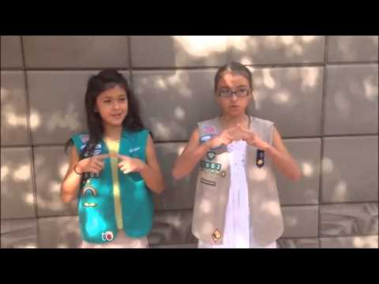

The Girl Scout Promise
The
Girl Scout Promise
On my honor, I will try:
To serve God and my country,
To help people at all times,
And to live by the
Girl Scout Law.

Slide 4


Let’s say the Pledge

Slide 5

Icebreaker:
Tell us one thing that makes you
UNIQUE
from everyone else!

Slide 6
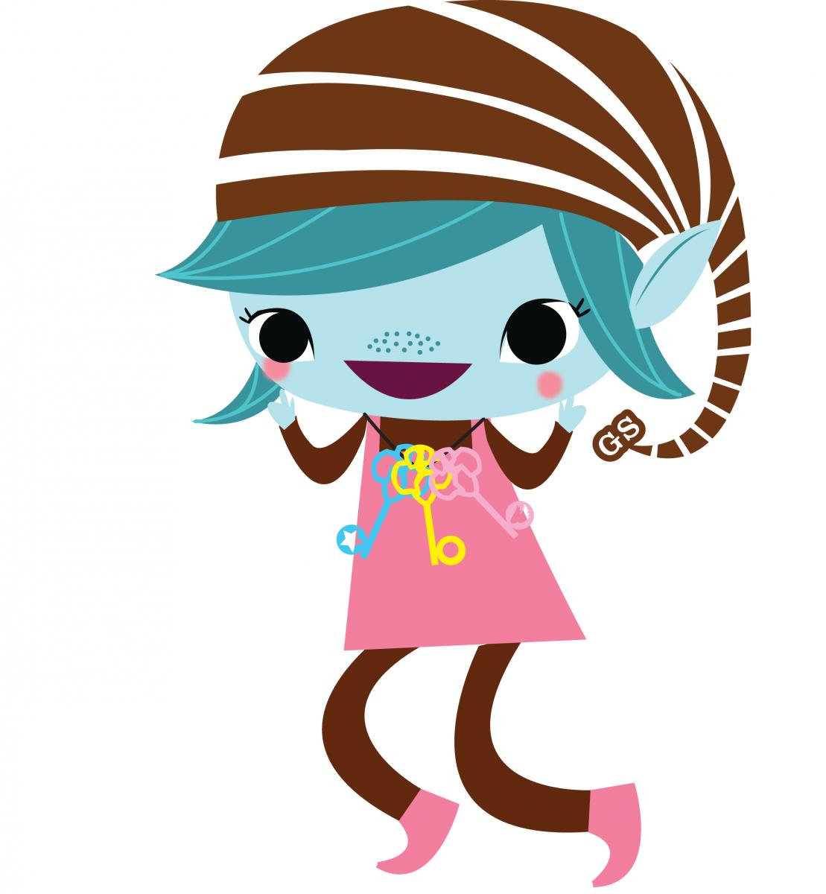
Step 1:
Get to know your body!
Draw a picture of yourself as a Brownie Elf

Slide 7
Now, on you elf drawing, label where on your body you feel...
Sad
Happy
Angry
Hungry
Thirsty
Nervous

Slide 8

Step 2:
Eat and play in a healthy way!
Let’s start with some exercise! Can you spell out your name by doing the exercise listed for each letter?

Slide 9
A
Jump up and down 10 times
K
March like a toy soldier for 12 seconds
U
Roll a ball using only your head
B
Spin around in a circle 5 times
L
Pretend to jump rope for 20 seconds
V
Flap your arms like a bird 25 times
C
Hop on one foot 3 times
M
Do 3 somersaults
W
Pretend to ride a horse for 15 seconds
D
Run to the nearest door and back
N
Pick up a ball without using your hands
X
Try and touch the clouds for 15 seconds
E
Walk like a bear for 5 seconds
O
Walk backwards 50 steps and skip back
Y
Walk on your knees for 10 seconds
F
Do 3 cartwheels
P
Walk sideways 20 steps and hop back
Z
Do 10 pushups
G
Do 10 jumping jacks
Q
Crawl like a crab for 10 seconds
H
Hop like a frog 8 times
R
Walk like a bear for 5 seconds
I
Balance on your left for 10 seconds
S
Bend down and touch your toes 20 times
J
Spin around in a circle 5 times
T
Pretend to pedal a bike with your hands for 17 seconds

Slide 10
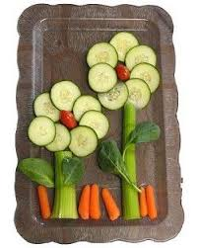
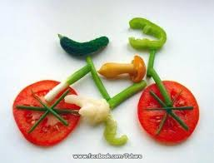
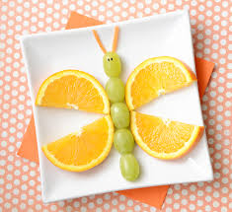
Use whatever fruits and vegetables you have on hand to make your own edible art!

Slide 11
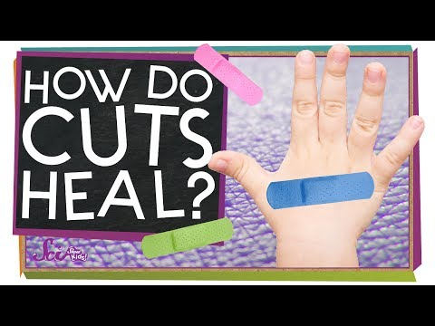
Step 3:
Find out how your body works!
How does your skin heal when you have a cut?

Slide 12
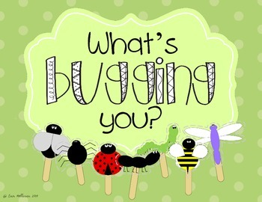
Step 4:
Know what to do when something is bugging you.
When you are feeling down or upset, how do you help yourself feel better?
Who can you talk to about it? Who could help?
What activities do you like to take your mind off it and feel happier?
What are some things we can all do to de-stress?

Slide 13

Did you know that both movement and music can help improve your mood? Let’s have a dance party!

Slide 14
Step 5: Meet a health helper! Choose one of these to do with your troop.
Invite a guest speaker such as a Doctor, Nurse, or EMT to your meeting. Have them tell you about what they do in their job each day, and ask the girls to try to think of a question to ask.
Work together as a troop to write a letter to a pediatrician, ER Doctor/Nurse, or ambulance driver. Work together to come up with questions to ask them about their job.
Make Thank You cards for healthcare heroes such as hospital staff or ambulance drivers.

Slide 15
Congratulations!
You have earned the
My Best Self Badge

