Slide 1
My Best Self
Girl Scouts of Central Illinois - Home Edition 2020
GetYourGirlPower.org
1-888-623-1237

Slide 2
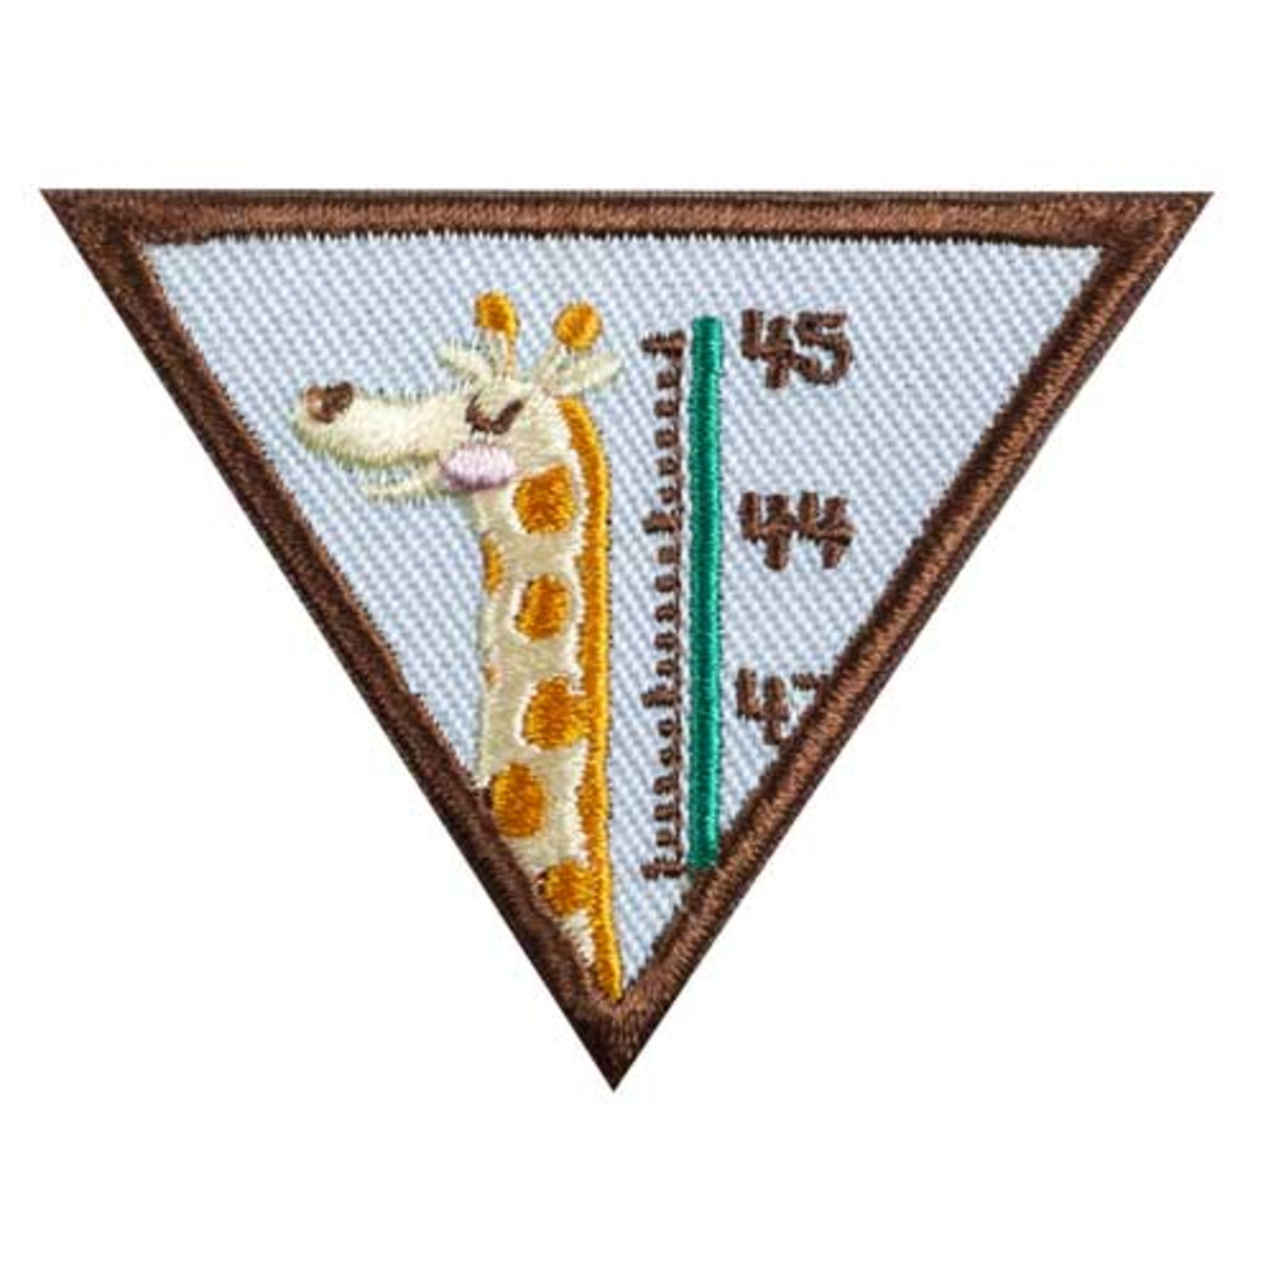
WE ONLY HAVE ONE BODY
Because we only have one body, it is important to take care of it. Learn to pay attention to what your body needs and how to ask for health help if you need it - so you can keep yourself feeling great.

Slide 3
Step 1
Get to Know Your Body

Slide 4
Step 1 Activity
Pick 1 of these 3 options:
Draw your “Elf Self”. Be sure to color in your eyes, hair, and favorite clothes.
Write on your “Elf Self” where you feel happy, hungry, tired, nervous, sad, angry, and thirsty.
Share how you’re unique, such as height, color and texture of your hair, eye color, and traits that make you one-of-a-kind.

Slide 5
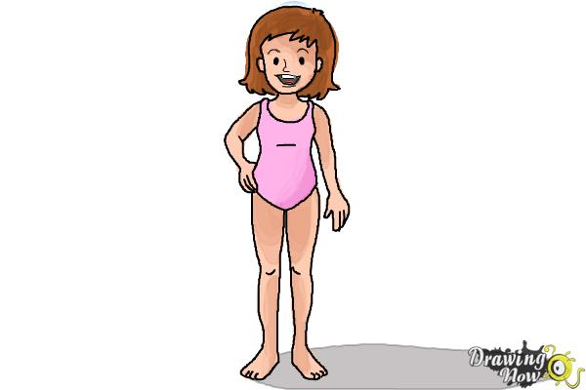
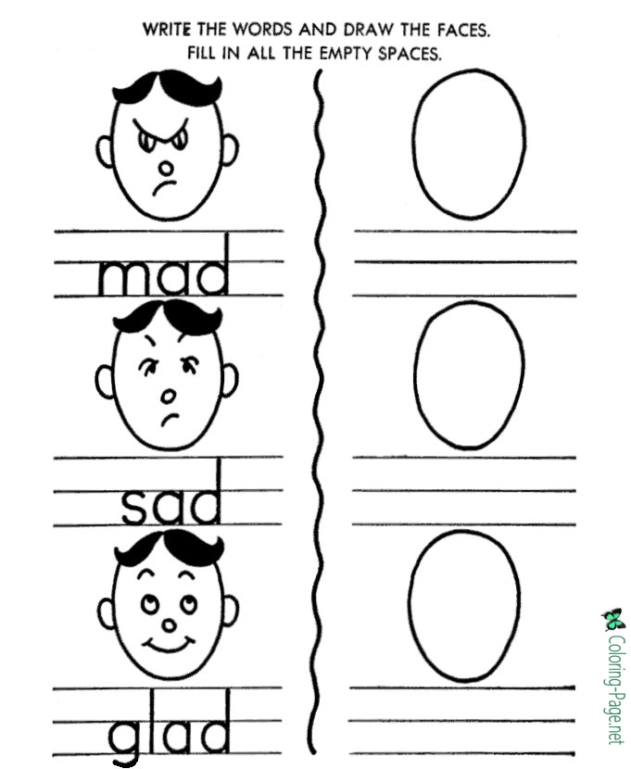
Step 1 Tips:
Learn how to draw your body here .
Learn how to draw faces & emotions here .

Slide 6
Step 2
Eat and Play in a Healthy Way

Slide 7
Step 2 Activity
Pick 1 of these 3 options :
Try three new foods that are good for you. Be sure to pick from different food groups.
Try three different kinds of exercise, such as jumping rope, playing soccer and yoga. Learning upbeat dance moves is an often overlooked form of exercise.
Take a thirsty challenge. Choose water over juice or sugary drinks. Your body is made of water & needs it!

Slide 8
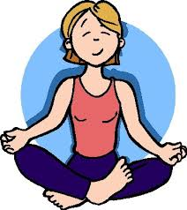

Step 2 Tips:
Learn to fill a plate with 5 food groups here .
Learn a Frozen-themed yoga here .

Slide 9
Step 3
Find Out How Your Body Works

Slide 10
Step 3 Activity
Pick 1 of these 3 options :
Talk about 3 common reasons your “tummy” might hurt. What you call “tummy” doctors call “abdomen.”
Learn about a healthy temperature and reasons why a temperature might be high.
Find out about bandages. Learn why there are different sizes, shapes, colors and uses of bandages.

Slide 11
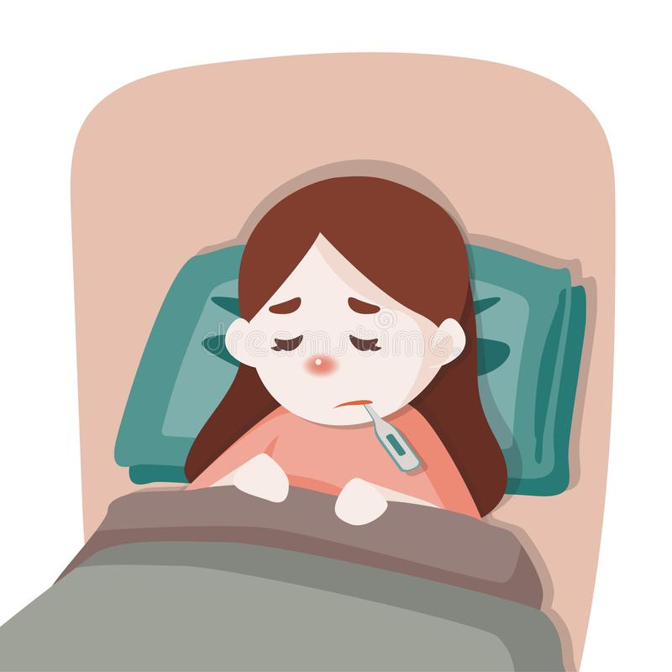
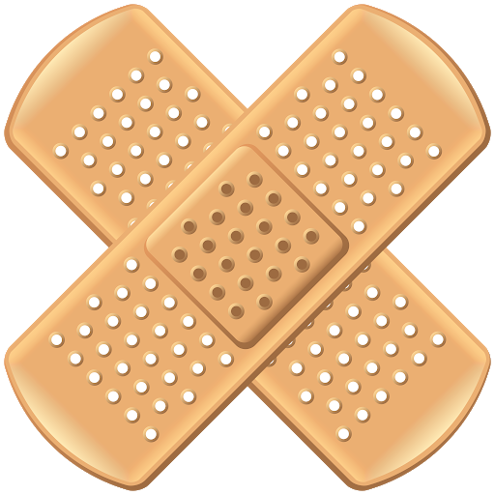
Step 3 Tips:
Learn about high temperature/fever here .
Learn about a variety of bandages here .

Slide 12
Step 4
Know What to do if Someone Bugs You

Slide 13
Step 4 Activity
Pick 1 of these 3 options :
Create a “Happy Box” with 5 of your favorite things, so you can dive into it when you get worried or upset.
Each day for one week, draw your feelings. Which times are you happiest and why? Try using emojis.
Try mindful coping skills. Moving helps our bodies feel happier. Using meditation helps to reduce stress and anxiety.

Slide 14
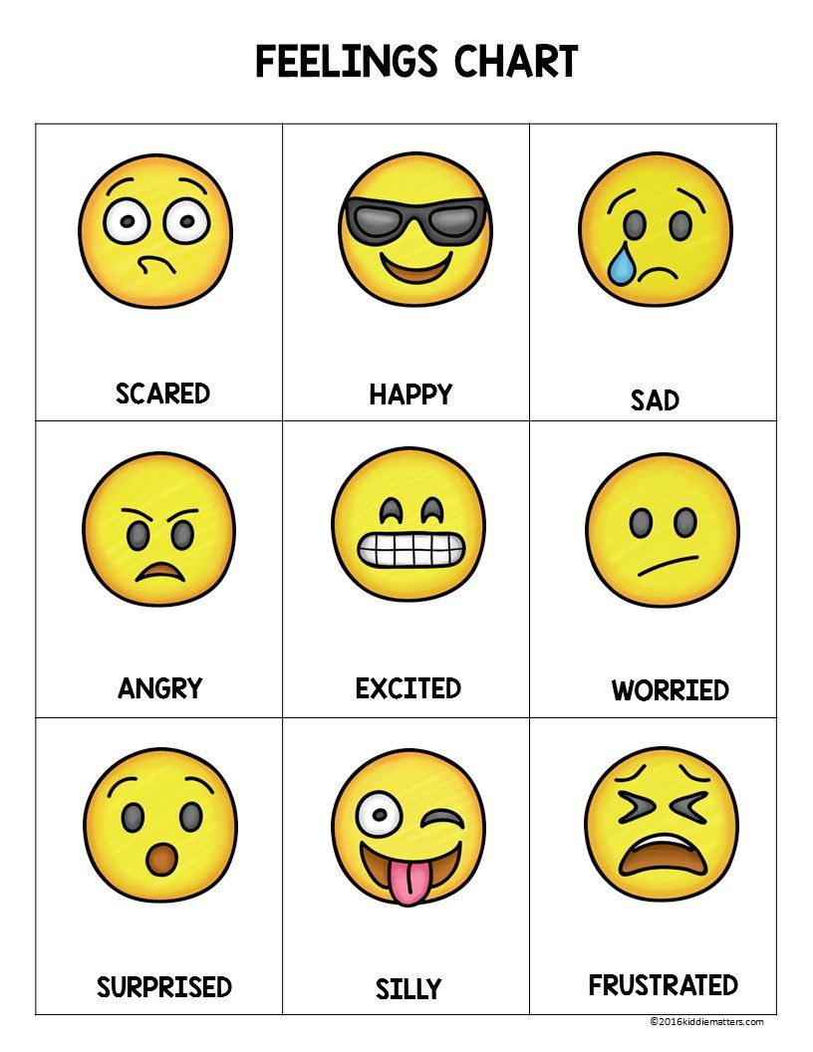
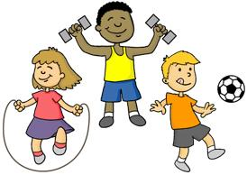
Step 4 Tips:
Learn about emoji feeling faces here .
Learn how movement relieves stress here .

Slide 15
Step 5
Meet a Health Helper

Slide 16
Step 5 Activity
Pick 1 of these 3 options :
Visit a doctor, dentist, or optometrist. If you can’t make an appointment to meet in person, find a way to connect with a professional virtually.
Visit or email a school nurse or counselor. Find out what they do for students and why students might need their support.
Visit someone who works in an ambulance. Use trustworthy internet resources to learn more about first responders.

Slide 17
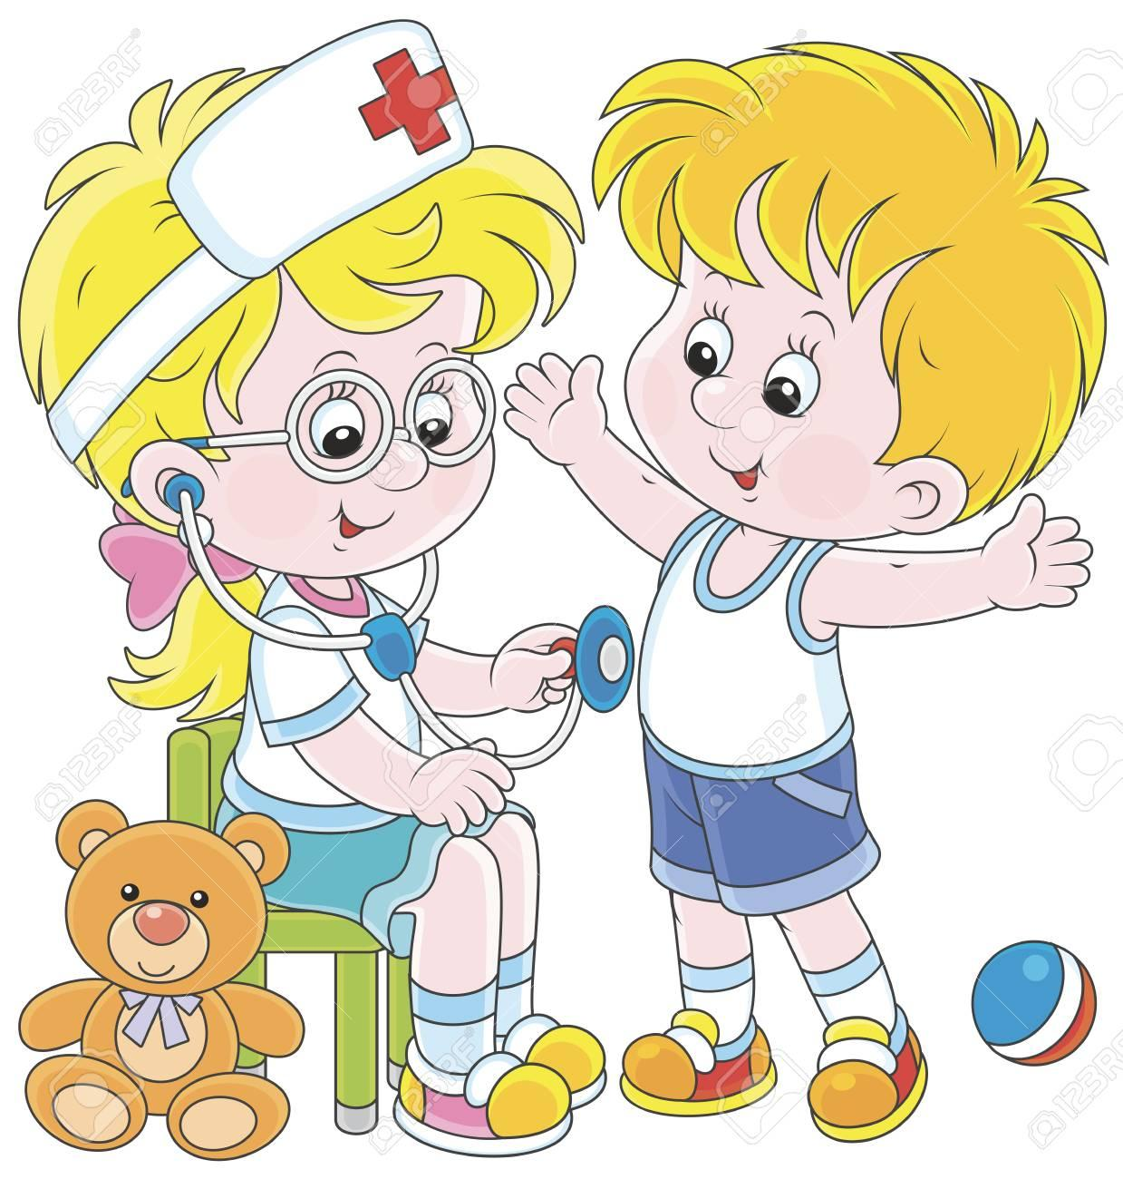

Step 5 Tips:
Learn about healthcare careers here .
Teach kids about first responders here .

Slide 18
Now that I’ve earned this badge...
I can give service by:
Helping my family try a new healthy food
Sharing fun new exercises with friends
Teaching other Brownies healthy ways to get happy if they’re feeling down
Girl Scouts of Central Illinois GetYourGirlPower.org
1-888-623-1237

Slide 19

Share with us!

