Slide 1

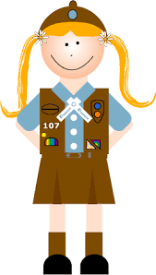
Brownie Money Manager
Girl Scouts of Central Illinois

Slide 2
Tips Before Takeoff!
Be sure to review the internet safety pledge with an adult you trust. You’ve probably already looked at this if you’ve done online cookie sales or other Girl Scout activities online.

Slide 3
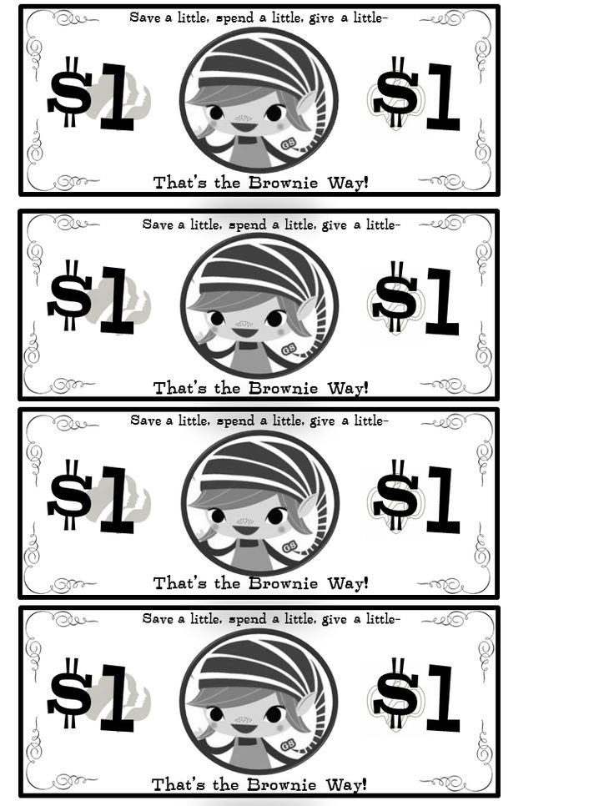
Gather Your Supplies
For this badge, you’ll need a few things.
First, you’ll need a shopping buddy! Grab a doll, teddy bear, or get a brother or sister to join in the fun! If you have the Girl’s Guide to Girl Scouting, you can use the Elf paper doll in the “My Girl Scouts” section.
You’ll also need to make some pretend things to buy, and some pretend money! If you don’t have a printer, grab some paper and make your own items and fun money using these as a guide.
Fun Money Elf Shopping Items

Slide 4
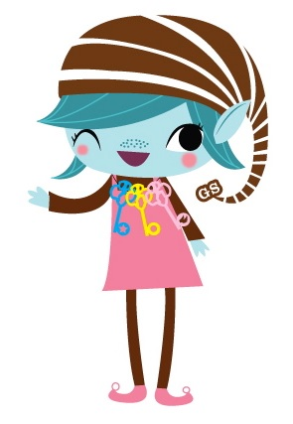
Step One: Shop for elf items with your buddy!
Go shopping at home! Place the elf shopping items around your home. Practice paying with your elf money by counting out the correct amount of money for each item. Then challenge yourself by pretending to buy exactly $10 worth of items, $15 worth of items, and $20 worth of items.

Slide 5

Step Two: Go grocery shopping
Count out $30 from your stack of play money to go grocery shopping. Then write down five food items you need to be healthy and strong!
Look online with an adult or in supermarket ads to figure out how much these items cost, or use your Elf Shopping Items. Was $30 enough?

Slide 6

Step Three: Go clothes shopping
Make a list of the most important clothes you want. Then budget $30 for your clothing, and pretend to shop for the items on your list. You can look through catalogs, online with an adult’s help, or use the Elf Shopping Items.

Slide 7

Step Four: Get ready for school
Write down the supplies you need for school every day. Then add a few extra things you would like to have at school, but don’t need.
Then, figure out how much this will cost! Have an adult help you find prices online or in a magazine or newspaper. How much money do you need? Do you have enough Elf Money to pay for it?

Slide 8

Step Five: Have some fun!
Think of a fun activity you’d like to do with your Girl Scout sisters. Maybe it’s horseback riding, going to the pool, or visiting a zoo. Have an adult help you look online to see how much this costs. Is there anything else you would need to pay for? Lunch? Souvenirs? Write down the total cost for two people to do this activity.

Slide 9
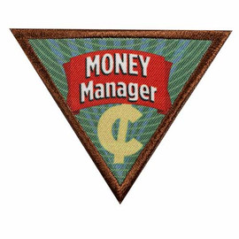
Congratulations!
Once you did steps 1-5, you are done with your Money Manager badge!
You can buy the badge online or in the shop once we re-open!
Share what you’ve done with Girl Scouts of Central Illinois using #GSCIShinesOn

