Slide 1


Making Friends
Brownie
www.GetYourGirlPower.org

Slide 2

Friends are another kind of family. They’re the people you have fun with and who help you when you need it. Try this badge to learn how to make new friends, keep old friends, and be the best Brownie friend you can be.

Slide 3

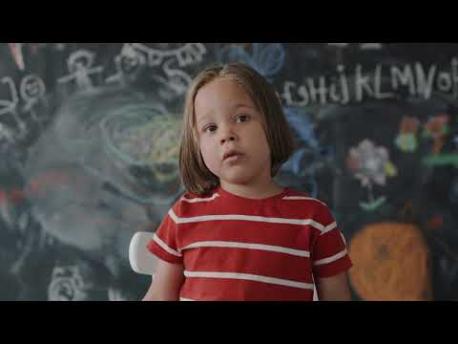
Step 1: Making Friendly Introductions
Making new friends can be as simple as introducing yourself. Ask your parents to introduce you to one of their adult friends. Tell that person something about yourself, and ask something about them. Be ready to have a conversation.
Script: Hello, my name is _____. I like ______. What is your favorite_____?

Slide 4

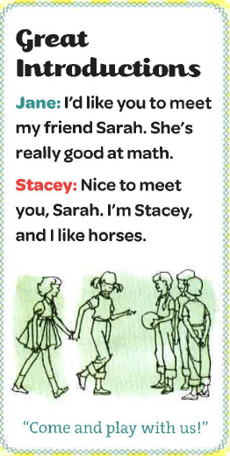
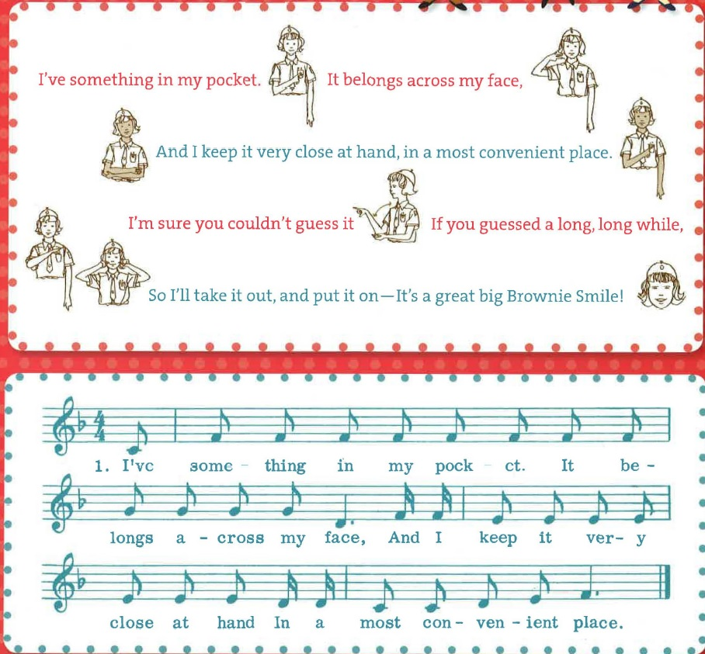
Quick Tip!

Slide 5

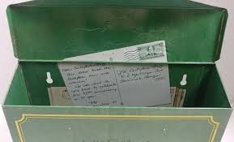
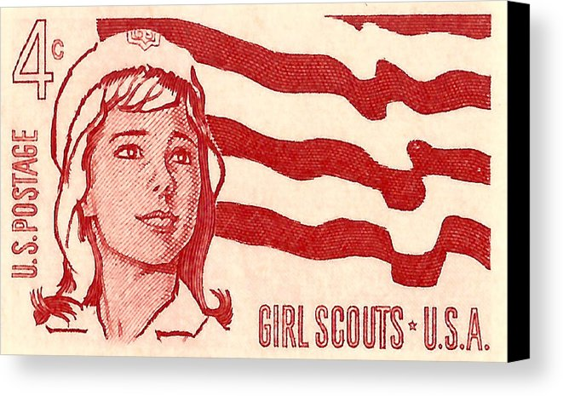
Step 2: Show Friends You Care
Good friends remind one anther of what makes them special, and help each other feel better when something goes wrong. Send a card to your friend. You can write a name poem or create a SWAP for them. It’s always nice to receive something special from a friend.

Slide 6

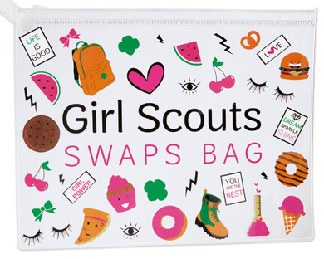
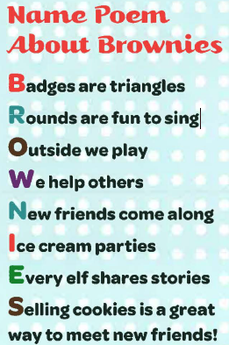
Mail one or both of these items to a friend!
Write a name poem. Write a friend's name vertically down a piece of paper. Beginning with each letter of the friend name, write something nice about that friend -something they do well, or one of the reasons you like being their friend.
Let's Make Some SWAPS!

Slide 7
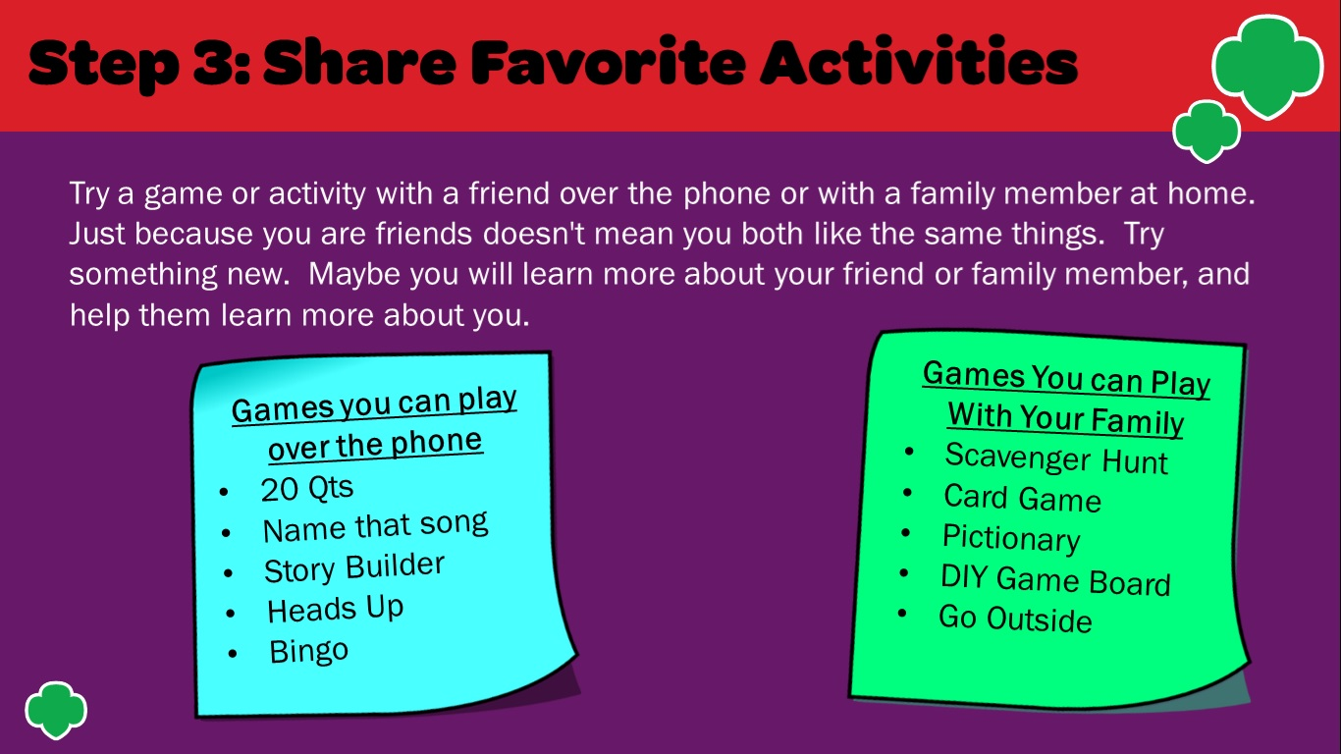

Slide 8
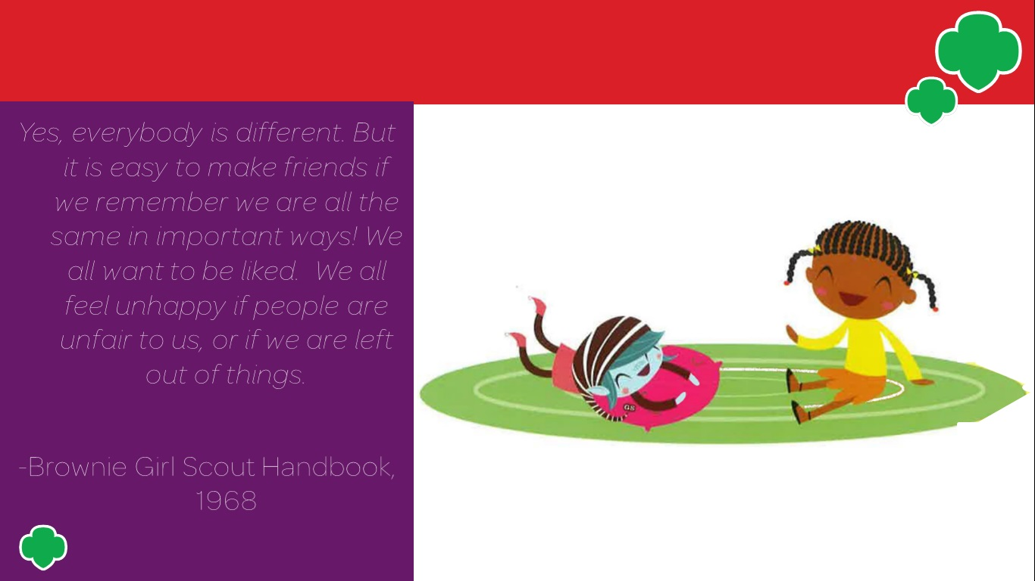

Slide 9
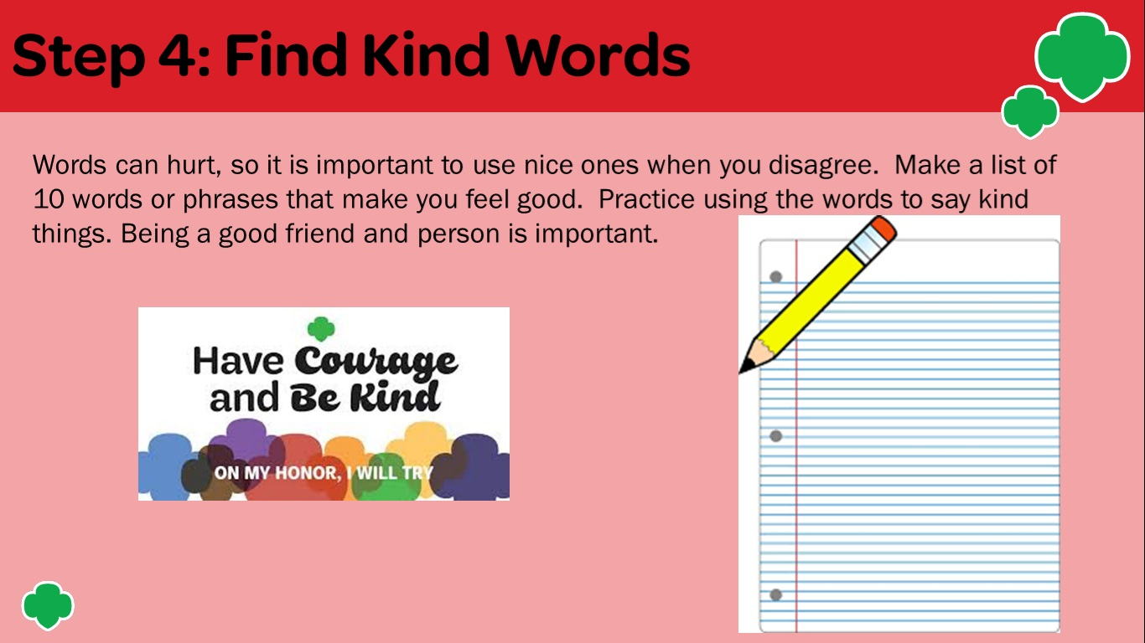

Slide 10
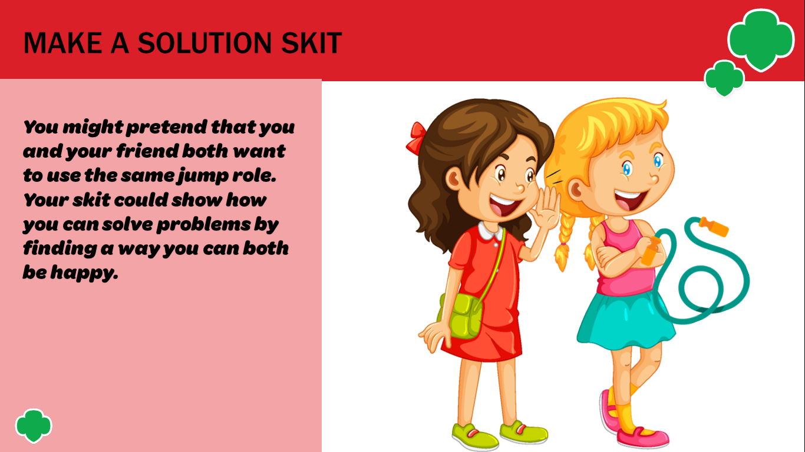

Slide 11
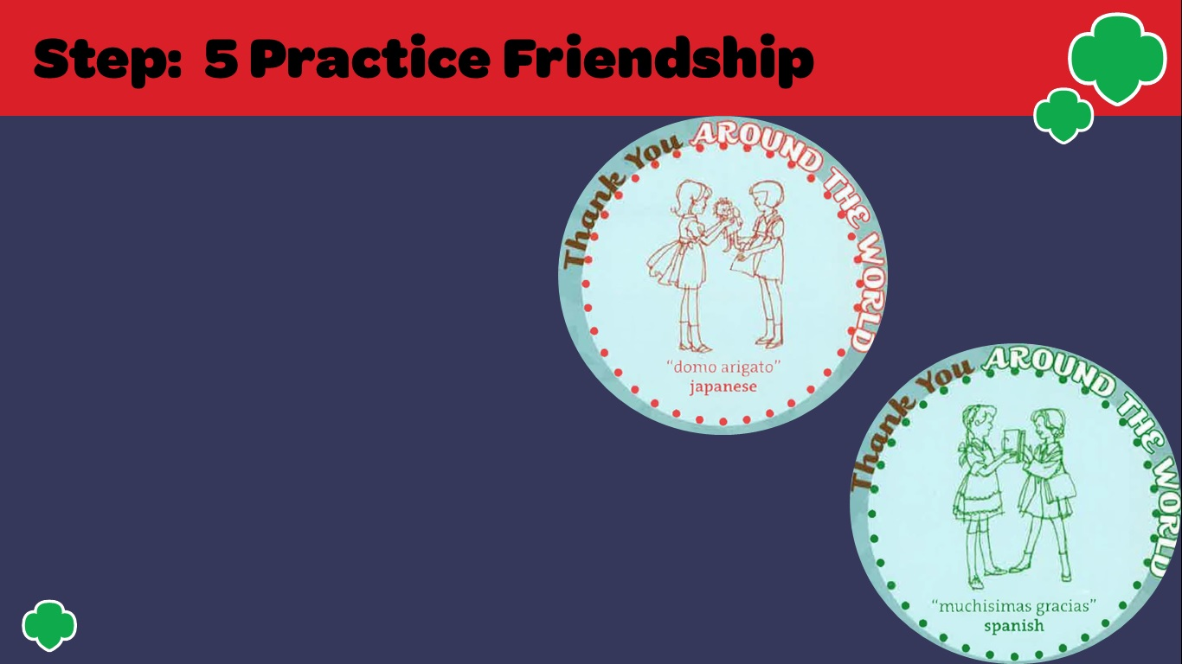
Now it is time to practice your friendship skills. Make a list of the top 3 things you have discovered that makes someone a good friend. Practice being a good friend. Say “Thank You!”to others when they help you, show kindness to the people in your home. Remember the list of kind words and phrase your created. Be kind to everybody

Slide 12

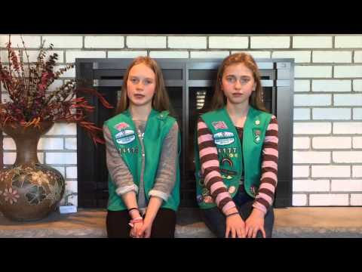
Friendship Song

Slide 13

Congratulations you earned Making Friends Brownie Badge
Please take our survey. We would love to hear your feedback.

