Slide 1


Leader Instructions & Meeting Prep:
Brownie Household Elf Badge
Brownie Household Elf Badge: :meeting plan supply list::
Paper
Coloring utensils, markers
Container/spray bottle
1 cup white vinegar & 1 cup water
1 white sock/washcloth
1 colored/pattern sock
2-3 rubber bands
Scissors
Cotton balls
1 of the following: uncooked rice, dried peas or beans
White glue
Optional: googly eyes
1-2 orange pompoms or orange felt triangles
3 buttons
Ribbon
Hot glue gun
The following slides will walk your troop through a virtual meeting to earn the Brownie Household Elf Badge. When you share your screen during your meeting, be sure to click “Present” so girls see the full screen. Also, when you are sharing your screen in zoom, google meet, or another meeting app, please make sure you are sharing both picture and audio. For more information on using Zoom, visit gsnw.gl/VirtualMeetingHowTo
Many of the interactive activities included are shared through YouTube videos. Just click on the arrow in the center of the image to play the video, and the girls can see it too! You should try to review the slides before your meeting if possible, so you are familiar with the activities and any supplies needed.
This meeting will typically take approximately 60-90 minutes as written, depending on participation level and number of girls. As always, Girl Scouting is flexible, and troops may select the activities interest them most, add their own activities, or have girls do some of the steps afterward as “homework”.
When you send out your meeting invitation, be sure to let girls and parents know what supplies they should have on hand for the online troop meeting. They are things most girls likely have at home.

Slide 2

Brownies
Household Elf Badge
Brought to you by Girl Scouts of the Northwestern Great Lakes

Slide 3
.Welcome!.
Girl Scouts!

Slide 4

Girl Scout Promise
On my honor, I will try, To serve God and my Country. To help people at all times, And to live by the Girl Scout Law.

Slide 5


Let’s say the pledge

Slide 6
Girl Scout Law
I will do my best to be honest and fair, friendly and helpful, considerate and caring, courageous and strong, and responsible for what I say and do, and to respect myself and others, respect authority, use resources wisely, make the world a better place, and be a sister to every Girl Scout.

Slide 7
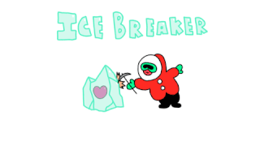
What is your favorite thing to do outside?

Slide 8
Badge Details:
Pick up some new household habits to help your family save energy, save water, and save the planet.
We will learn how to:
Save energy
Save water
Go natural
Reuse or recycle
Clear the air
When you've earned this badge, you'll know how to make your home clean and green.

Slide 9
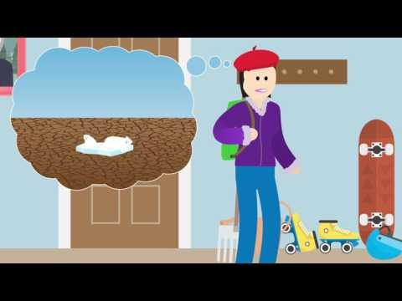
1.
Save energy.

Slide 10

Save energy.
When you sleep, you are saving energy so you can play more when you wake up. Saving energy in your house is important too so that the Earth doesn’t run out energy that makes electricity!
How Can You Save Energy?
Unplug appliances when you are not using them! (40% of all energy is used while appliances are off)
Turn off the lights when you leave the room
Clean the lint filter after every dryer load so it takes less energy and wash with cold water
Keep your refrigerator closed as much as possible
Replace your light bulbs with energy efficient ones
How can you help your family save energy?

Slide 11

2.
Save water.

Slide 12

Save water.
Did you know that the average faucet uses about 2-3 gallons per minute?
If you left the faucet on for 5 minutes while brushing your teeth and washing your hands, that’s 15 gallons of water!
For every minute in the shower, it’s about 5 gallons!
A 10 minute shower = 50 gallons of water!

Slide 13
.Let’s make.
change happen!
Let’s take a few minutes to create a sign to hang in your bathroom to remind everyone in your family to turn off the water while they are brushing their teeth or washing their hands.

Slide 14
.Let’s share!.
SAVE WATER!
Turn off the faucet when you are not using it.

Slide 15
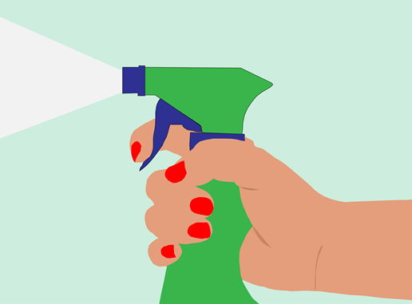
3.
Go natural.

Slide 16
Go natural.
We’re going to make a natural tile cleaner for the bathroom!
Grab your spray bottle, 1 cup of vinegar, and 1 cup of water
Pour 1 cup of white vinegar into your spray bottle
Pour 1 cup of water into your spray bottle
Place the top on and shake shake shake!
You can use this mixture to safely clean kitchen and bathroom counter and tiles. White vinegar dissolves many messes from smooth surfaces and absorbs odors instead of covering them with perfume!

Slide 17

4. Reuse &.Recycle.
Recycling and reusing is a great way to help the environment!
When you sent plastic, glass, or aluminum products away to the recycling plant, it can be repurposed into new products
When you reuse something, you’re keeping it out of the trash system completely!

Slide 18
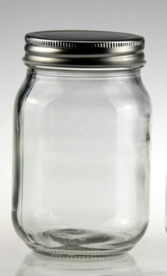
.How can you.
Reduce, Reuse & Recycle this?
Can you reduce, reuse, or recycle a glass container? Whether it’s from tomato sauce, salsa, or whatever it may be?

Slide 19

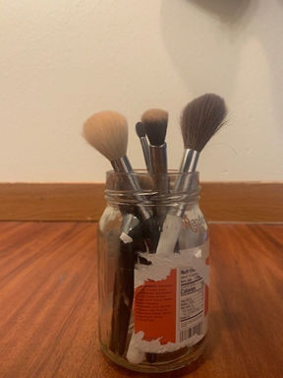
Great answers!.
Here’s an example of how to REUSE a glass salsa container - a bush holder!

Slide 20
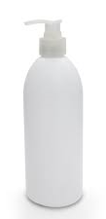
.How can you.
Reduce, Reuse & Recycle this?
Can you reduce, reuse, or recycle an empty lotion bottle?

Slide 21

Great answers!.
Here’s an example of how to REUSE an empty lotion bottle - a charging station for your phone!

Slide 22
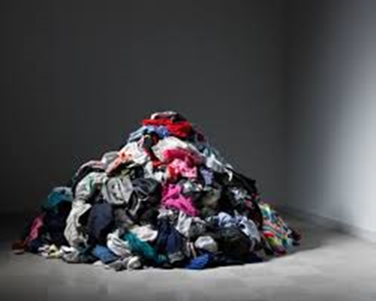
.How can you.
Reduce, Reuse & Recycle this?
Old clothes?

Slide 23
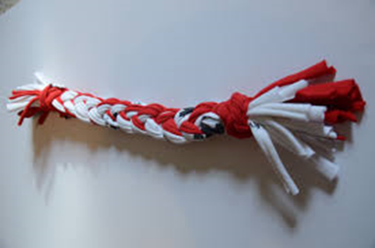
Great answers!.
Here’s an example of how to REUSE old clothes - make dog toys for an animal shelter!

Slide 24

.How many.
plastic bags are used every year?

Slide 25
.4-5 TRILLION.
plastic bags are used every year!

Slide 26
.How many.
plastic bags does a family of four use every year?

Slide 27
.1500.
plastic bags are used every year by a family of four!

Slide 28

Try to use REUSABLE bags. .whenever you can!.
When you can’t, try to get paper bags that can be recycled. If you have to use plastic bags, reuse them as lunch bags or garbage bags. You can also bring them in for recycling, but it is better to reduce and reuse plastic.

Slide 29
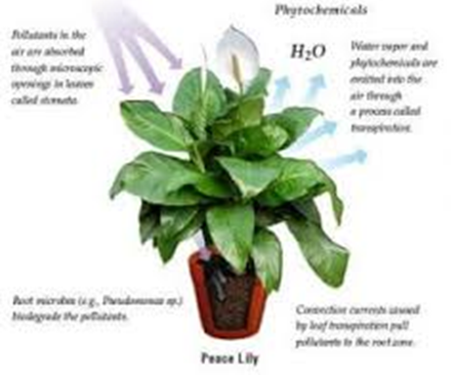
5.
Clear the air.

Slide 30
Clear the air.
The air we breathe in important in how we feel!
The air in your home can have dust or chemicals that can cause you to sneeze or make it hard to breathe
We breathe Carbon Dioxide out and Oxygen in. Plants do the opposite! Plants are important in keeping our air clean and safe for us!
What are some ways you can improve the air quality in your home?

Slide 31

.Let’s Upcycle!.
Upcycling is when you use something you already have to create something else out of this. Many people do this with plastic containers, glass jars, clothing, and much more!
We’re going to make a decorative Snow Woman out of things you already have!

Slide 32
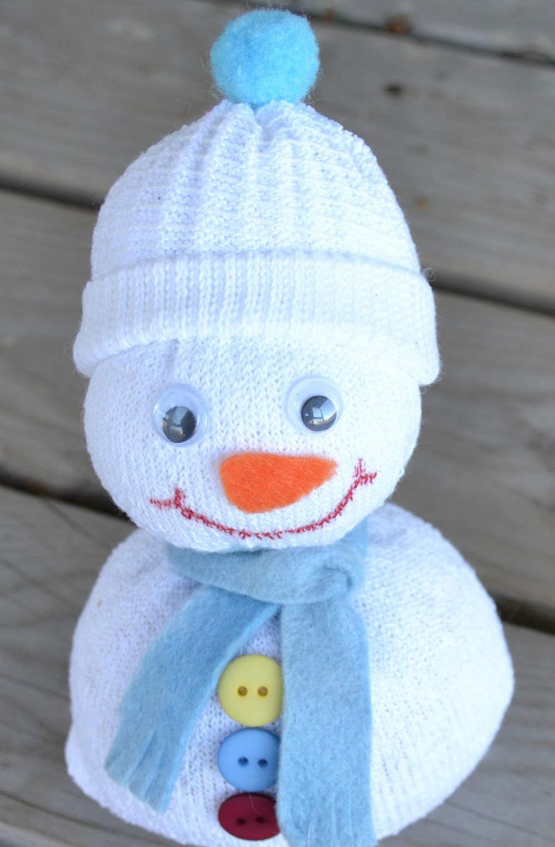
.Sock Snow Woman.
Supplies
1 white sock or washcloth
Any size sock will work
1 colored or patterned sock
2-3 rubber bands or hair ties
Scissors
Markers (Sharpies preferably)
Cotton balls
One of these: uncooked rice, dried peas or beans
White Glue
Optional: Googly eyes, 1-2 Mini Orange pom poms or orange felt triangle for nose, 3 Buttons, Ribbon, Hot Glue gun with adult assistance

Slide 33
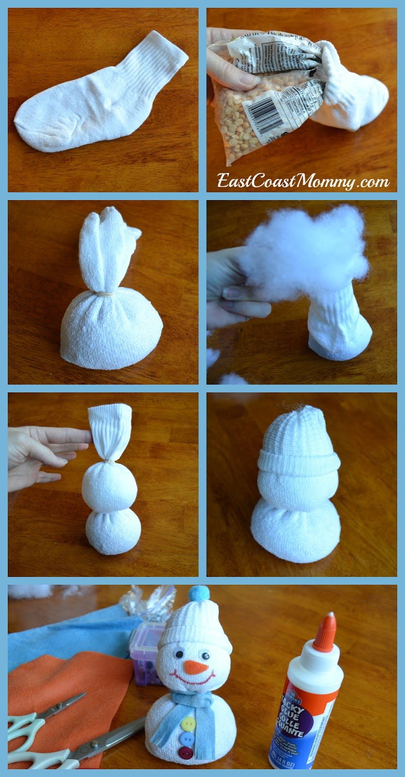
.Sock Snow Woman.
https://eastcoastmommyblog.blogspot.com/2015/12/spare-sock-snowman.html
Instructions
Start with a plain white sock, and fill the toe with rice (or something else that will give it some weight and keep it sturdy). Secure with an elastic.
Add some cotton filling for the head, and secure with an elastic.
Fold the top of the sock down to form a hat.
Use glue to add a pom pom to the hat, googly eyes, a felt carrot nose, and buttons. I used tacky glue that is suitable for use with fabric.
Draw a mouth with a permanent marker.
Cut a strip of felt to make a scarf, tie it around the snowman's neck, and use scissors to fringe the ends.

Slide 34
And now you know how to make your house clean & green!
Way to go, you have earned your badge!

