Slide 1

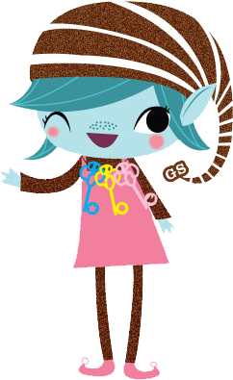
Brownie Home Scientist Badge
Girl Scouts of Central Illinois
#GSCIShinesOn

Slide 2
Getting Started...
To earn this badge, you’ll do five science experiments with things you can find around your home!
You’ll need help from an adult with these experiments.
Put on some clothes you don’t mind getting dirty or stained.

Slide 3
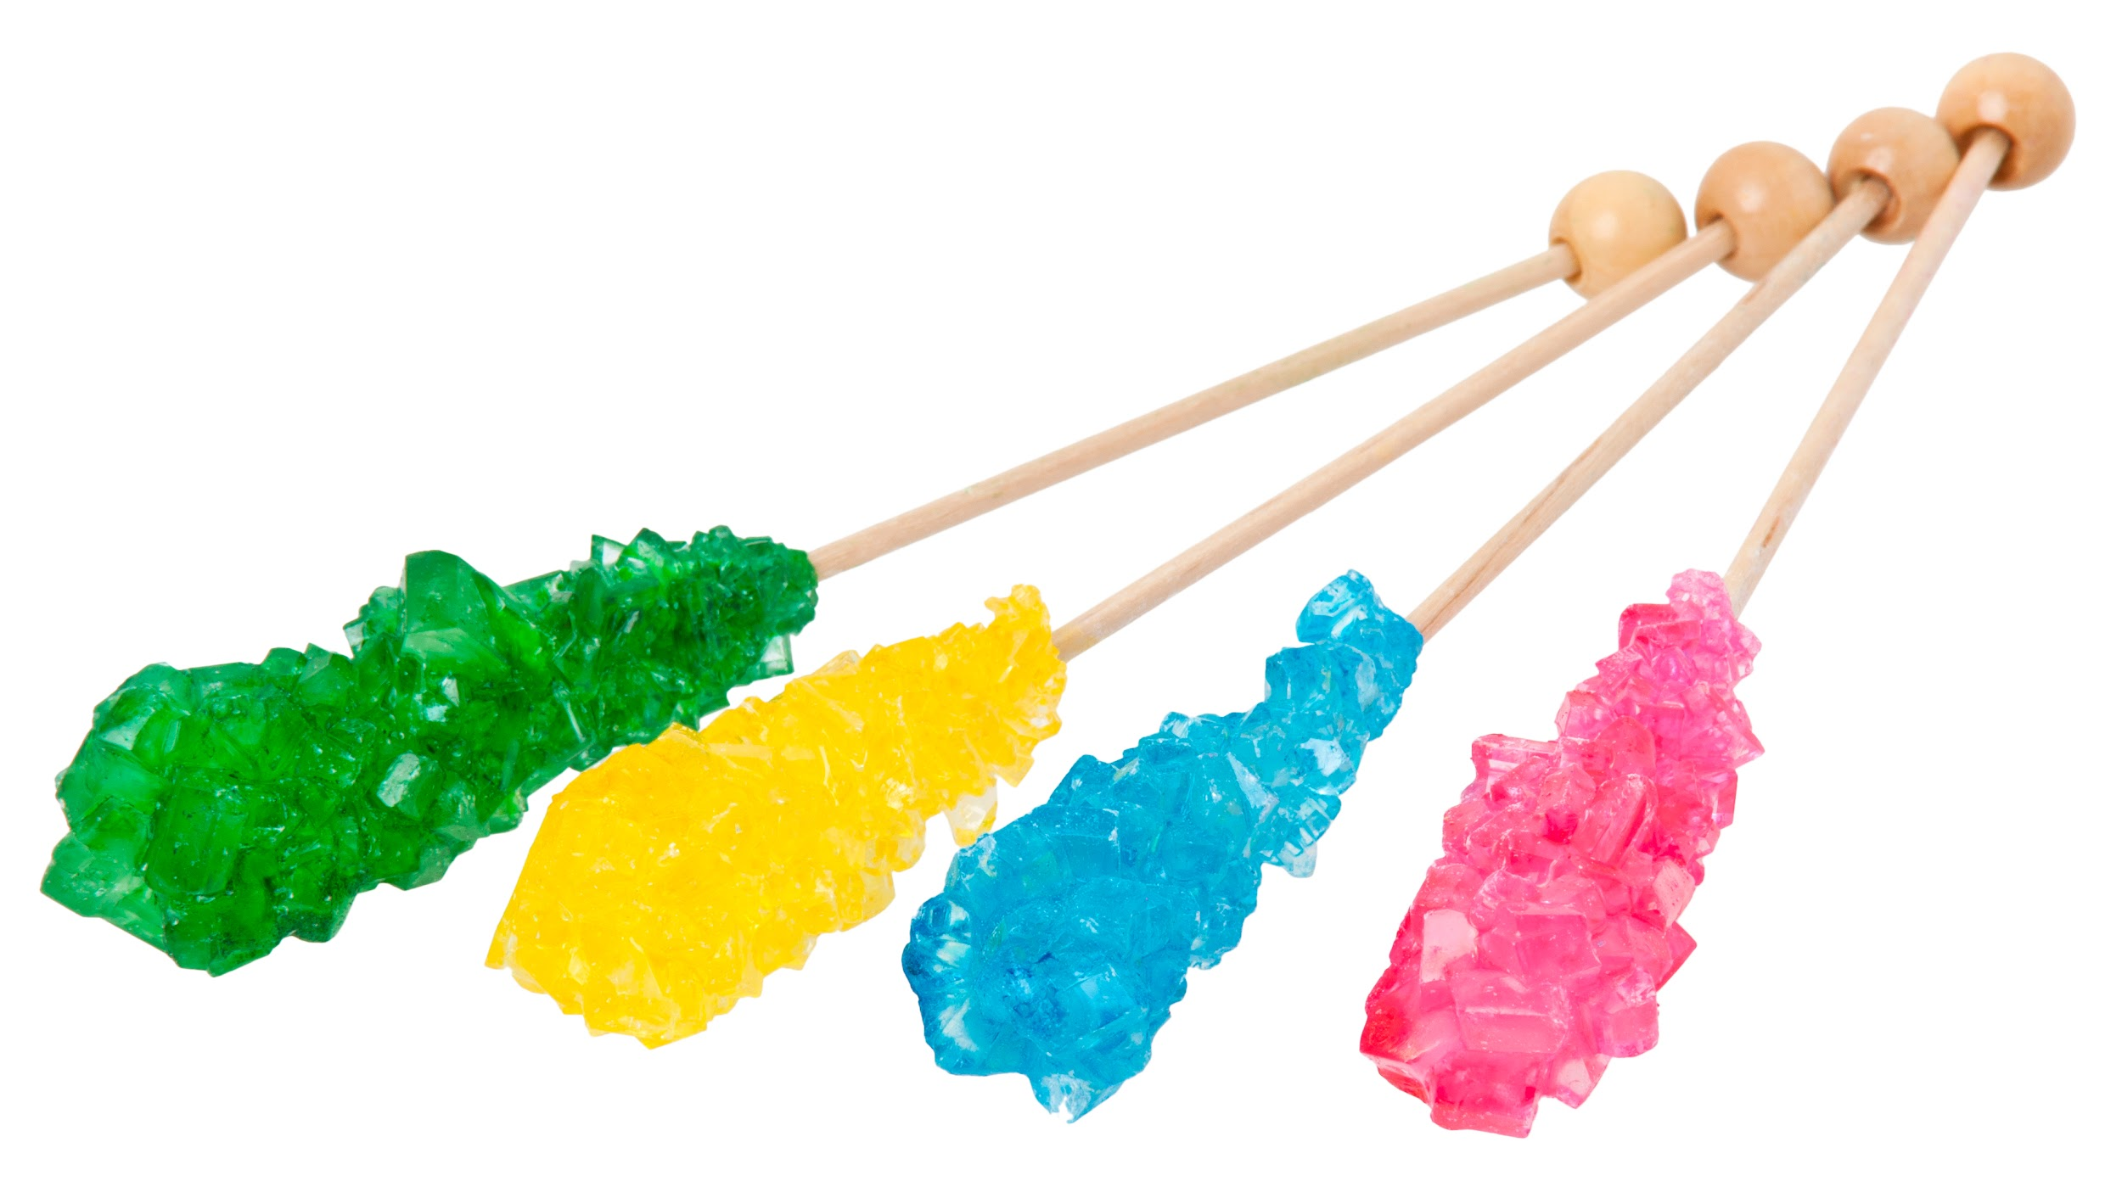
Step One: Be a kitchen chemist!
Start your experimenting in the coolest place for science in your house--the kitchen! Science is responsible for making lots of different foods. For our first experiment, we’re going to try making Rock Candy!

Slide 4
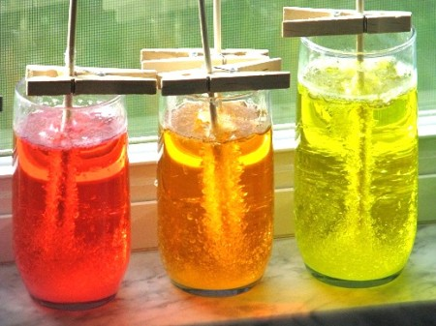
Gathering Supplies
First, you’ll need to get a few items!
1 cup water
4 cups sugar
Food coloring (optional)
Fruit flavoring (optional)
Jar
Wooden skewers and clothespin OR string and pencil

Slide 5
Instructions
First, get an adult to help you!!
First, boil the water.
Then, slowly add the sugar. Stir to make sure it dissolves
When the sugar won’t dissolve anymore and being building up on the bottom of the pan, add the food coloring and fruit flavoring.
Pour this liquid into the jar very carefully! It will be hot. Make sure no undissolved sugar gets in the jar.
Get the the skewer or string wet and roll it in some sugar.
Finally, put the skewer or string into the the solution or tie string to a pencil and place the pencil across the jar.

Slide 6

This video gives a great example and explanation of the science behind why these crystals form!

Slide 7
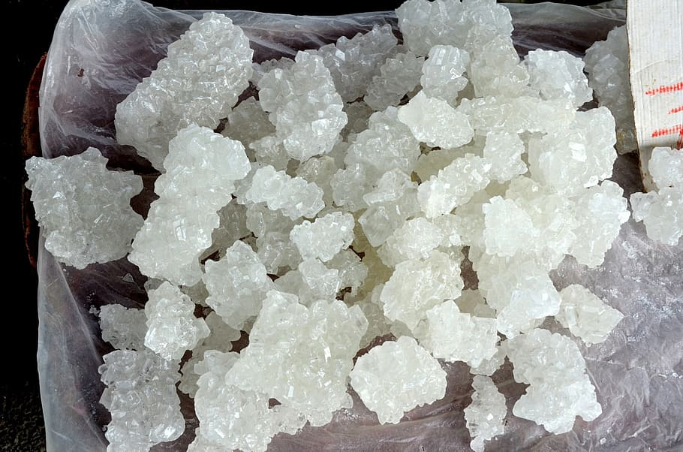
What happens?
Set your experiment in a safe place and leave it alone for several hours.
When you come back to check on it, do you notice anything?
Leave it for a few days, checking on it a few times each day to observe any changes
Sugar is made of tiny crystals that clump together. As the water cools, these tiny crystals stick together to make bigger stickers.
See the video on the previous page fora scientific explanation.

Slide 8
Step Two: Create static electricity
Ever wonder why your clothes sometimes cling to you? Or why you feel a shock when you touch a doorknob? It’s because of static electricity. Watch the video on the next page and try it yourself to find out more about how it works!

Slide 9
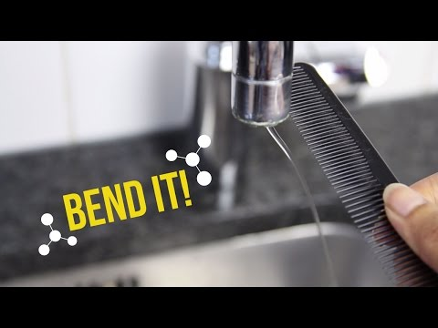
All you need for this experiment is a plastic comb, hair, and running water!
You can rub the comb with a wool sweater if you don’t want to use your hair.

Slide 10
Static Electricity… what is it!?
Static electricity is created when objects get an electrical charge. They get this charge when two objects are rubbed together. Rubbing causes tiny particles called electrons to move from one object to another. They object that loses electrons gets a positive charge, and the one that gains them gets a negative charge.
Objects with the same charge repel each other. Objects with opposite charges attract. How many electrons move--and how much charge each ojbect gets--depends on what the objects are.
In our experiment, by rubbing the comb against your hair or the sweater, you gave the comb a positive charge. This caused the water to be attracted to the charged item.

Slide 11
Step Three: Dive into density!
How come some things float, while others don’t? It’s all about density. Density is not weight, but it’s related. For example, if you swim in the pool with blow-up floaties or a raft, you won’t sink because the air inside the floaties is less dense than the water around you. SO the air helps hold you up!
We’ll do an experiment to find out more about density.
Follow along with the video on the next page!

Slide 12
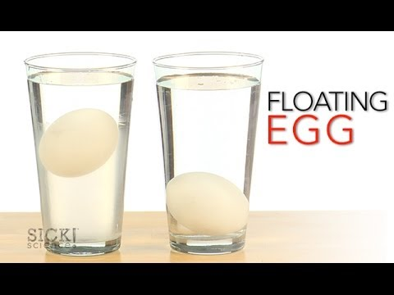
For this experiment you will need:
Two eggs
Water
Salt
Two tall glasses

Slide 13
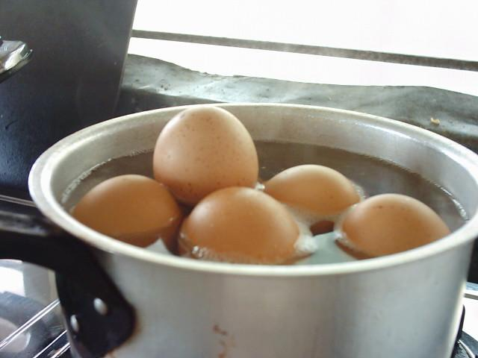
What do you think?
What happened to the egg?
Why do you think it happened.
Come up with your own best guess about why it happened. Remember what the explanation of density from a few slides back…
Check the next slide to see what happened!

Slide 14
What happened?
If you added the water slowly enough, you’ll notice that the egg floats in the middle, between the salt water and the fresh water.
This is because adding the salt makes the water more dense or increases the density. This means the salt water is more dense than the egg, but the egg is more dense than the fresh water!
If you ever swim in the ocean, you will notice that you float better in the ocean than a swimming pool or lake for the same reason. The salt makes the water more dense!

Slide 15
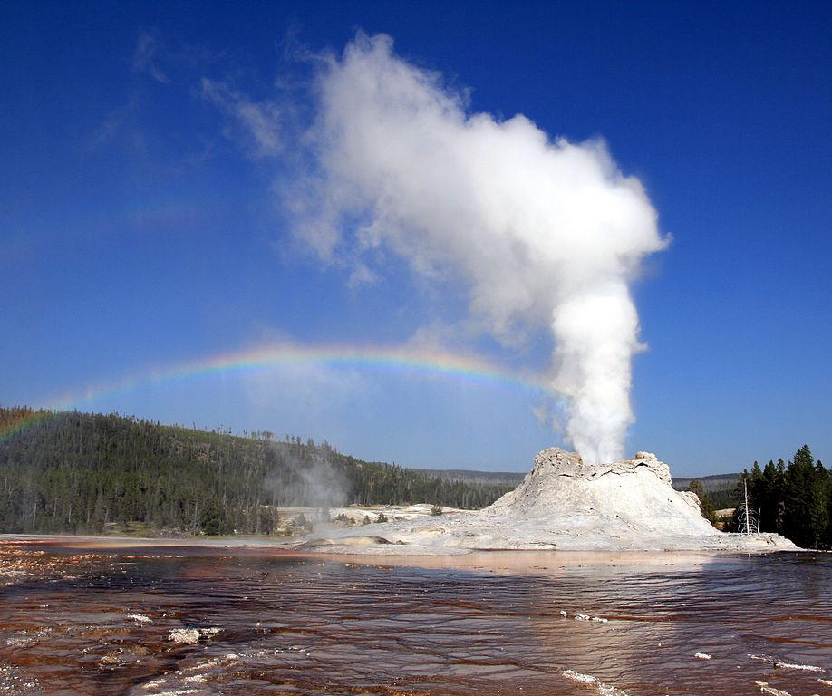
Step Four: Make something bubble up
IMPORTANT: When you do this experiment, make sure you are wearing glasses or safety goggles to protect your eyes.
When mixed with a gas called carbon dioxide, some household items can have a fun reaction.
You’ll want to do this experiment outside on a nice day.
We’re going to make a soda geyser!

Slide 16
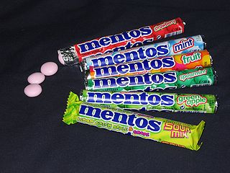
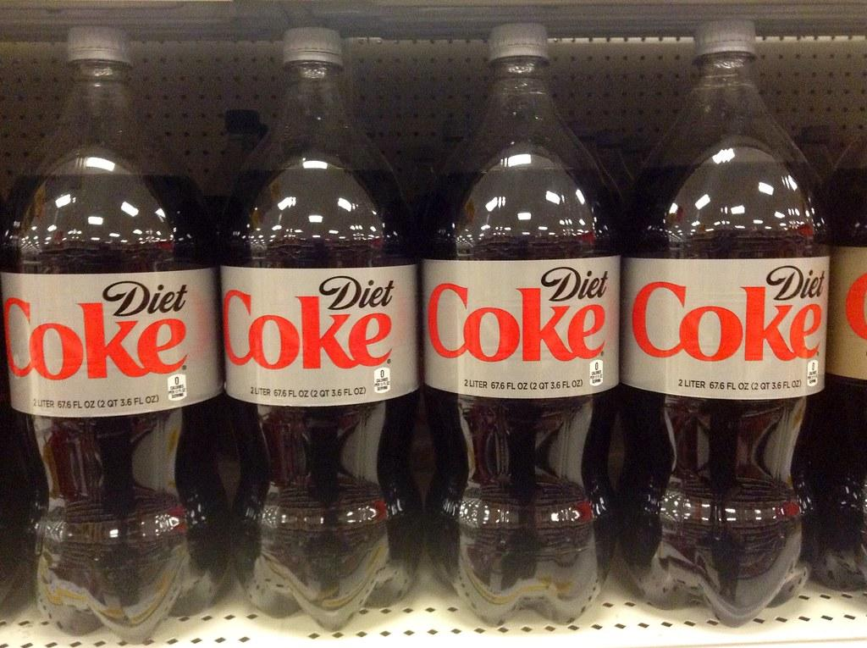
Getting started
A geyser is a hole in the earth that sprays out hot water and steam. So making your own is definitely an outside experiment!
You’ll need:
2 liter bottle of Diet Coke
Roll of Mentos candy (mint works best)
Long piece of scotch tape

Slide 17
Instructions
First, take the top off the soda bottle and set the bottle on the ground somewhere outside with nothing else around.
Then, open the package of Mentos candy, and stick them along a piece of tape so you can drop them all into the soda at once.
When you are ready to make the drop be ready to run and stand back!
A soda geyser will erupt because of the carbon dioxide gas created by the rapid reaction between the candy and soda.
If you don’t have access to these materials, you can just watch the video on the next page and do it in person some other time!

Slide 18
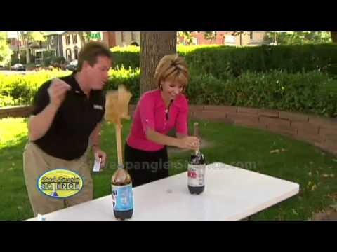

Slide 19
Step Five: Play with science
Follow this recipe for homemade silly putty, or find another recipe for slime online with a parent to try out!
You’ll need:
Food coloring
¾ cup glue
¼ cup liquid starch or borax
Mixing Bowl
Water

Slide 20
Instructions
Instructions:
In the bowl, mix 8 drops of food coloring, the glue, and 1 cup water.
Mix the borax with 1 ⅓ cups water. Slowly add the liquid starch or borax mixture to the colored glue and water mixture.
Knead the mixture until you can stretch it but it isn’t too mushy.
Store in a plastic bag or covered container so it doesn’t dry out!

Slide 21


