Slide 1
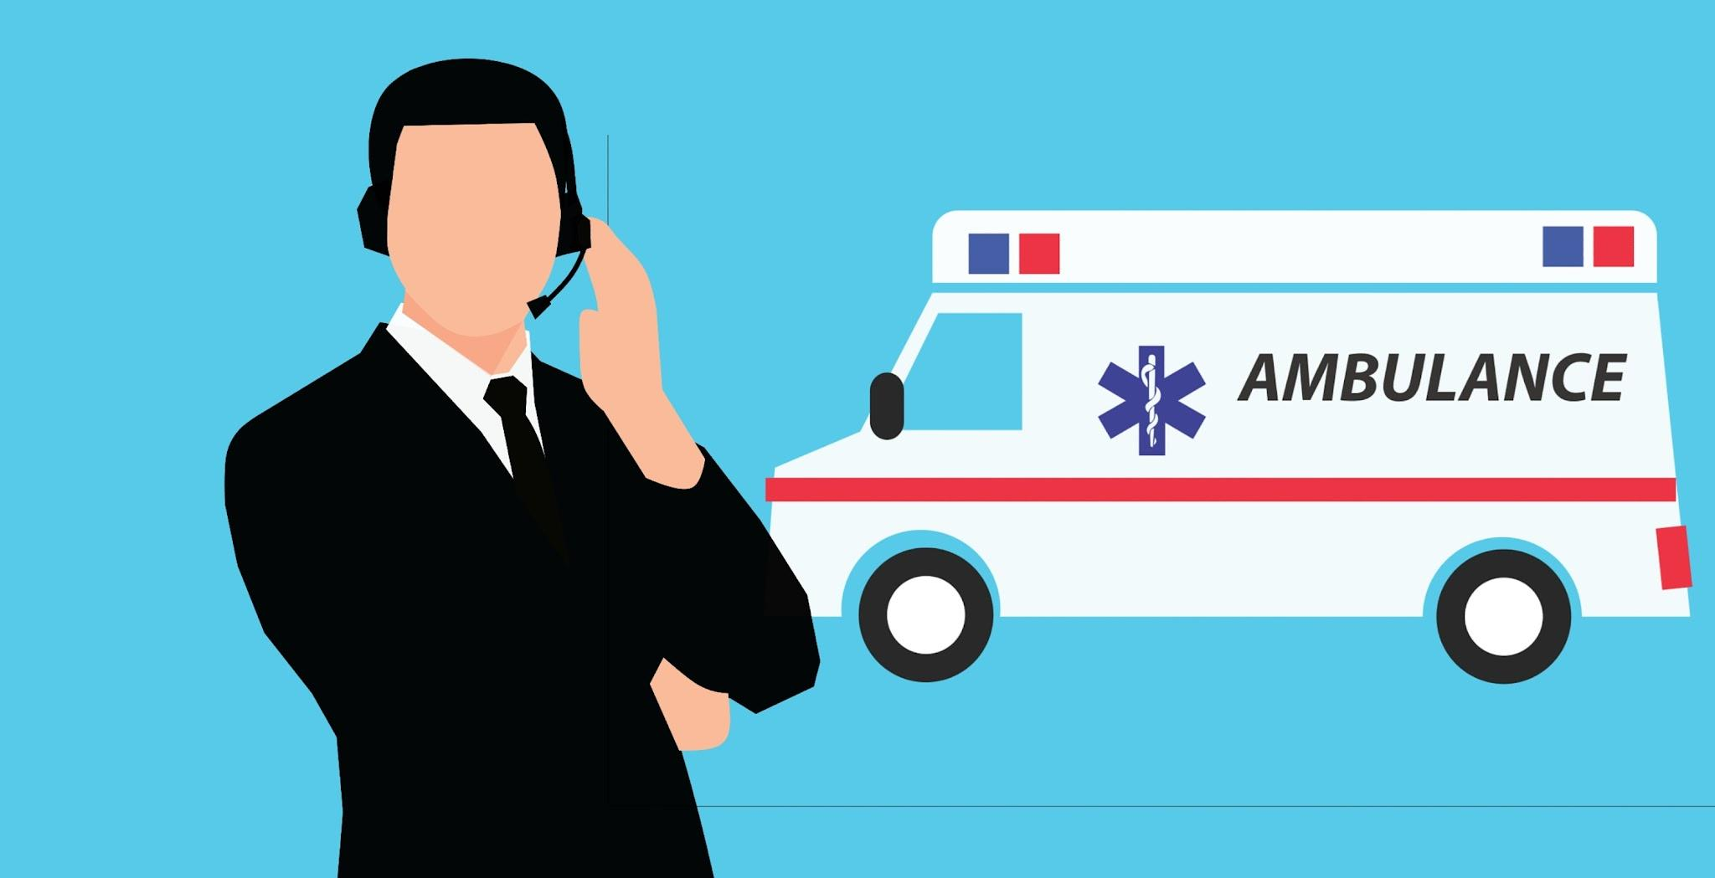
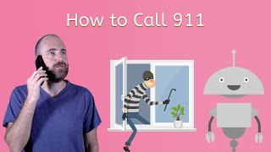
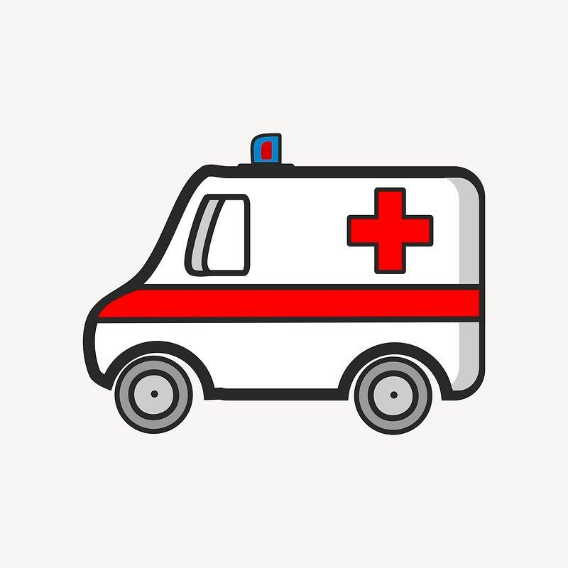
What is 911?
911 is an emergency number that anyone can call to reach police, fire or an ambulance.
Calling 911 signifies that the emergency requires help immediately.
NEVER call 911 as a joke - you might prevent other people from getting help.

Slide 2
When to call 911 - yes or no?
Your friend fell off her bike and scraped her knee?
You were in a car accident and your Mom is not feeling well and is acting different?
Your neighbor's house is on fire?
Your sister fell down the stairs and hurt her arm?
Someone at the mall is having a seizure?
Your brother is being mean to you?
You lost your favorite stuffed animal?
** Remember: It is very important to stay calm and speak clearly so help can be sent as quickly as possible **

Slide 3
Calling for Help - 911
Stay calm
Speak clearly
Name - Phone number - Address of emergency
What happened and what’s wrong. They may ask if
anyone has any allergies or health conditions. If you
know the answer, tell them. If not, that is okay.
How many people are hurt and how old they are
Stay on the phone unless the dispatcher tells you to hang up
Notes:
How to access:
iPhone - press side button 5x
select emergency on lock screen
Android - press power button 3x

Slide 4
Making a First Aid Kit
Always be prepared!
Grab a bag!
Gather your supplies!
You can speak to your parent to see if you are able to other items that may be useful ….

Slide 5
How to Treat a Minor Cut
Most small cuts aren’t dangerous. But always note where the cut is located, how large is it, etc:
If you are asked to help with a small wound - wear gloves
Rinse the wound thoroughly with water to clean out dirt.
(If needed use an antiseptic solution to prevent infection)
Cover the wound with a sterile adhesive bandage or sterile gauze and adhesive tape.

Slide 6
Fun Fact: Why Do We Wear Bandages?
Adhesive bandages (like band-aids) can help heal wounds that are not deep enough to need stitches. Putting a bandage over a minor cut helps keep out germs. The bandage also keeps a scab from forming. Scabs can break open and let in germs! Band-aids do the work of a scab, but they don’t break open!
Band-aids are often used along with antiseptic. An antiseptic is a spray or cream that kills germs and keeps them from spreading.

