Slide 1
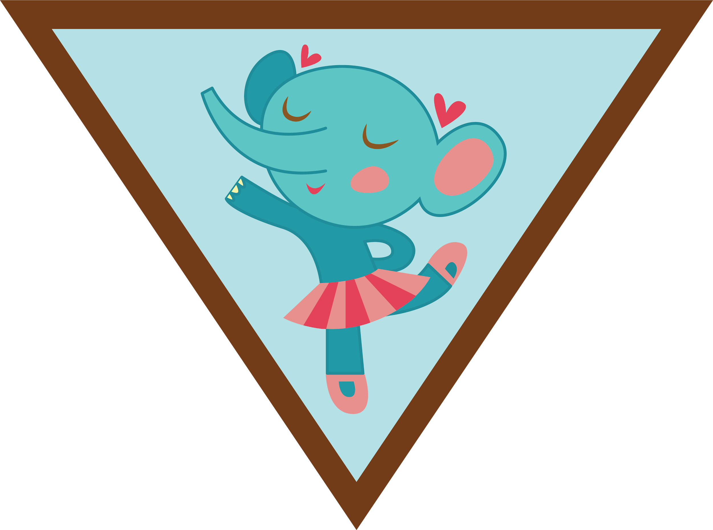

Leader Instructions & Meeting Prep:
Brownie Dancer Badge
Brownie Dancer Badge: :meeting plan supply list::
No actual supplies—have the girls wear clothes they can dance in, and have room to dance!
The following slides will walk your troop through a virtual meeting to earn the Brownie Dancer Badge. When you share your screen during your meeting, be sure to click “Present” so girls see the full screen. Also, when you are sharing your screen in zoom, google meet, or another meeting app, please make sure you are sharing both picture and audio. For more information on using Zoom, visit gsnw.gl/VirtualMeetingHowTo
Many of the interactive activities included are shared through YouTube videos. Just click on the arrow in the center of the image to play the video, and the girls can see it too! You should try to review the slides before your meeting if possible, so you are familiar with the activities and any supplies needed.
This meeting will typically take approximately 60-90 minutes as written, depending on participation level and number of girls. As always, Girl Scouting is flexible, and troops may select the activities interest them most, add their own activities, or have girls do some of the steps afterward as “homework”.
When you send out your meeting invitation, be sure to let girls and parents know what supplies they should have on hand for the online troop meeting. They are things most girls likely have at home.

Slide 2
Brownie Dancer Badge

Slide 3
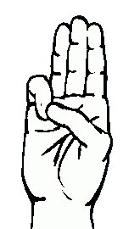
Let’s start with the Girl Scout Promise
On my honor, I will try: To serve God and my country, To help people at all times, and to live by the Girl Scout Law.

Slide 4


Let’s say the Pledge

Slide 5
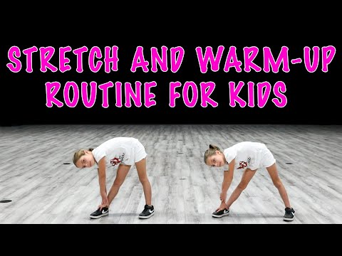

Step 1: Warm up and get moving!
Did you know that Dancers always stretch and warm up? Let’s try a warm up routine!

Slide 6
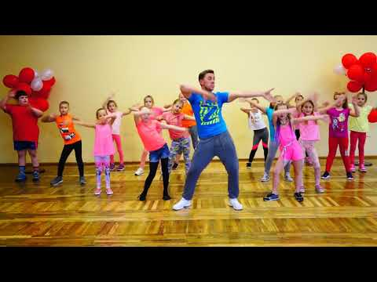
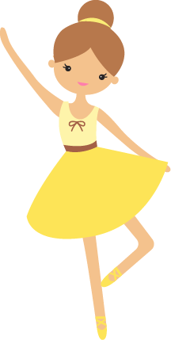

Step 2: Try a new dance!
Many people dance as a form of exercise. Zumba is a form of dance that is great exercise! Can you follow the moves in this Zumba routine?

Slide 7

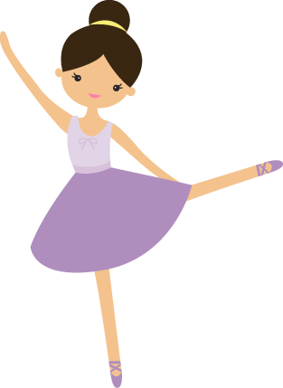
Step 3: Take to the floor like a dancer!
Can you learn these dance moves?

Slide 8

Step 3:
Create your own dance!
to dance
Let’s take turns making up our own dance steps, and teaching them to the group! Try to base your dance move on your favorite animal! Can the group guess your animal from your movements? (*You can play this video for music, or choose your own song! Stop video whenever everyone has had their turns.)

Slide 9
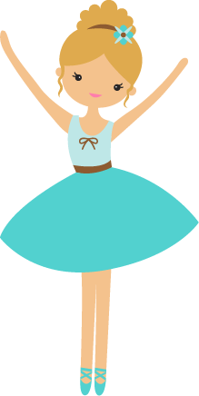
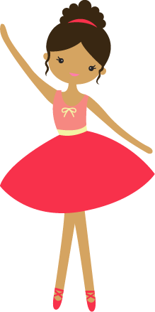
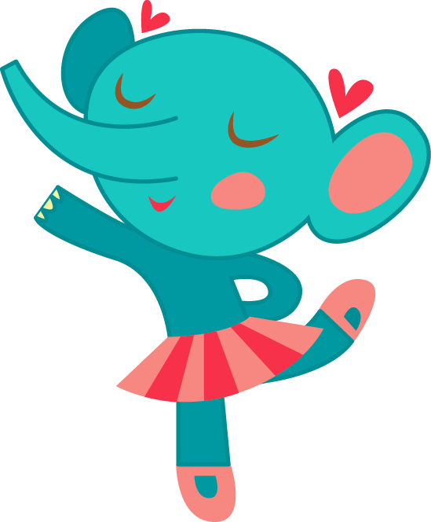
Show your moves!
For your final step toward earning the Dancer Badge-- put your new dancing skills to work by throwing a dance party at home! Put on some favorite music, and get your family members moving!

Slide 10
WOW!
You have earned the
Dancer Badge!

