Slide 1
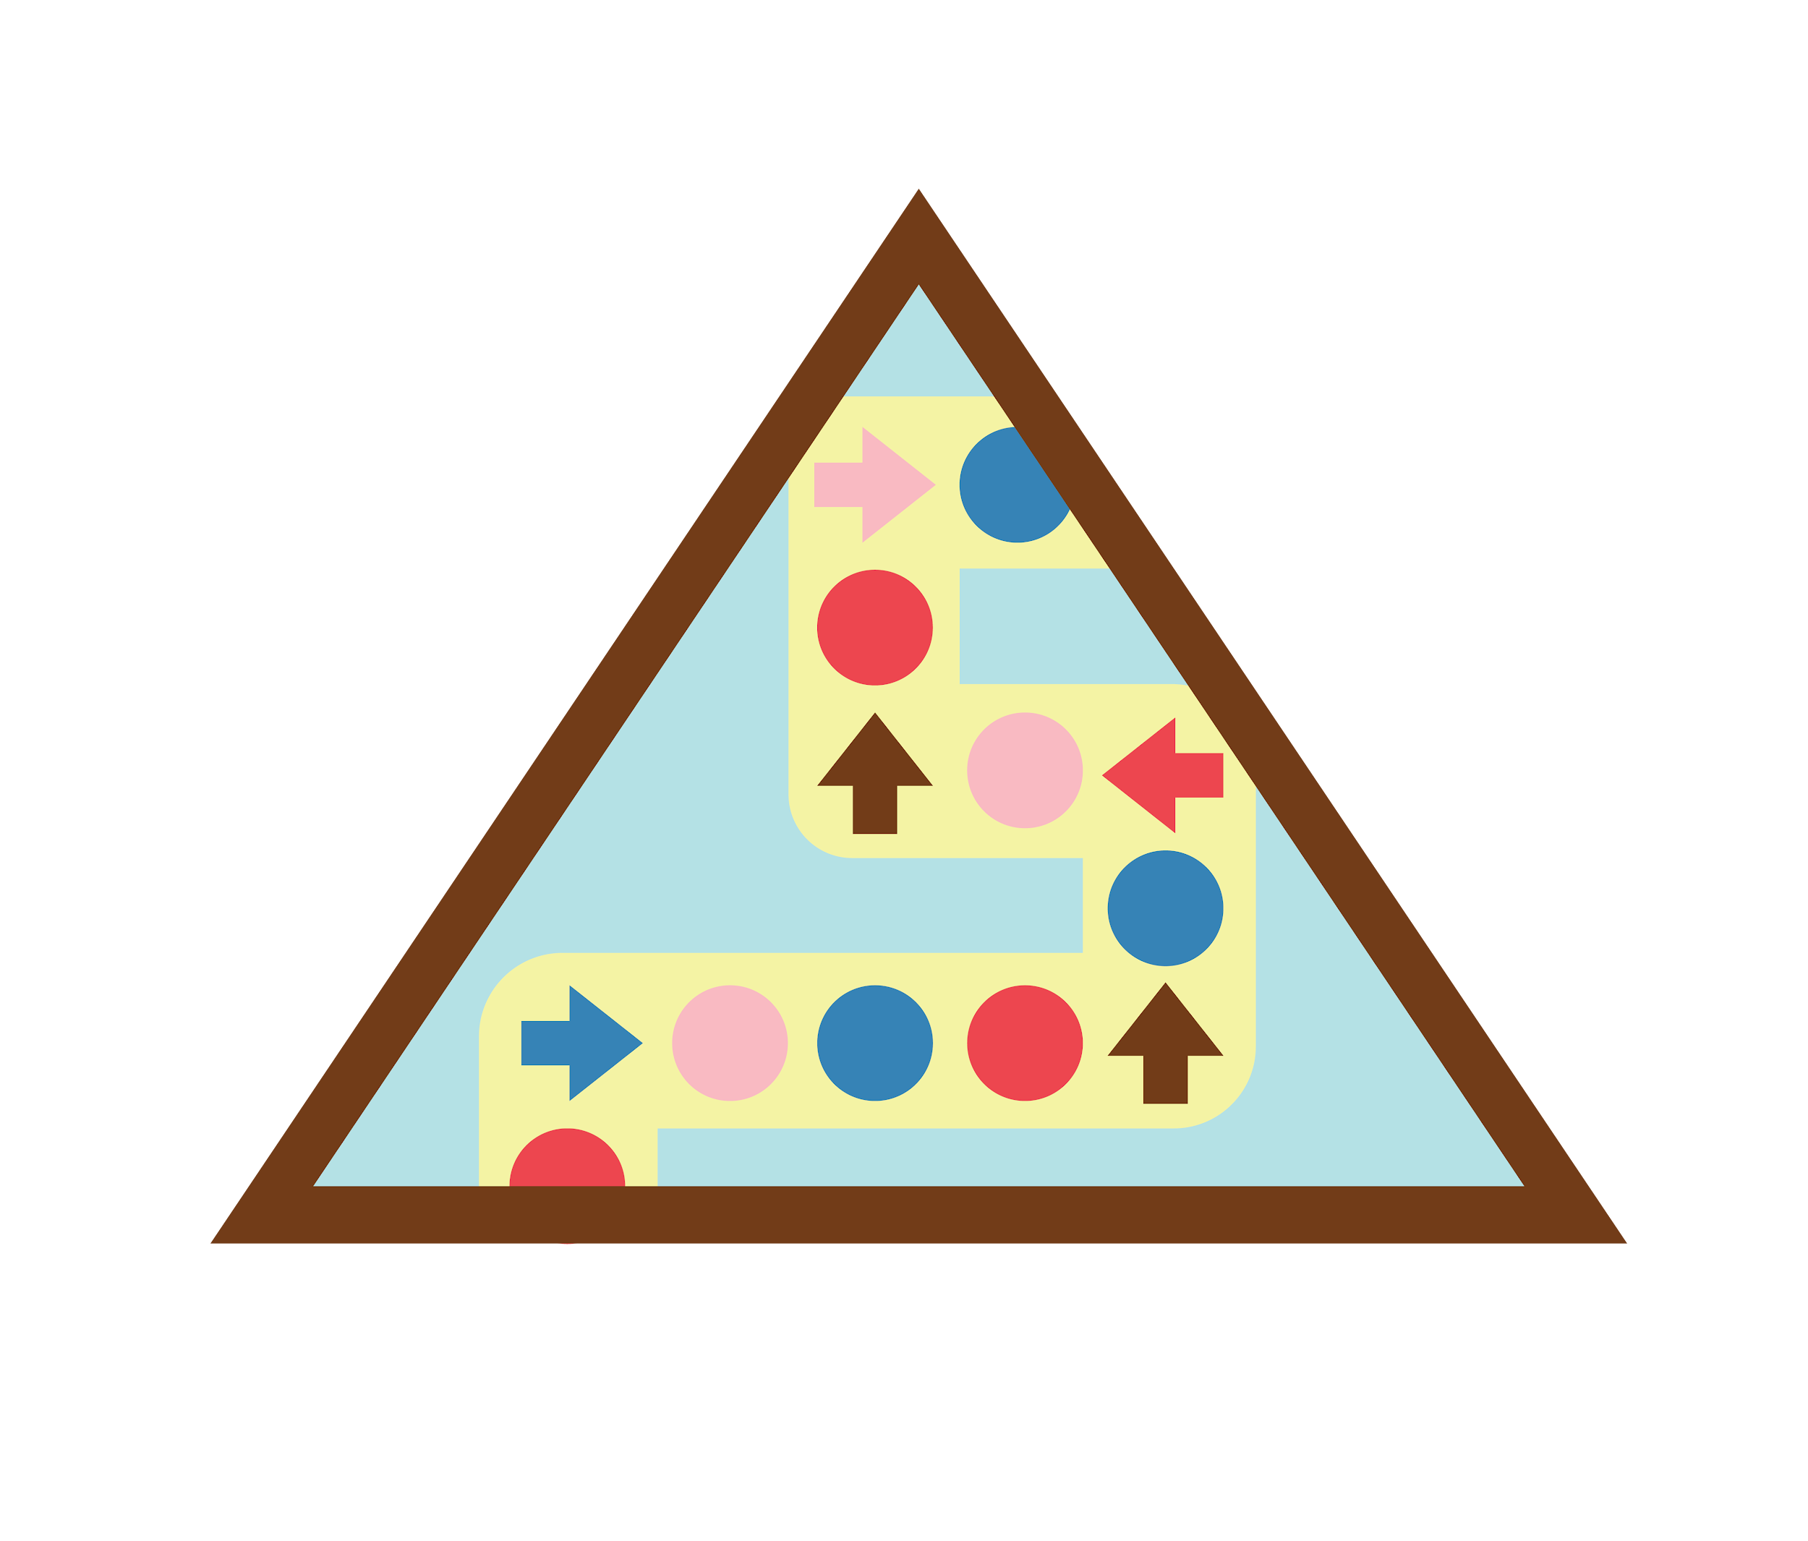

Leader Instructions & Meeting Prep:
Brownie Coding For Good: Coding Basics Badge
The following slides will walk your troop through a virtual meeting to earn the Brownie Coding For Good: Coding Basics Badge. When you share your screen during your meeting, be sure to click “Present” so girls see the full screen. Also, when you are sharing your screen in zoom, google meet, or another meeting app, please make sure you are sharing both picture and audio. For more information on using Zoom, visit gsnw.gl/VirtualMeetingHowTo
Many of the interactive activities included are shared through YouTube videos. Just click on the arrow in the center of the image to play the video, and the girls can see it too! You should try to review the slides before your meeting if possible, so you are familiar with the activities and any supplies needed.
This meeting will typically take approximately 60-90 minutes as written, depending on participation level and number of girls. As always, Girl Scouting is flexible, and troops may select the activities interest them most, add their own activities, or have girls do some of the steps afterward as “homework”.
When you send out your meeting invitation, be sure to let girls and parents know what supplies they should have on hand for the online troop meeting. They are things most girls likely have at home.

Slide 2

Brownies
Coding for Good:
Coding Basics
Brought to you by Girl Scouts of the Northwestern Great Lakes

Slide 3

Girl Scout Promise
On my honor, I will try, To serve God and my Country. To help people at all times, And to live by the Girl Scout Law.

Slide 4


Let’s say the pledge

Slide 5
Girl Scout Law
I will do my best to be honest and fair, friendly and helpful, considerate and caring, courageous and strong, and responsible for what I say and do, and to respect myself and others, respect authority, use resources wisely, make the world a better place, and be a sister to every Girl Scout.

Slide 6
Badge Details:
Find out how programmers write programs that make computers work and how people can use computers to help others.
Steps
Create algorithms for a computer that follow a sequence
Use loops to improve your algorithm
Use events to make things happen
Learn about women in computer science
Create your own set of commands that use events

Slide 7
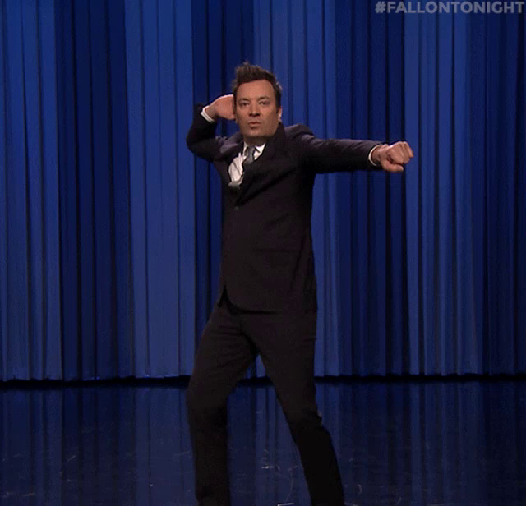
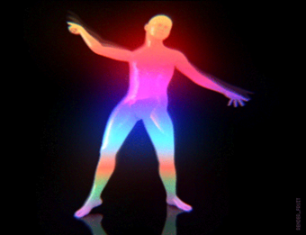
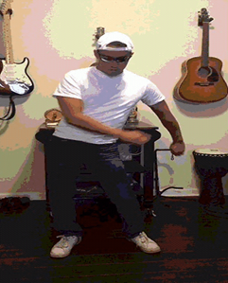

In this badge, we’re going learn how computers follow sets of instructions just like dancers follow steps from a choreographer.
Which of these is your favorite dance move?.

Slide 8

Computers are pretty smart,
BUT they can only do what their algorithm, written in code by a programmer, tells them to do.
Programmer: person who can write in code
Code: language that computers speak
Algorithm: a set of instructions, like a recipe (or a super-secret recipe!)

Slide 9

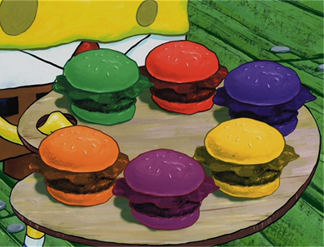
Let’s make a
Krabby Patty:
SpongeBob SquarePants makes amazing Krabby Patties using a super-secret algorithm (recipe). Shh! Don’t tell Plankton what it is!
First, draw your Krabby Patty! Then, we’ll write the algorithm (recipe)
While you draw, think about the ingredients you are using and the steps to build the Krabby Patty. You will need that information to write your algorithm.

Slide 10
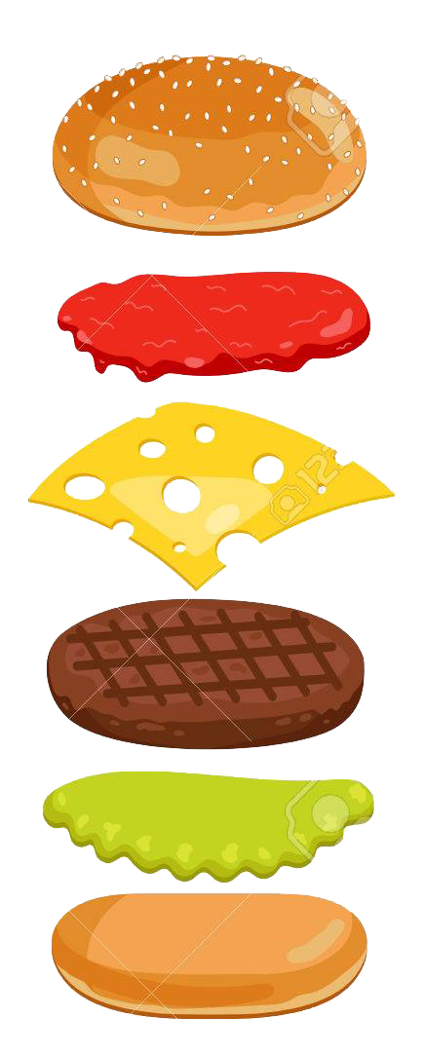
Did it work?
Did you have any issues?
If there was an error or a bug in your code, you have to find and fix it or debug!
If you get stuck, you can always talk it out with others! Sometimes it takes many tries to get something right. Computer scientists persevere or keep trying until they get it right!

Slide 11
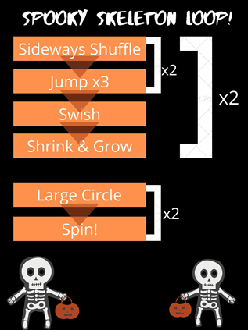
Let’s learn about Loops!
Loops are repeated instructions
For example:
The skeletons repeat the first two moves, rather than saying it twice, we add the bracket with “x2”
The skeletons jump 3 times, rather than saying “jump jump jump” you can loop the move by saying “jump x3”
Loops are used to make things easier to understand!

Slide 12
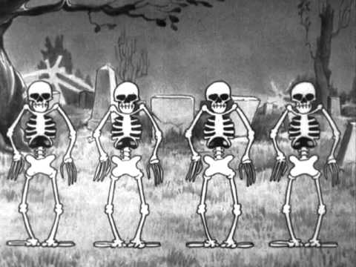
The Skeleton Dance
Can you see the repetition in their dance?

Slide 13
Let’s create our own dance with Loops!
Supplies:
Paper and something to write with
Let’s use what learned to create our own dance with loops! Take a look at the example for ideas. When you’re done, let’s learn some of our dance loops!
Step to the left x4.
Step to the right x4.
Do the wave.
Clap.
Turn Around.
Touch the Ground.
FREEZE!.
Turn to the Right.
x2
x4

Slide 14

The Macarena
This dance also has loops
Let’s take a minute to learn it!

Slide 15
Let’s play a game
In the next couple of slides, I’m going to show you a couple of situations and you are going to have two actions to pick between!
Your job is to pick which action makes the most sense to do!

Slide 16
What should you do when...
You have cookies in the oven and the timer goes off?
Take the
cookies out.
Dance around to the sound of the timer.

Slide 17
What should you do when...
You have cookies in the oven and the timer goes off?
Take the
cookies out.
Dance around to the sound of the timer.

Slide 18
What should you do when...
The coach tells you to go?
Spin around in circles.
Run REALLY fast.

Slide 19
What should you do when...
The coach tells you to go?
Spin around in circles.
Run REALLY fast.

Slide 20
What should you do when...
The recess bell rings?
Run away.
Return to the school.

Slide 21
What should you do when...
The recess bell rings?
Run away.
Return to the school.

Slide 22
What happens when an event causes an action?
These last two questions show that an event may cause an action to happen, this also happens with coding.
  Event example: clicking “play” on a video
Now, we are going to play a game like “Red light, green light,” but instead of saying “red light, yellow light, or green light” we’re going to use a different set of commands and it’ll be girl led!
On the next slide, there is a command list, which is a list of events and the action the event causes

Slide 23
Let’s Play!

Slide 24




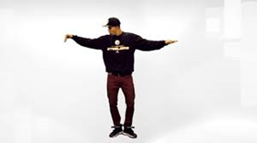

Raised Hand
Girls Rock
Clap
Jump
Arm Wave
Spin

Slide 25
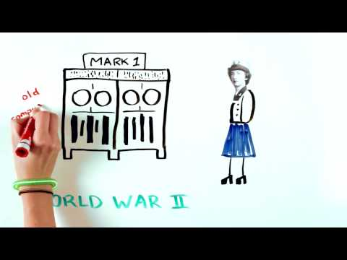
Grace Hopper
An AMAZING Computer Scientist

Slide 26
Congrats,
You have earned your badge!
Now that you’ve earned this badge, you can give service by:
Sharing what you have learned about women in computer science to inspire other girls to code.
Doing a show-and-tell on how to create an algorithm for an everyday task.
Encouraging others to persevere when projects are difficult

