Slide 1
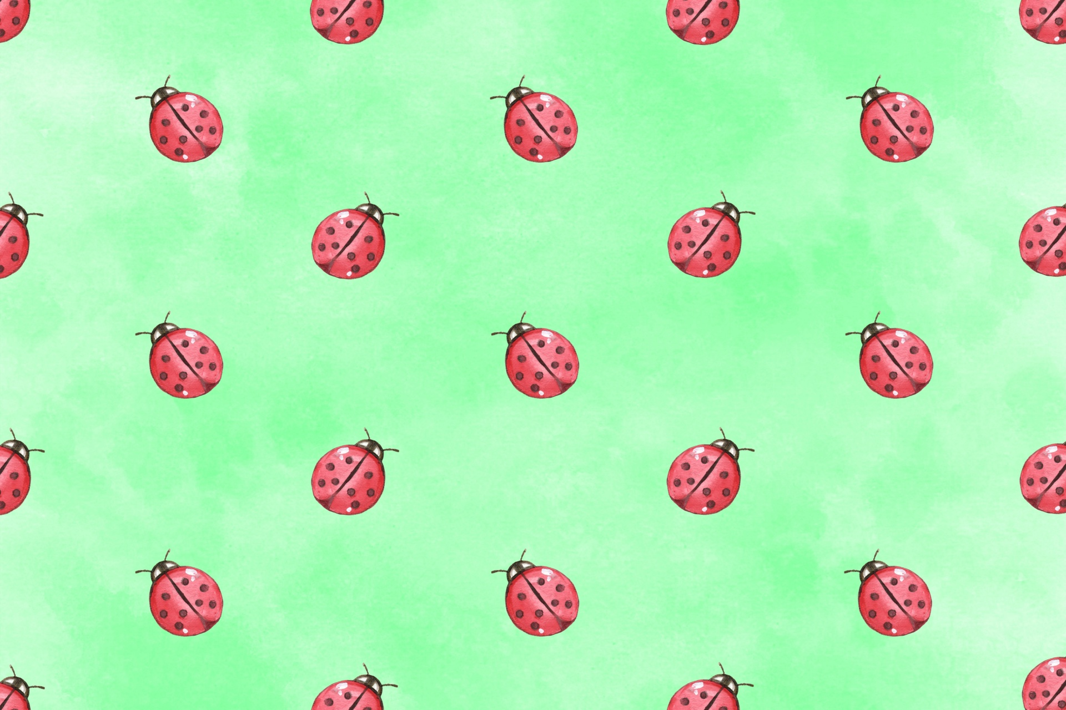
Brownie Bugs Badge

Slide 2
Step #1: Draw a Bug Poster
Visit this link to National Geographic Kids and learn about some of the insect featured.
https://kids.nationalgeographic.com/animals/invertebrates/insects/

Slide 3
Pick the insect that you thought was most interesting and make a poster. On this poster draw a picture of the insect along with this information:
· Insect name
· How big they get
· What do they eat
· Where do they live
· How they protect themselves from predators (animals that want to eat them)
· A fun fact about them

Slide 4
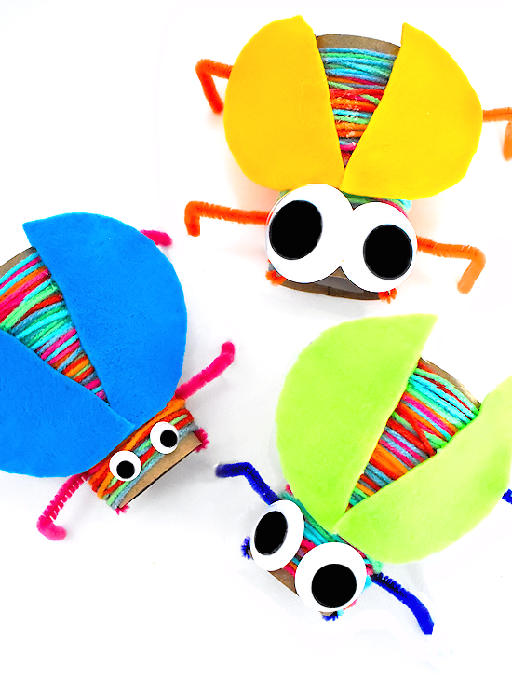
Step #2: Try a Bug Craft
Cardboard Roll Yarn Wrapped Bug
Supplies:
Toilet paper or paper towel cardboard roll
Yarn
Pipe cleaners
Felt, foam, or construction paper
Wiggle eyes
Hole punch
Clear tape
Scissors
Hot glue

Slide 5
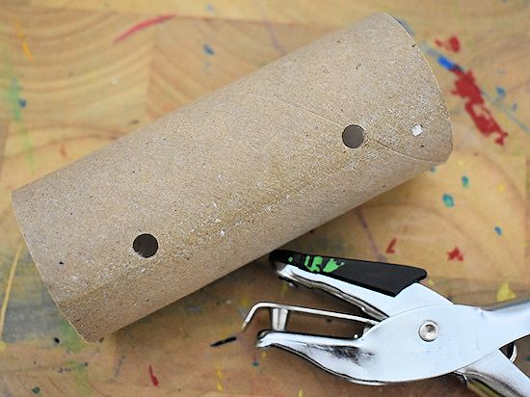
Take your cardboard roll and use the hole punch to make four holes for legs.

Slide 6
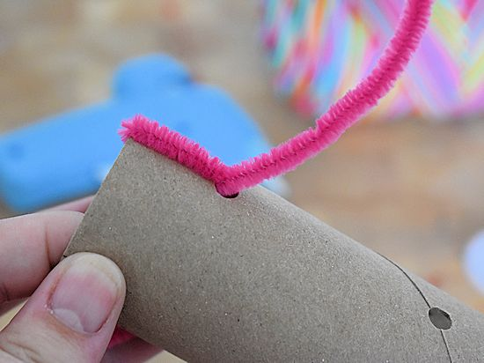
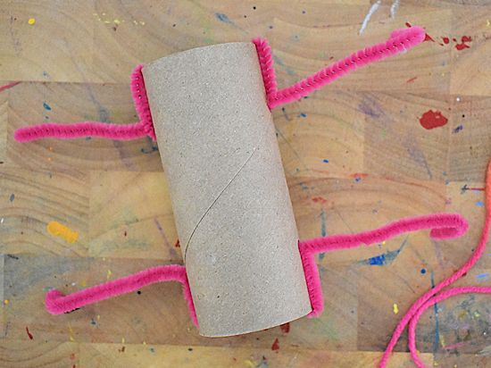
Take a pipe cleaner and slide through one hole and the hole directly on the other side of it for the bug’s legs. Wrap an end of the pipe cleaner around the end of the cardboard roll and back through the hole to secure. Do the same for the other legs.

Slide 7
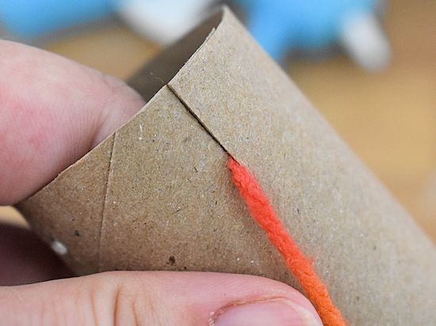
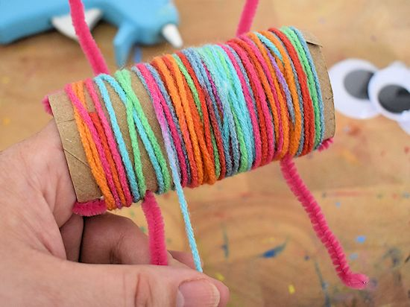
Cut a small slit at the end of the roll. Insert one end of the yarn into the slit and start wrapping around the cardboard roll until completely covered.

Slide 8
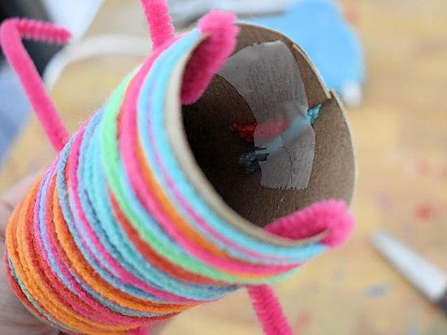
Once covered, finish wrapping near the slit. Cut yarn and insert that end into the slit as well. Tape yarn down on inside.

Slide 9
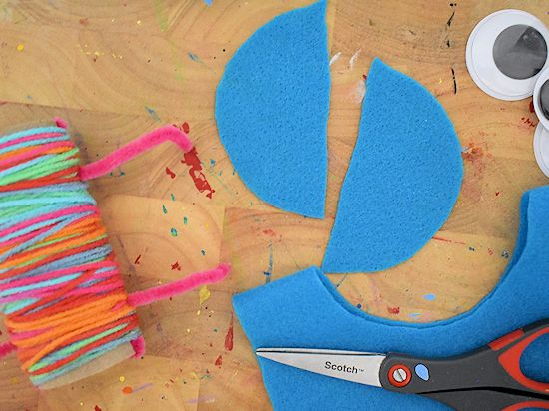
Cut a circle from the felt (foam or construction paper work too) for the wings. Cut the circle in half.

Slide 10
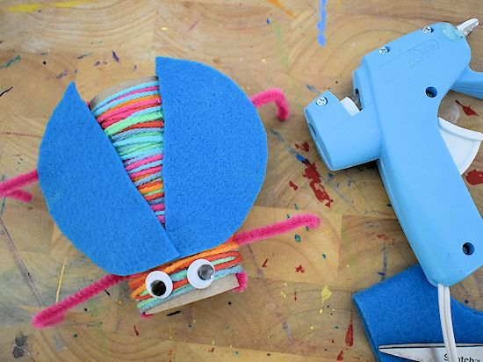
Glue the wings in place along the top part of the yarn. Then glue the eyes in place.
Congrats! You just made a bug!

Slide 11
Step #3: See Bugs in Action
Go outside and see if you can find any bugs. Good places to look are under logs, pots, bricks, or anything that can easily be lifted. Have a basement with lots of spider webs? Take a look and see if you can spot any spiders in action. You can also go along buildings and scoop away leaf litter.

Slide 12
If you find bugs watch them for a while and see what they are doing. Take some notes with the following information:
What type of bug you think it is.
What they are doing.
Why they are doing it.
Since it is still early Spring you may not be able to find bugs outside. If you are not able to find live bugs check out some of these videos and take notes.

Slide 13
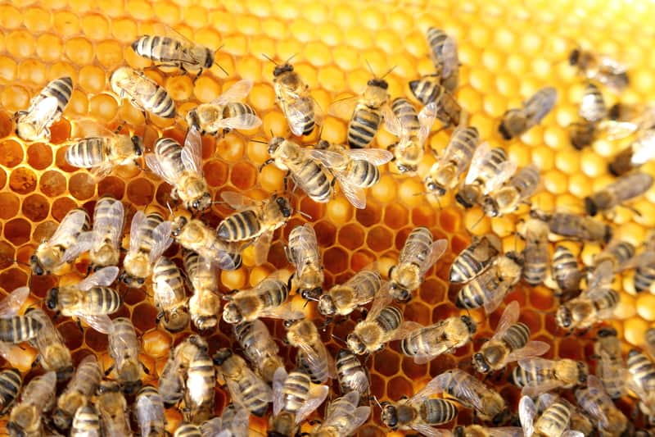
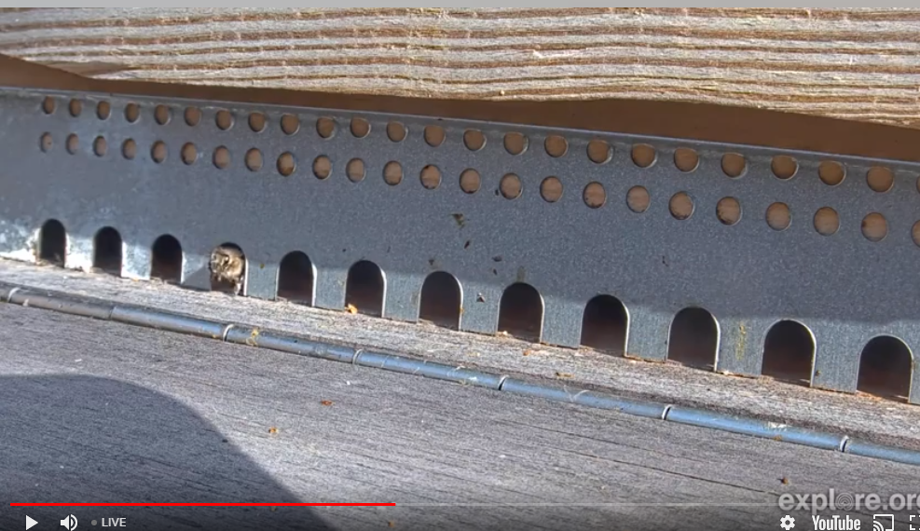
Honey Bee Hive Live Cam from Germany
Honey Bee Landing Zone Live Cam from Germany

Slide 14
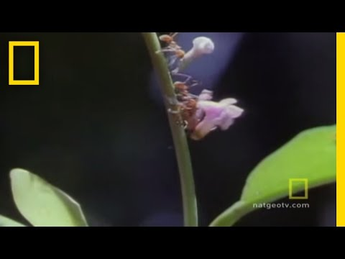
Leafcutter Ants

Slide 15
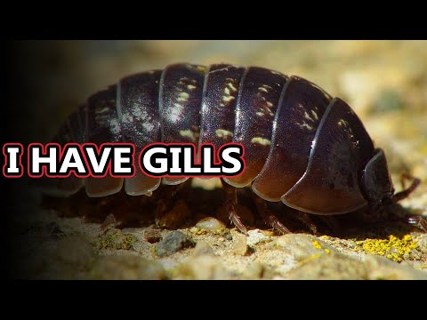
Roly Poly

Slide 16
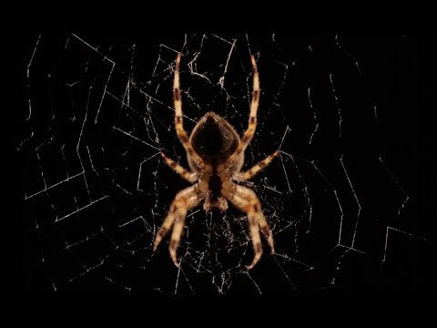
Orb Spider

Slide 17
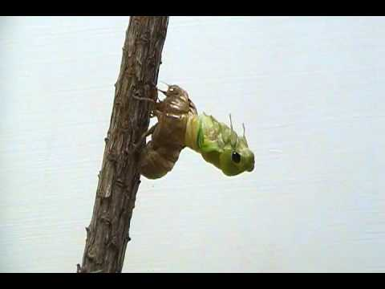
Cicada

Slide 18
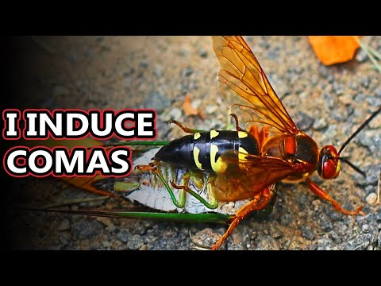
Cicada Killer Wasp

Slide 19
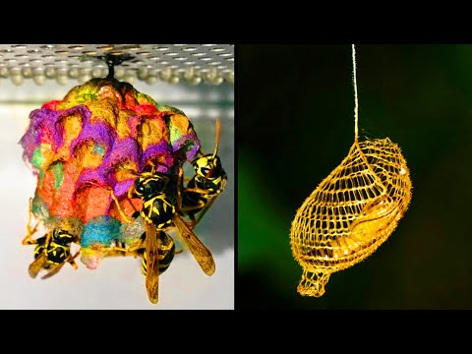
Step # 4: Explore Bug Homes
Bugs build all kind of amazing homes. Check out this video that shows just a few of them.

Slide 20
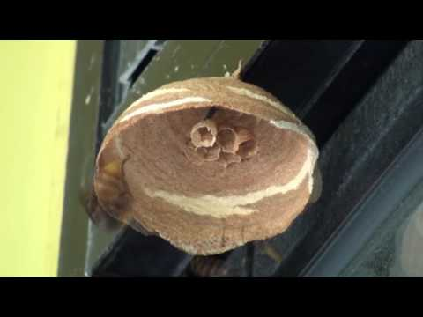
Check out this hornets nest being built!

Slide 21
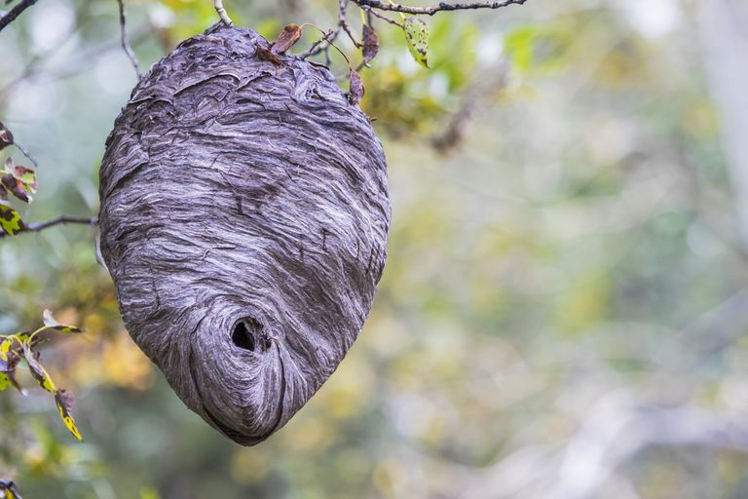
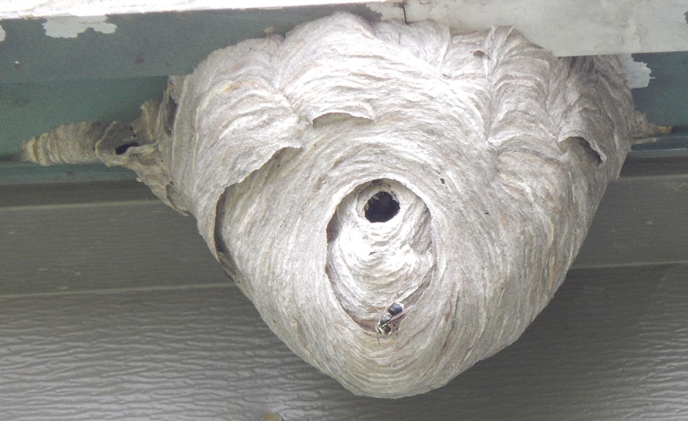
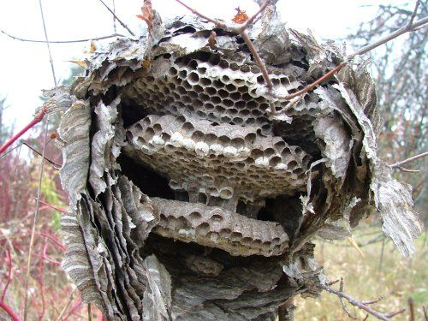
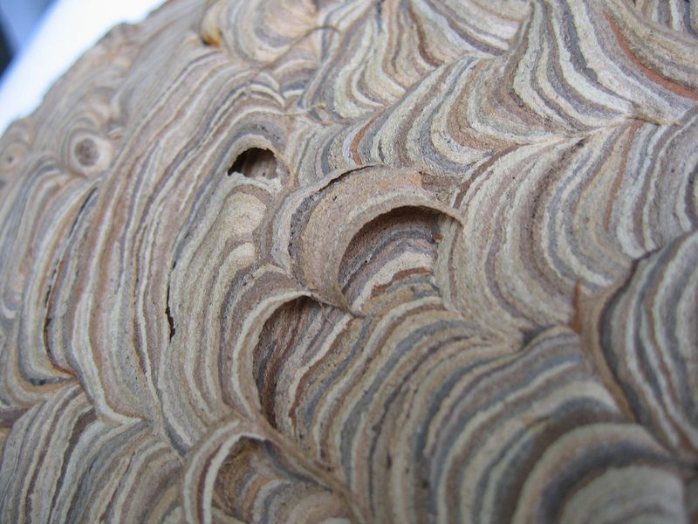
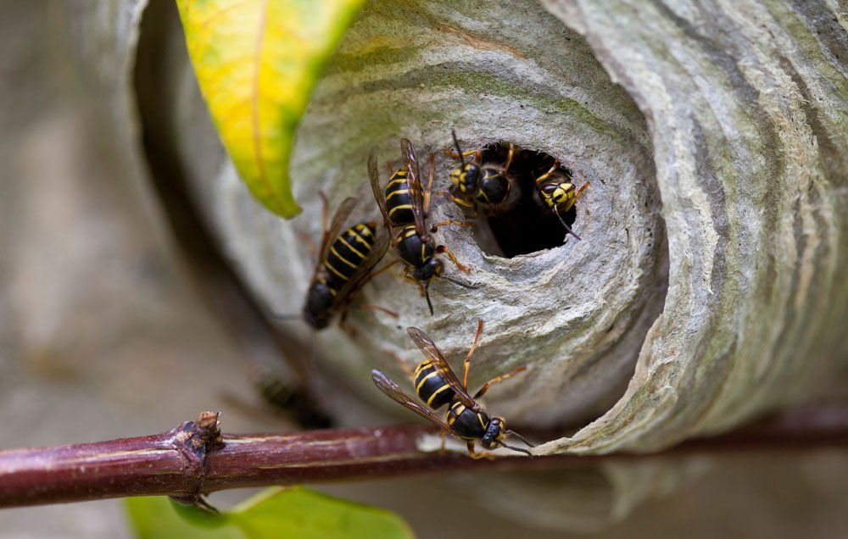
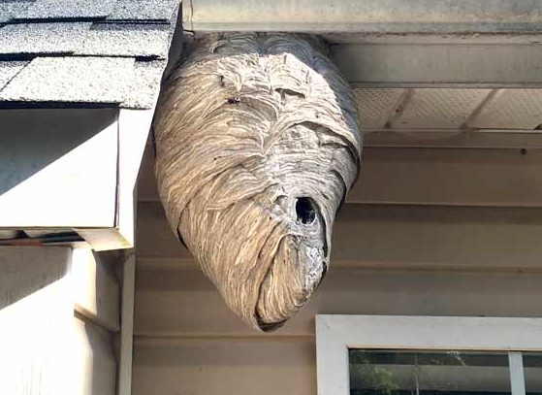
Check out these hornet nests!

Slide 22
Build a Hornet nest
Hornets build their nest by collecting materials like bark, leaves, and twigs. They then chew it up and mix it with their saliva. This creates a sticky material that they use to create the outer shell of the nest. Now lets build a model of a hornet nest.

Slide 23
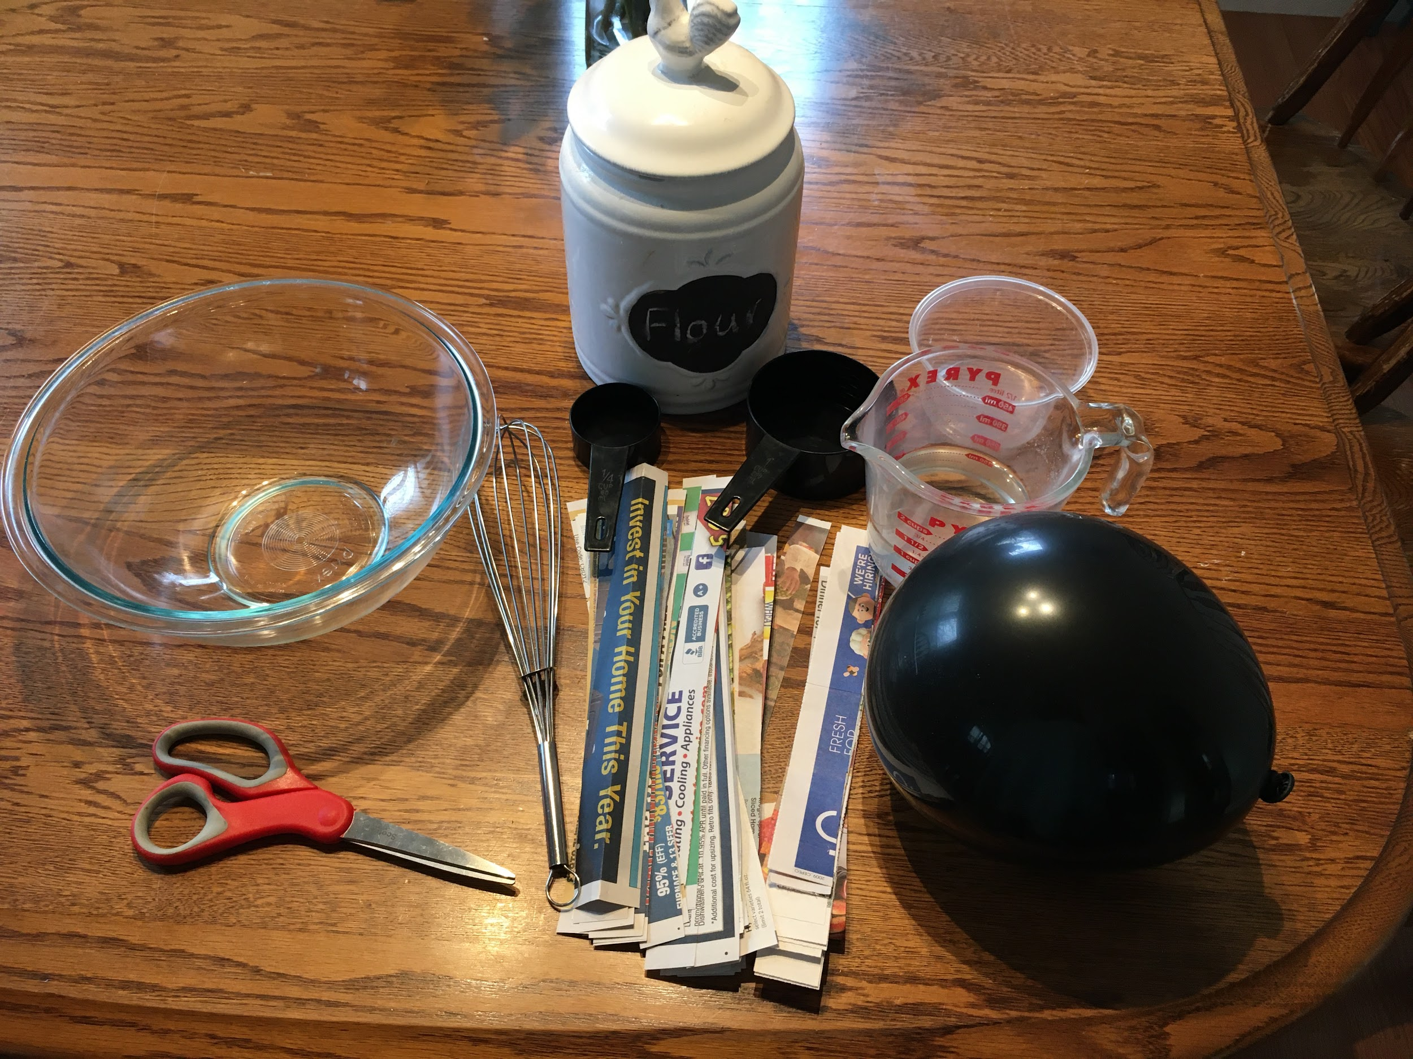
What You Need
1 Cup flour
1 ¼ Cup water
Large bowl
Whisk
Wax paper
Newspaper cut into 1 inch strips
Balloon
Small bowl

Slide 24
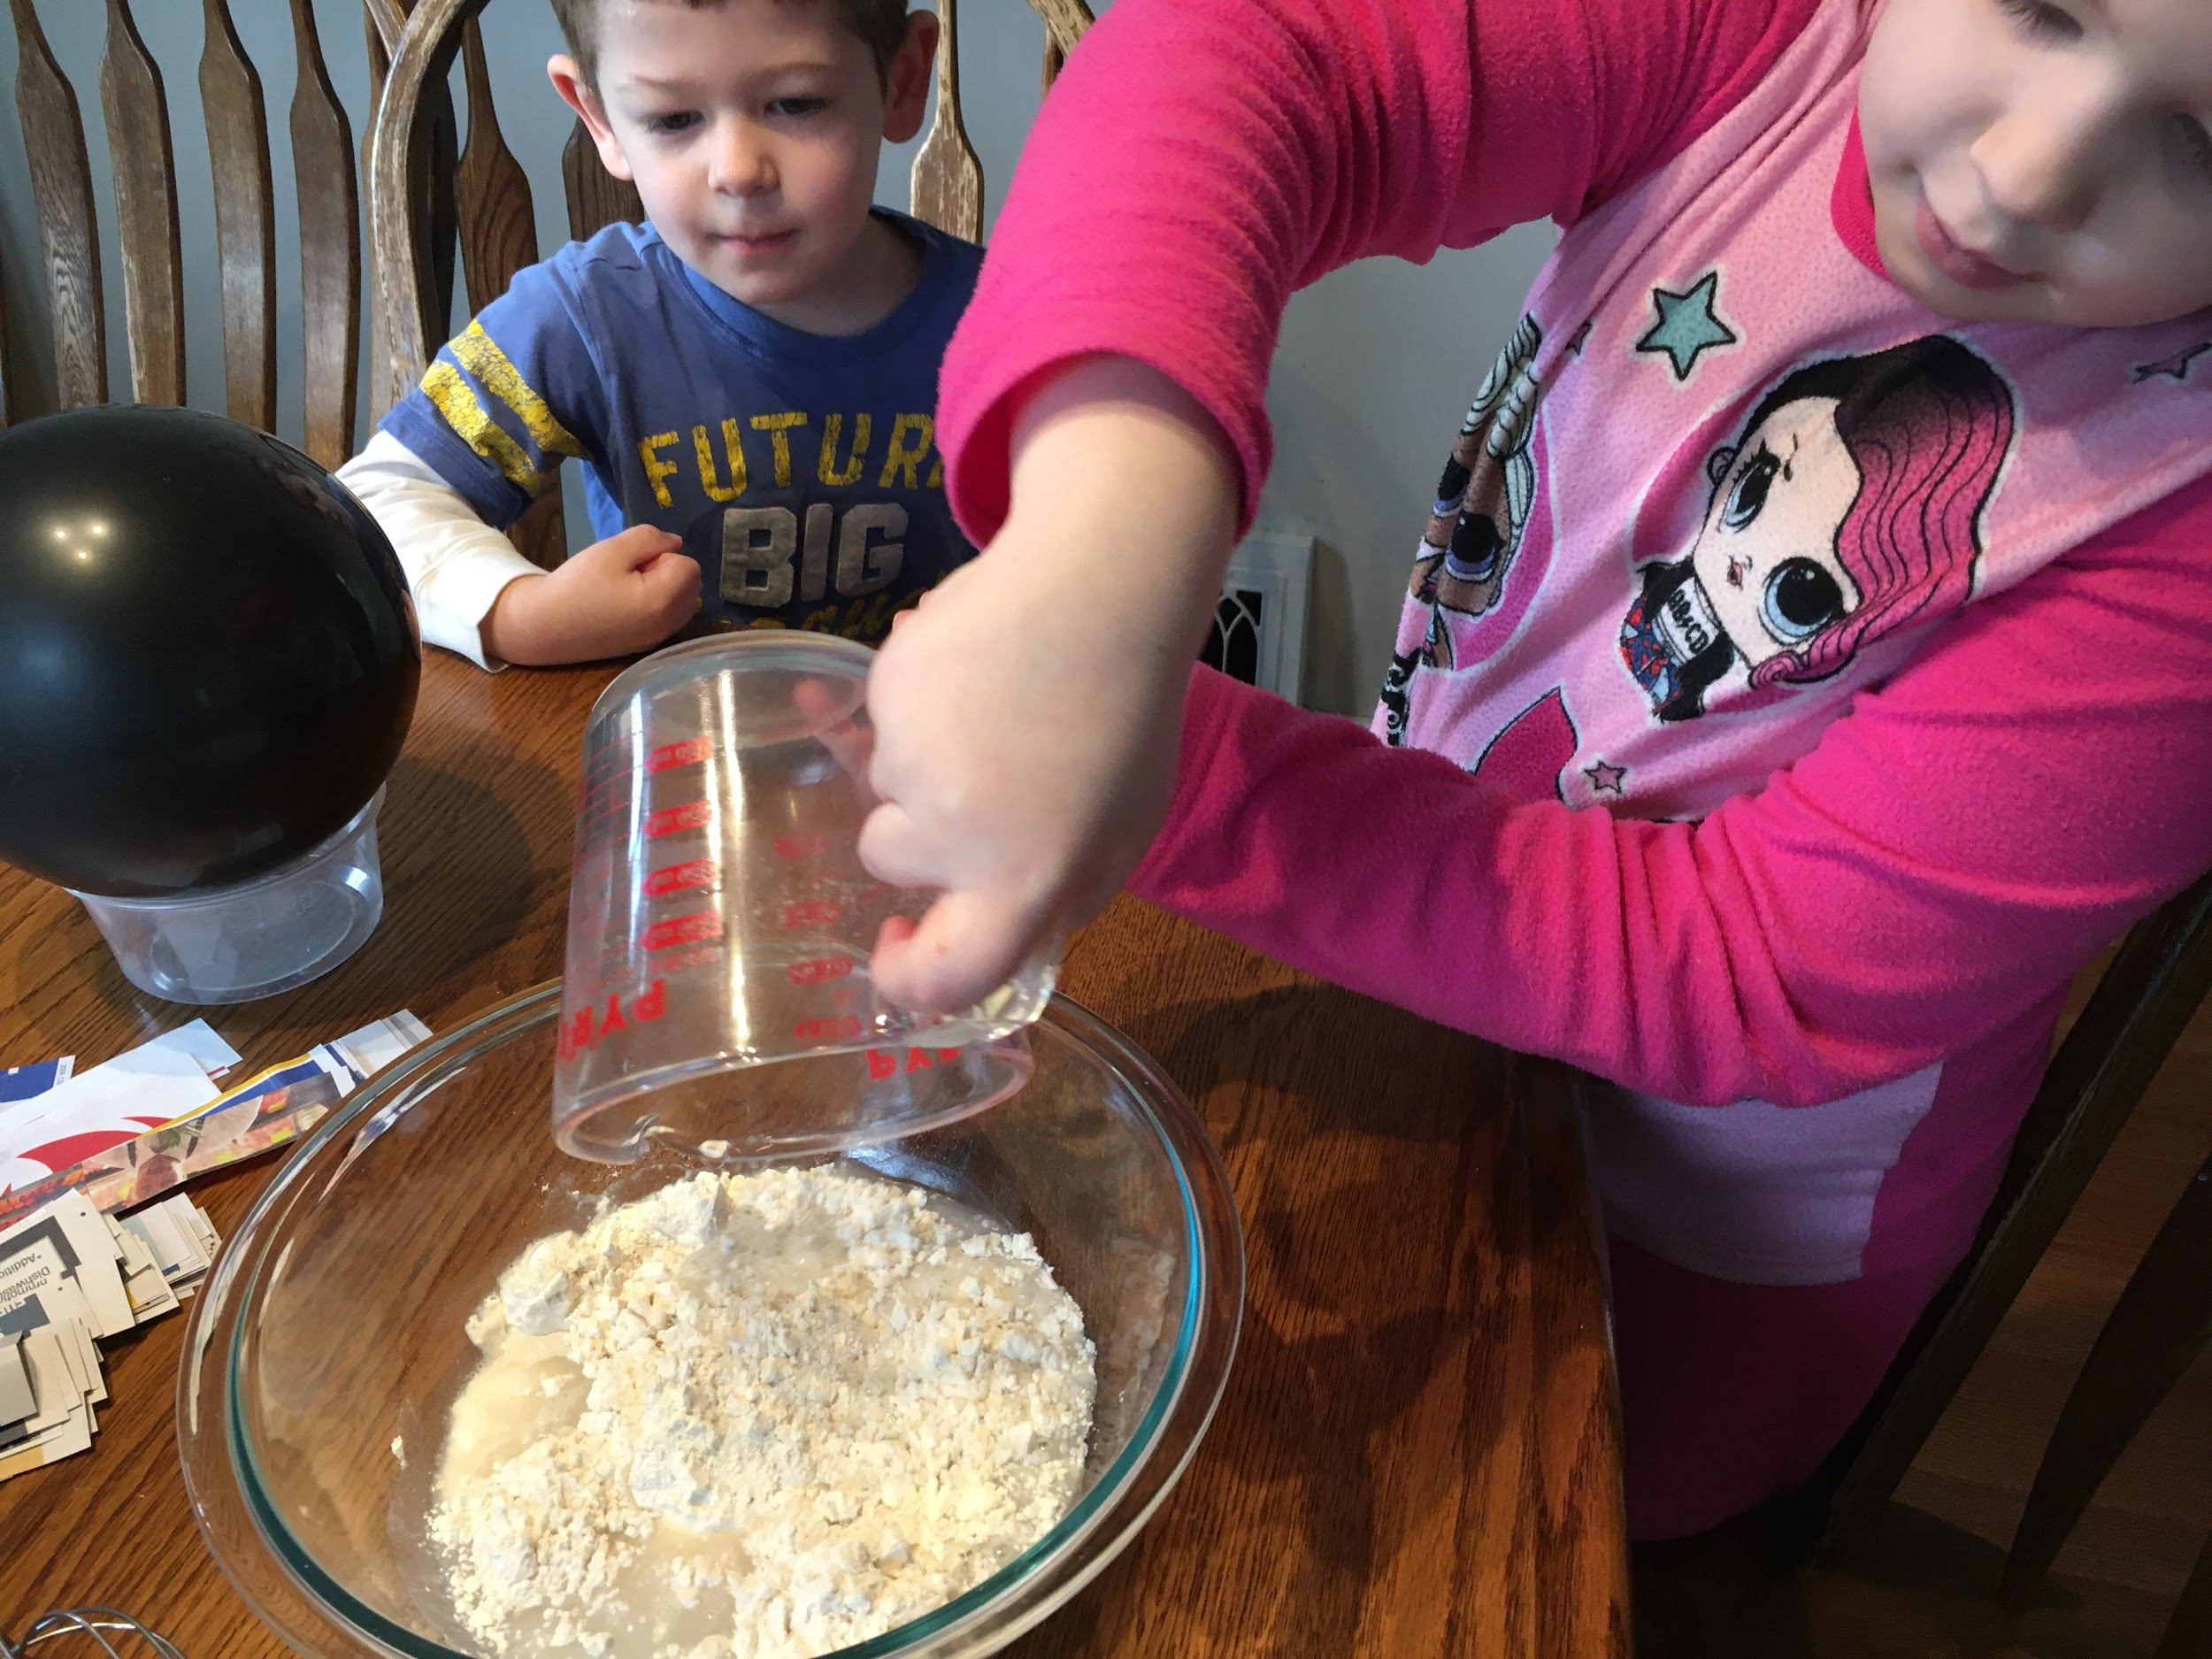
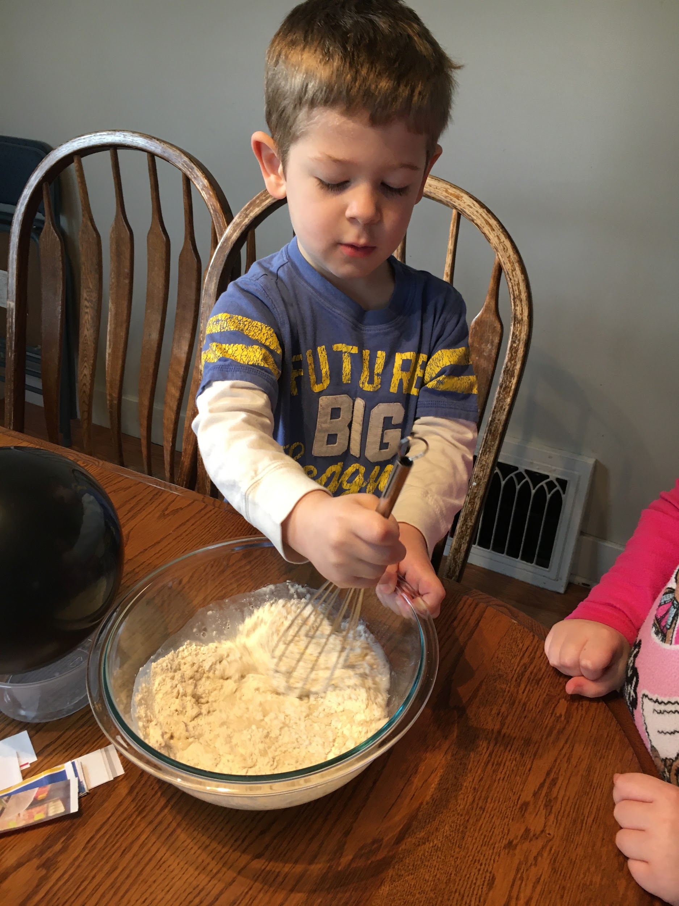
Whisk together flour and water in a large bowl until it is the consistency of glue.
Place the balloon on top of the small bowl.

Slide 25
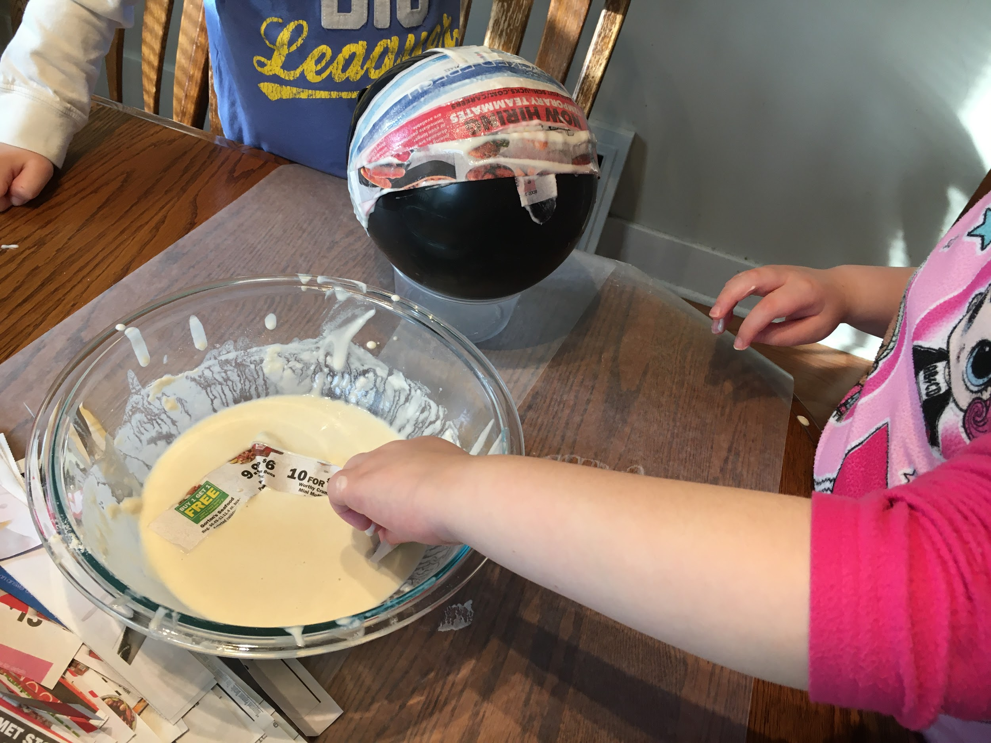
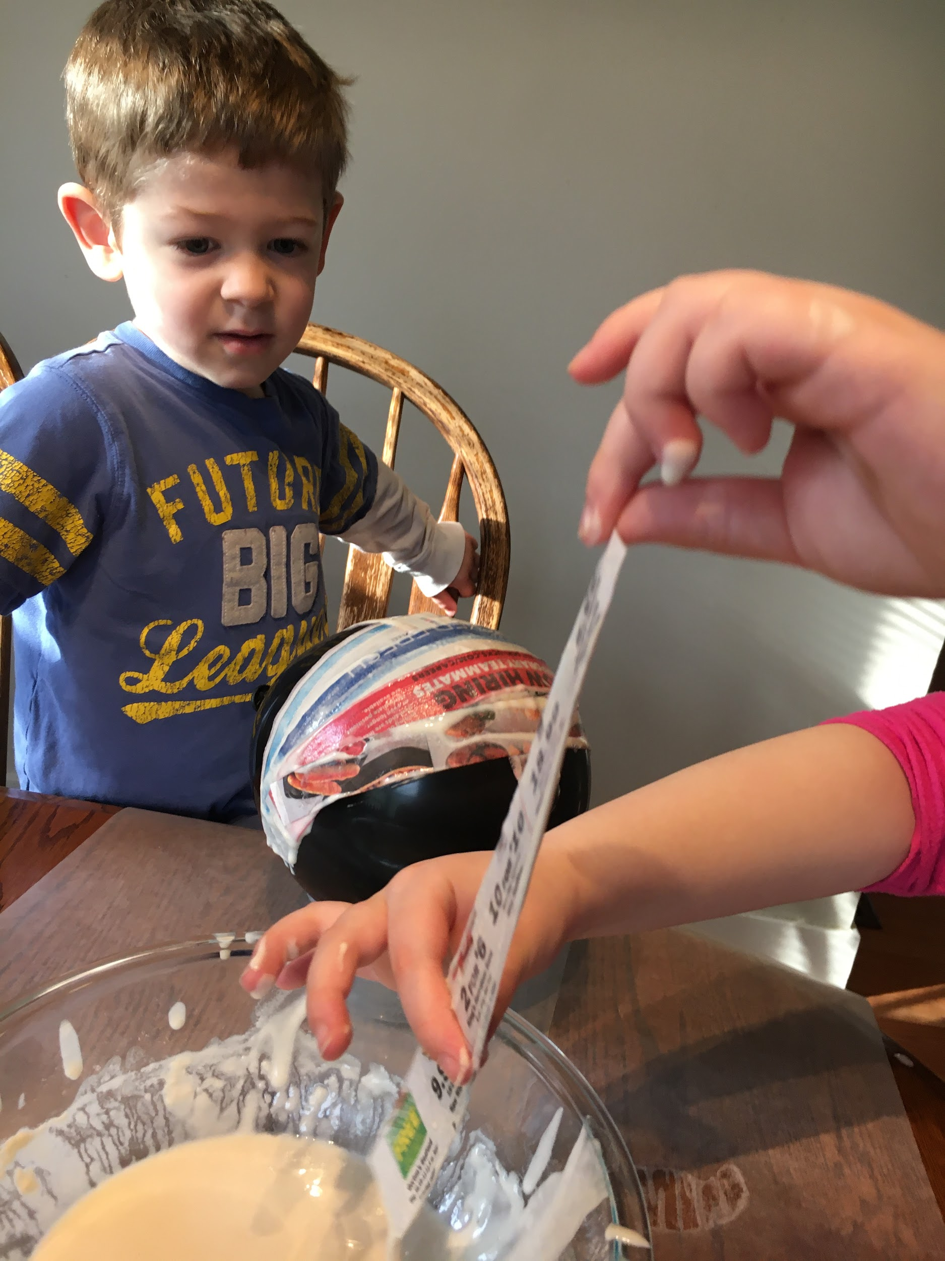
Take strips one strip of newspaper at a time and dip it into the flour/water mix. Use your fingers to wipe off excess paste.
Place strips of paper onto the balloon, but avoid covering the place where the balloon is tied off.

Slide 26
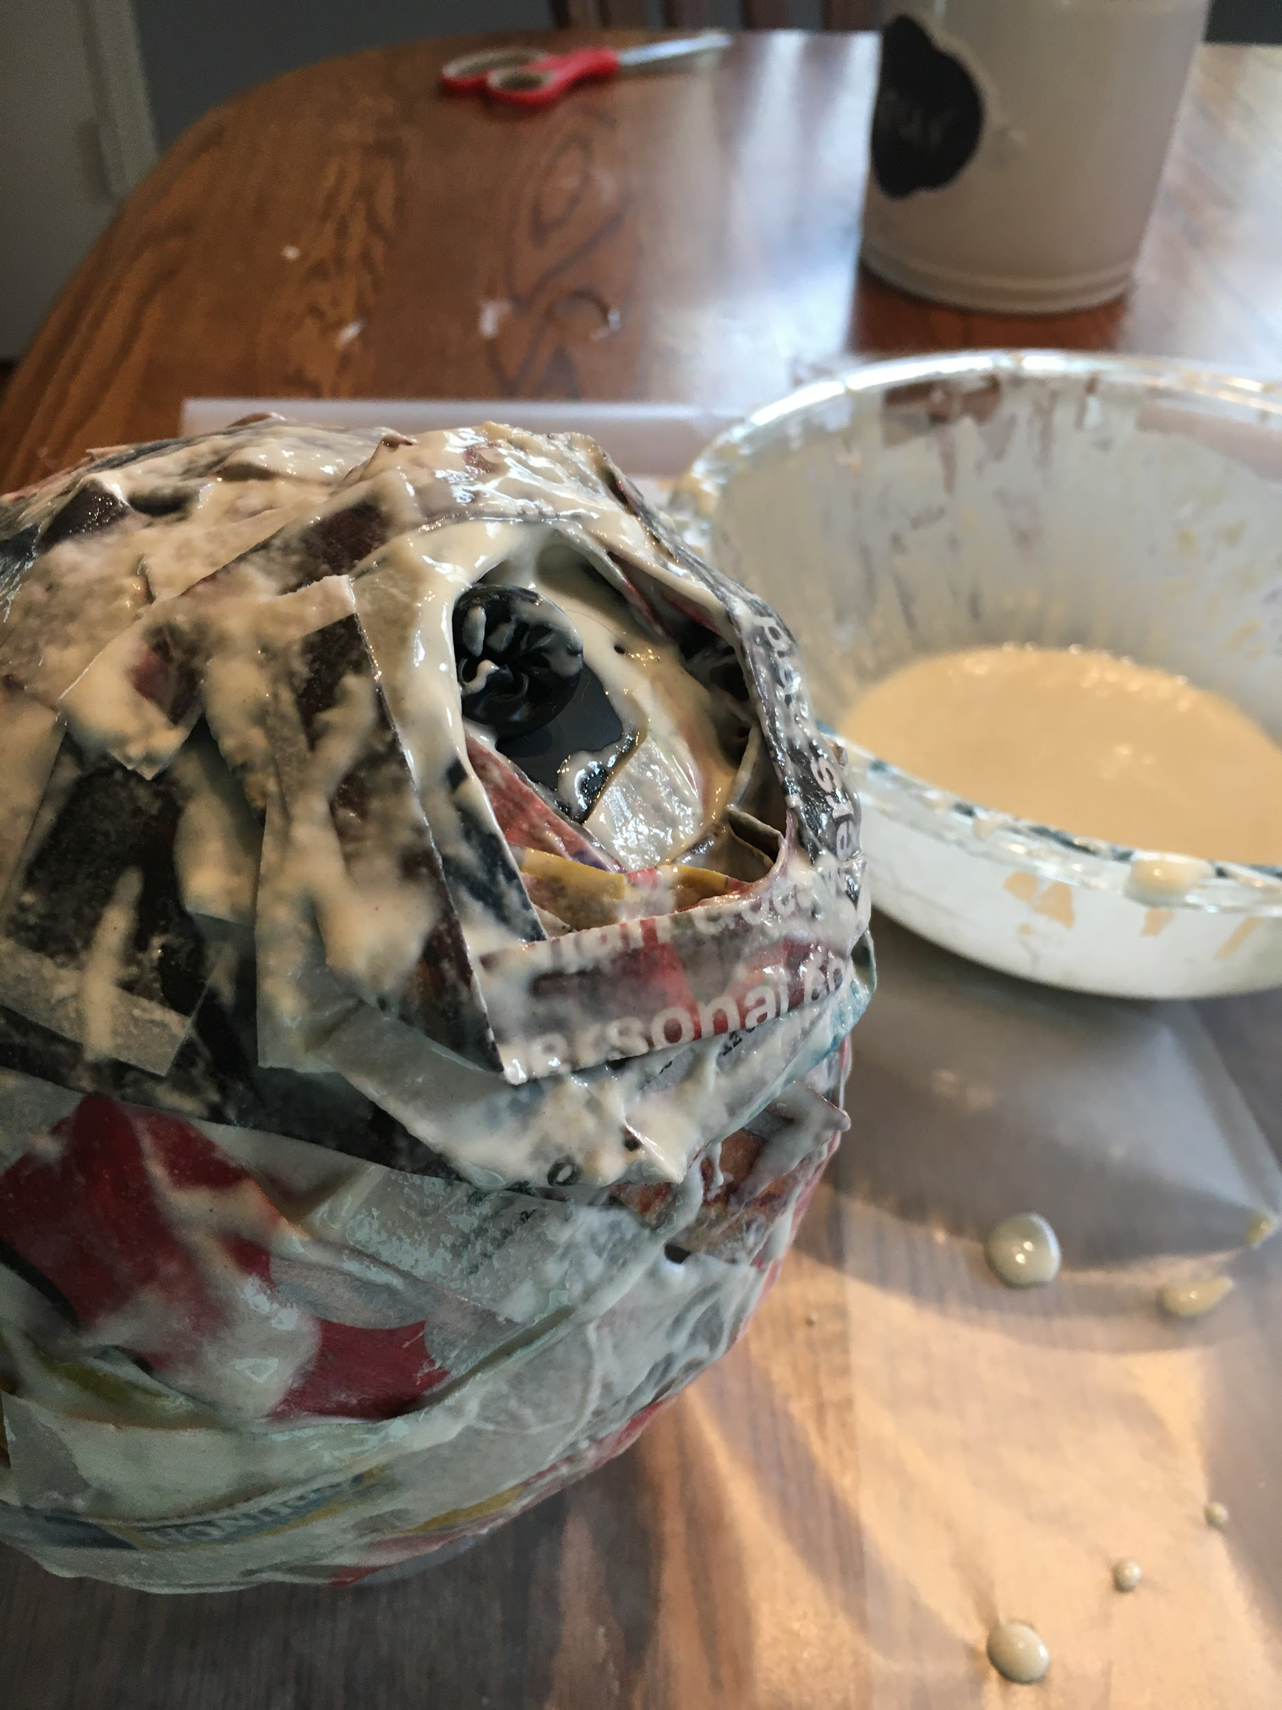
After you get one layer added start to make your entrance for the hornets nest.
In the area where the balloon is tied off start stacking layers of newspaper stripped.
Once it has a hornets nest shape add another layer of newspaper strips to the entire nest.

Slide 27
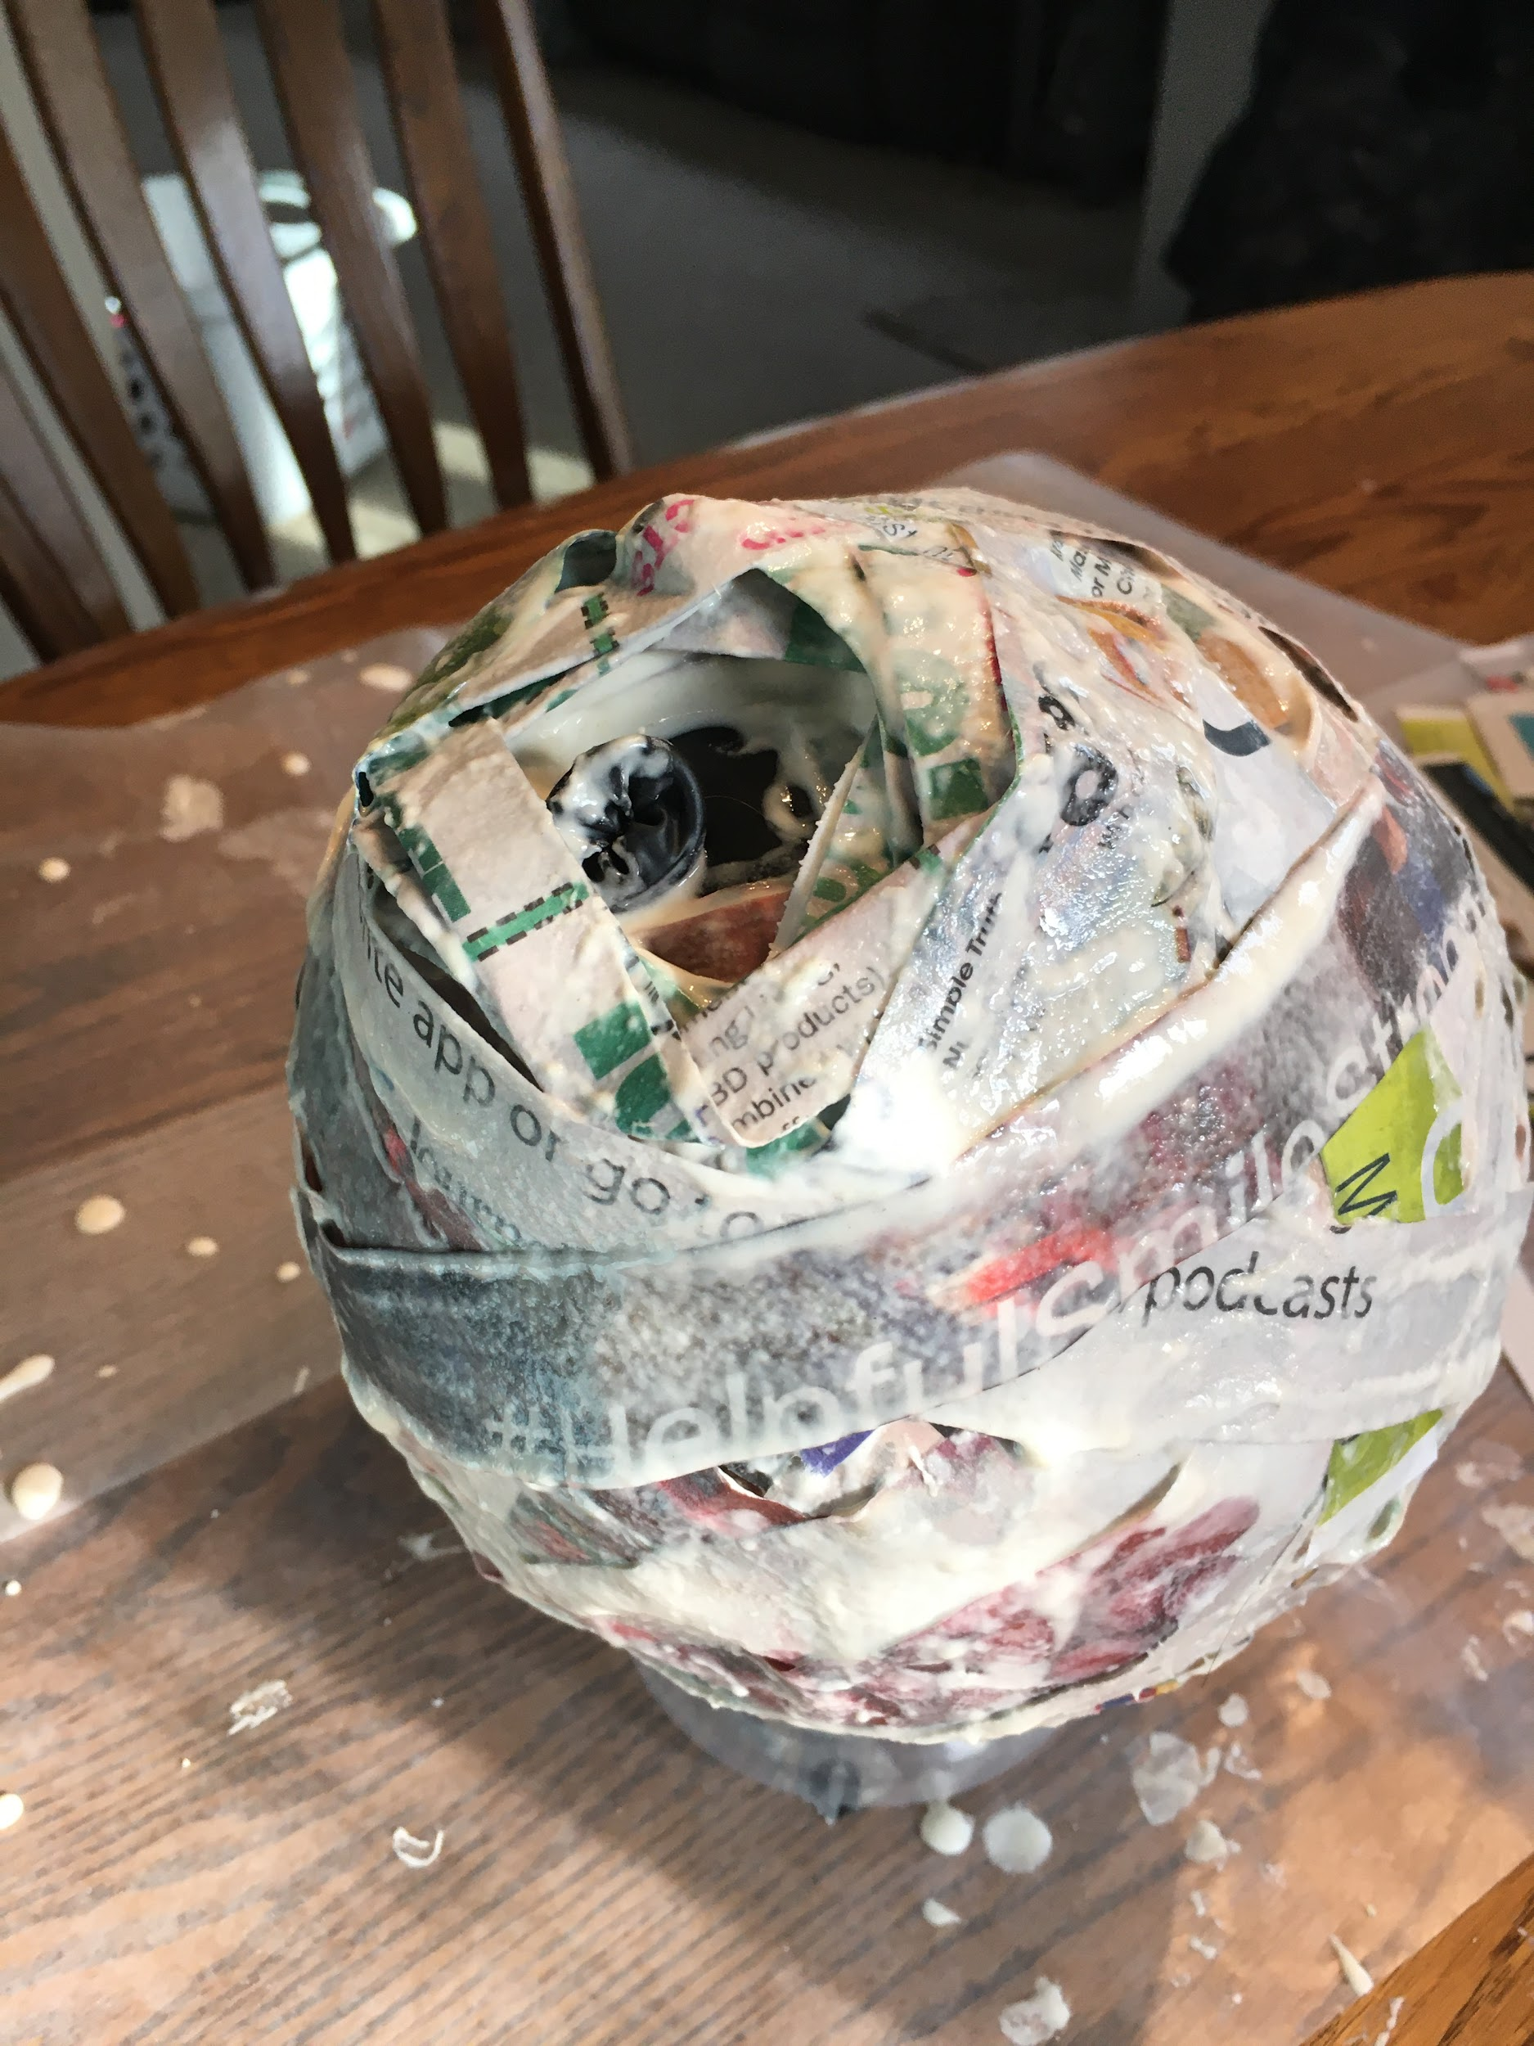

Let your hornet's nest dry. Once dry pop the balloon and you can color the nest if you would like or leave it as is.
Hang up your nest by threading string through the top or hot glueing it to a stick.
ENJOY!
Finished photo coming soon! We are waiting for ours to dry ;-)

Slide 28
Step #5: Take a Bug Field Trip
Choice One: Take a bug walk
The best way to view bugs is outside where they live! Go outside and search for some bugs. Here are some places to look for bugs:
Look under logs, rocks, wood, or planters. A lot of insects like dark areas.
Dig around in leaf litter or mulch.
Check out inside corners of buildings for spiders
Take a notepad and keep track of how many bugs you find, what the bug was doing, where you found it, and make a sketch of the bug.

Slide 29
Choice two: Visit a zoo, museum, or botanical garden that has bug displays.
Since we are not able to visit those places currently you can watch this virtual field trip to the Victoria Bug Zoo on the next slide. While watching take notes and answer these questions.
What bugs did you meet and where are they found
Write down one fun fact you learned about each bug
Which was the strangest bug you saw
Which one would you want to hold and which one would you not like to hold

Slide 30
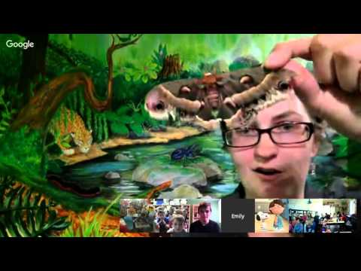

Slide 31
Congrats!
You completed your
Brownie Bugs Badge!

