Slide 1


Leader Instructions & Meeting Prep:
Brownie Automotive Design Badge
Brownie Automotive Design Badge: :meeting plan supply list::
Markers, crayons
Paper
Any craft supplies you would like to use to make a model car (Play-Doh, tin foil, etc)
The following slides will walk your troop through a virtual meeting to earn the Brownie Automotive Design Badge. When you share your screen during your meeting, be sure to click “Present” so girls see the full screen. Also, when you are sharing your screen in zoom, google meet, or another meeting app, please make sure you are sharing both picture and audio. For more information on using Zoom, visit gsnw.gl/VirtualMeetingHowTo
Many of the interactive activities included are shared through YouTube videos. Just click on the arrow in the center of the image to play the video, and the girls can see it too! You should try to review the slides before your meeting if possible, so you are familiar with the activities and any supplies needed.
This meeting will typically take approximately 60-90 minutes as written, depending on participation level and number of girls. As always, Girl Scouting is flexible, and troops may select the activities interest them most, add their own activities, or have girls do some of the steps afterward as “homework”.
When you send out your meeting invitation, be sure to let girls and parents know what supplies they should have on hand for the online troop meeting. They are things most girls likely have at home.

Slide 2

Brownies
Automotive Design Badge
Brought to you by Girl Scouts of the Northwestern Great Lakes

Slide 3
.Welcome!.
Girl Scouts!

Slide 4

Girl Scout Promise
On my honor, I will try, To serve God and my Country. To help people at all times, And to live by the Girl Scout Law.

Slide 5


Let’s say the pledge

Slide 6
Girl Scout Law
I will do my best to be honest and fair, friendly and helpful, considerate and caring, courageous and strong, and responsible for what I say and do, and to respect myself and others, respect authority, use resources wisely, make the world a better place, and be a sister to every Girl Scout.

Slide 7

Tell us your name, something you enjoy, and what do you like to use to build things (Play-Doh, paper, etc)?

Slide 8
Badge Details:
Find out how automotive designers come up with ideas for new vehicles. Then, design your own.
Steps:
Explore how people move from place to place
Discover design criteria
Choose your vehicle's design criteria
Sketch a vehicle to meet your criteria
Skulpt and share your vehicle

Slide 9
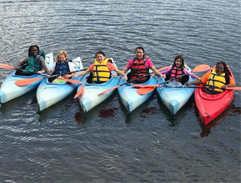
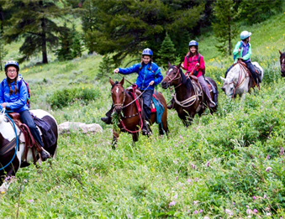
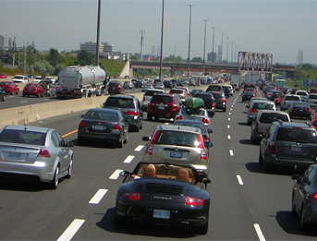
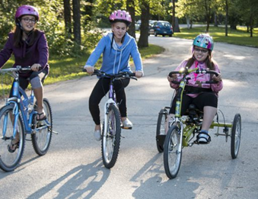
There are many types of transportation!
Have you ever used. .any of these?.

Slide 10
.Let’s test your.
knowledge!
What is the safest mode of transportation?

Slide 11


Slide 12
.Let’s test your.
knowledge!
What is the most popular mode of transportation in the United States?

Slide 13
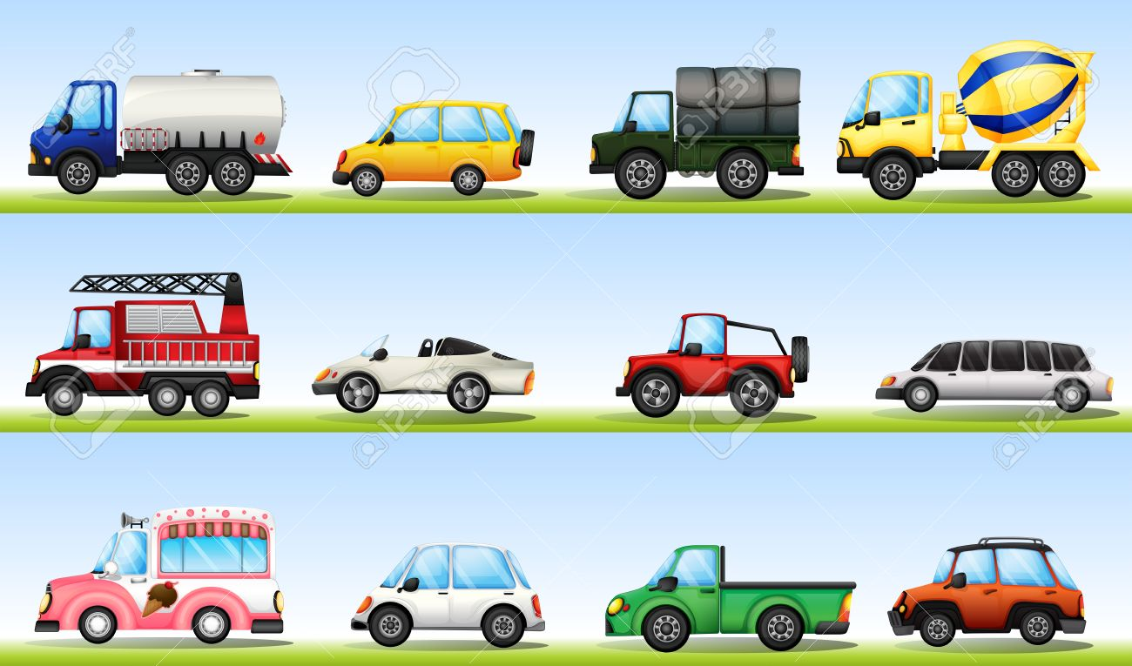

Slide 14
.Let’s test your.
knowledge!
In Europe what is often the most effective way to travel?

Slide 15
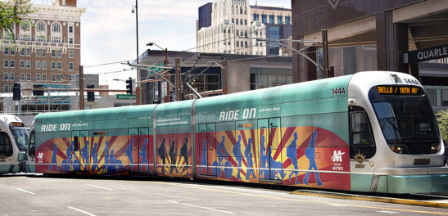

Slide 16
What other modes of transportation are popular?
What new modes of transportation would you like to see?
In the Netherlands, the government will pay you to bike rather than drive or ride the bus. Isn’t that cool!

Slide 17

Let’s watch how cars are made and you will see the criteria or requirements of each car.

Slide 18
.Can you guess.
the car part?
Notes:
I’m going to show you images of car parts and I want you to guess what they are!

Slide 19

Hint:
It gives off light

Slide 20
.Answer:.
Headlight

Slide 21
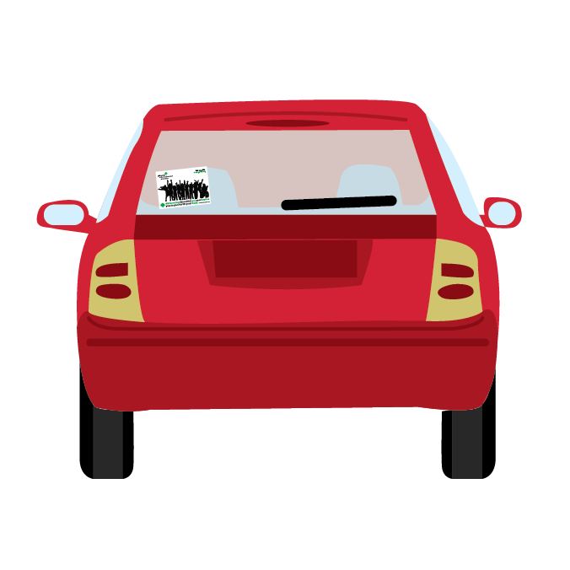
Hint:
You put your bags in it when you travel

Slide 22
.Answer:.
Trunk

Slide 23
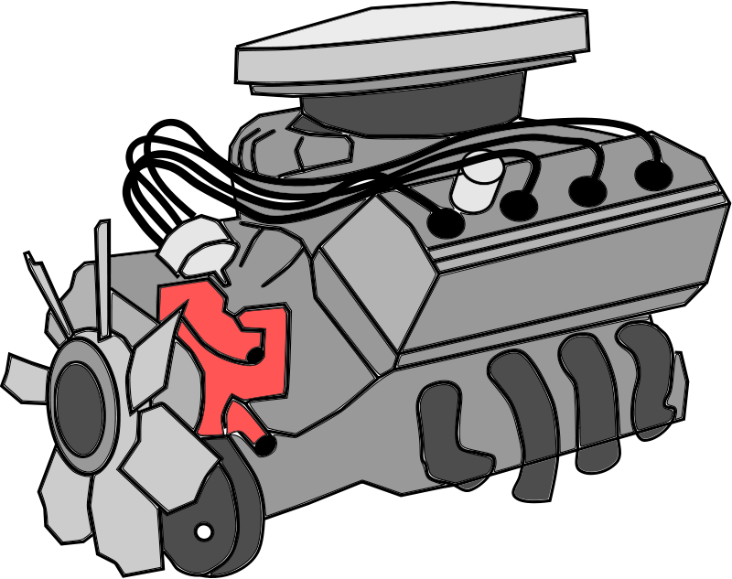
Hint:
It makes a vehicle go

Slide 24
.Answer:.
Engine

Slide 25
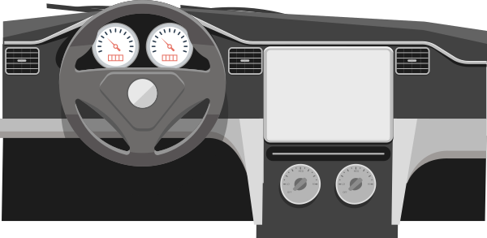
Hint:
It wear the steering wheel and radio are in a vehicle

Slide 26
.Answer:.
Dashboard

Slide 27
Now,
let’s design our own car!

Slide 28
Take some time and sketch your car..
Things to think about...
What will your car be used for?
What will your vehicle do to make the world a better place?
Who is your vehicle for?

Slide 29
.Let’s share!.

Slide 30

Now,
let’s make
a model of
your car!
Feel free to use playdough, tinfoil, paper, legos or anything to create a model.

Slide 31
.Let’s share!.

Slide 32
Now that you’ve earned this badge, you can give service by:
Teaching Daisies about the parts of a vehicle, special features, or design criteria.
Sketching an idea for how you can help someone else.
Sharing something you’ve made with others to ask for ideas to make it even better.
WOW, you have earned your badge!

