Slide 1

Leader Instructions & Meeting Prep:
Daisy Friendly and Helpful Petal
Daisy Friendly and Helpful: :Petal meeting plan supply list::
Paper
Pencil
Scissors
Paint
Paint Brushes
Fork
String
Bird Seed
Peanut Butter or Crisco
Toilet Paper Roll
The following slides will walk your troop through a virtual meeting to earn the Daisy Friendly and Helpful Petal. When you share your screen during your meeting, be sure to click “Present” so girls see the full screen. Also, when you are sharing your screen in zoom, google meet, or another meeting app, please make sure you are sharing both picture and audio. For more information on using Zoom, visit gsnw.gl/VirtualMeetingHowTo
Many of the interactive activities included are shared through YouTube videos. Just click on the arrow in the center of the image to play the video, and the girls can see it too! You should try to review the slides before your meeting if possible, so you are familiar with the activities and any supplies needed.
This meeting will typically take approximately 60-90 minutes as written, depending on participation level and number of girls. As always, Girl Scouting is flexible, and troops may select the activities interest them most, add their own activities, or have girls do some of the steps afterward as “homework”.
When you send out your meeting invitation, be sure to let girls and parents know what supplies they should have on hand for the online troop meeting. They are things most girls likely have at home.

Slide 2



Friendly & Helpful
Daisy eTroop meeting
#3
Brought to you by Girl Scouts of the Northwestern Great Lakes

Slide 3
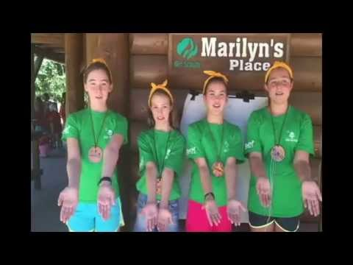
Girl scout Promise:
On my honor, I will try,
To serve God and my Country.
To help people at all times,
And to live by the Girl Scout Law.

Slide 4


Let’s Say the Pledge

Slide 5


How are we doing with the Girl Scout Promise?
Do I have any friends that would like to try
to lead the promise at our next meeting?

Slide 6
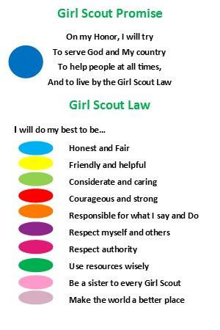

Notes:
Review of the two patches earned already: Promise and the Honest & Fair petal. Talk about the GS Law and what we will earn today!

Slide 7
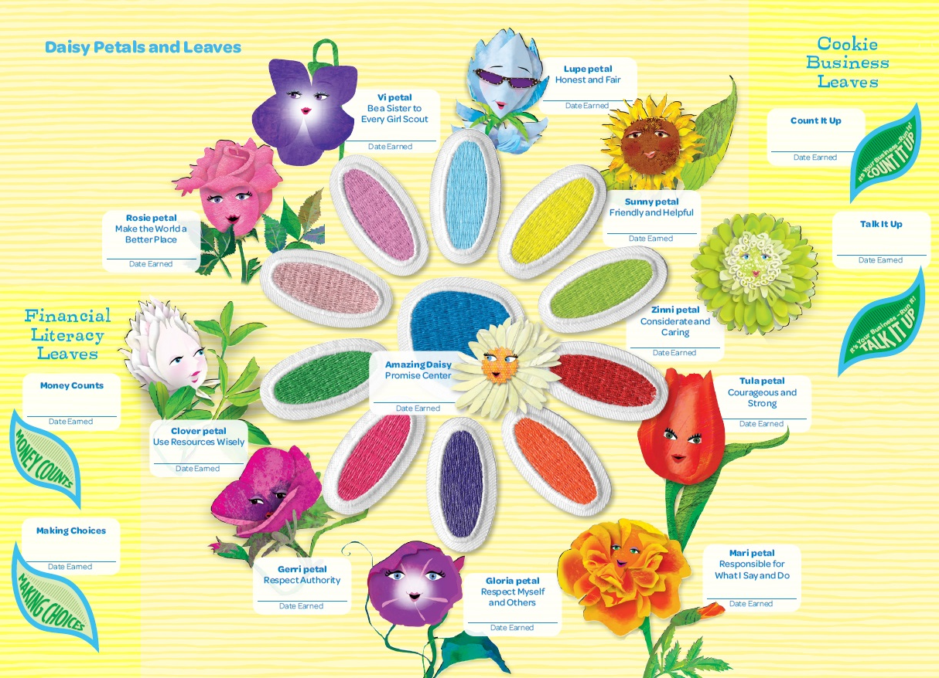
Who can find Sunny the YELLOW petal?

Slide 8

THere she is, Sunny is pictured here.
Let’s learn all about what it means to be a FRIENDLY and HELPFUL Girl Scout!
I bet many of you already do many things that demonstrate this petal!

Slide 9


Who is here today?
Let’s each say our name and something
we like to do when it’s SUNNY outside!

Slide 10
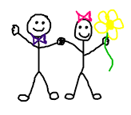

What is friendly?
Can we come up with three examples?

Slide 11

Notes:
Before starting the video, chat a little bit about how being friendly can be simply saying hello!

Slide 12
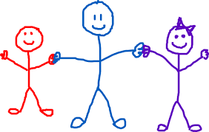
What is helpful?
Can we come up with three examples?

Slide 13

Notes:
Share how this was a favorite of mine growing up.

Slide 14

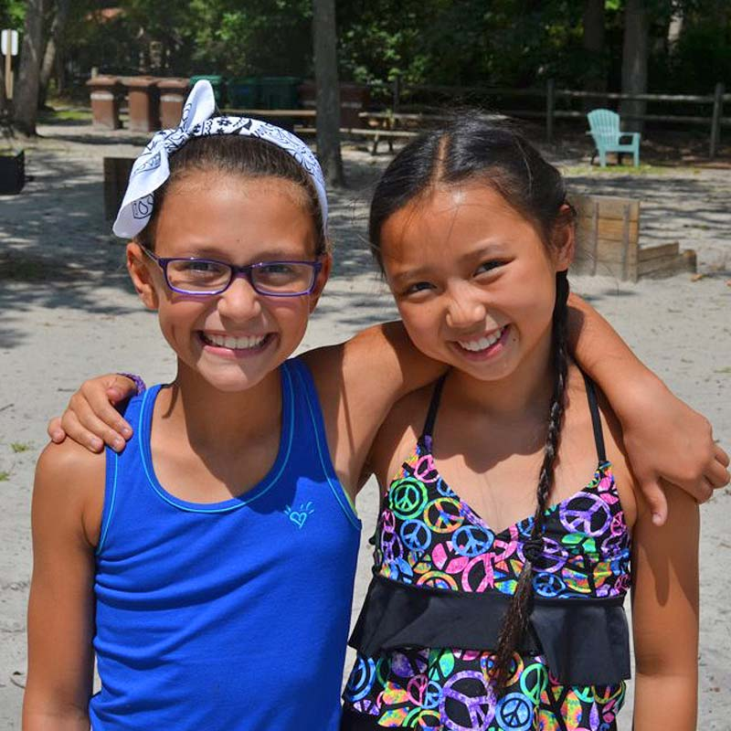
Friendly & Helpful
My favorite thing about this badge is when we demonstrate these two words it always puts a smile on someone’s face.
Notes:
Wow, demonstrate is a big word, talk about what that means!

Slide 15
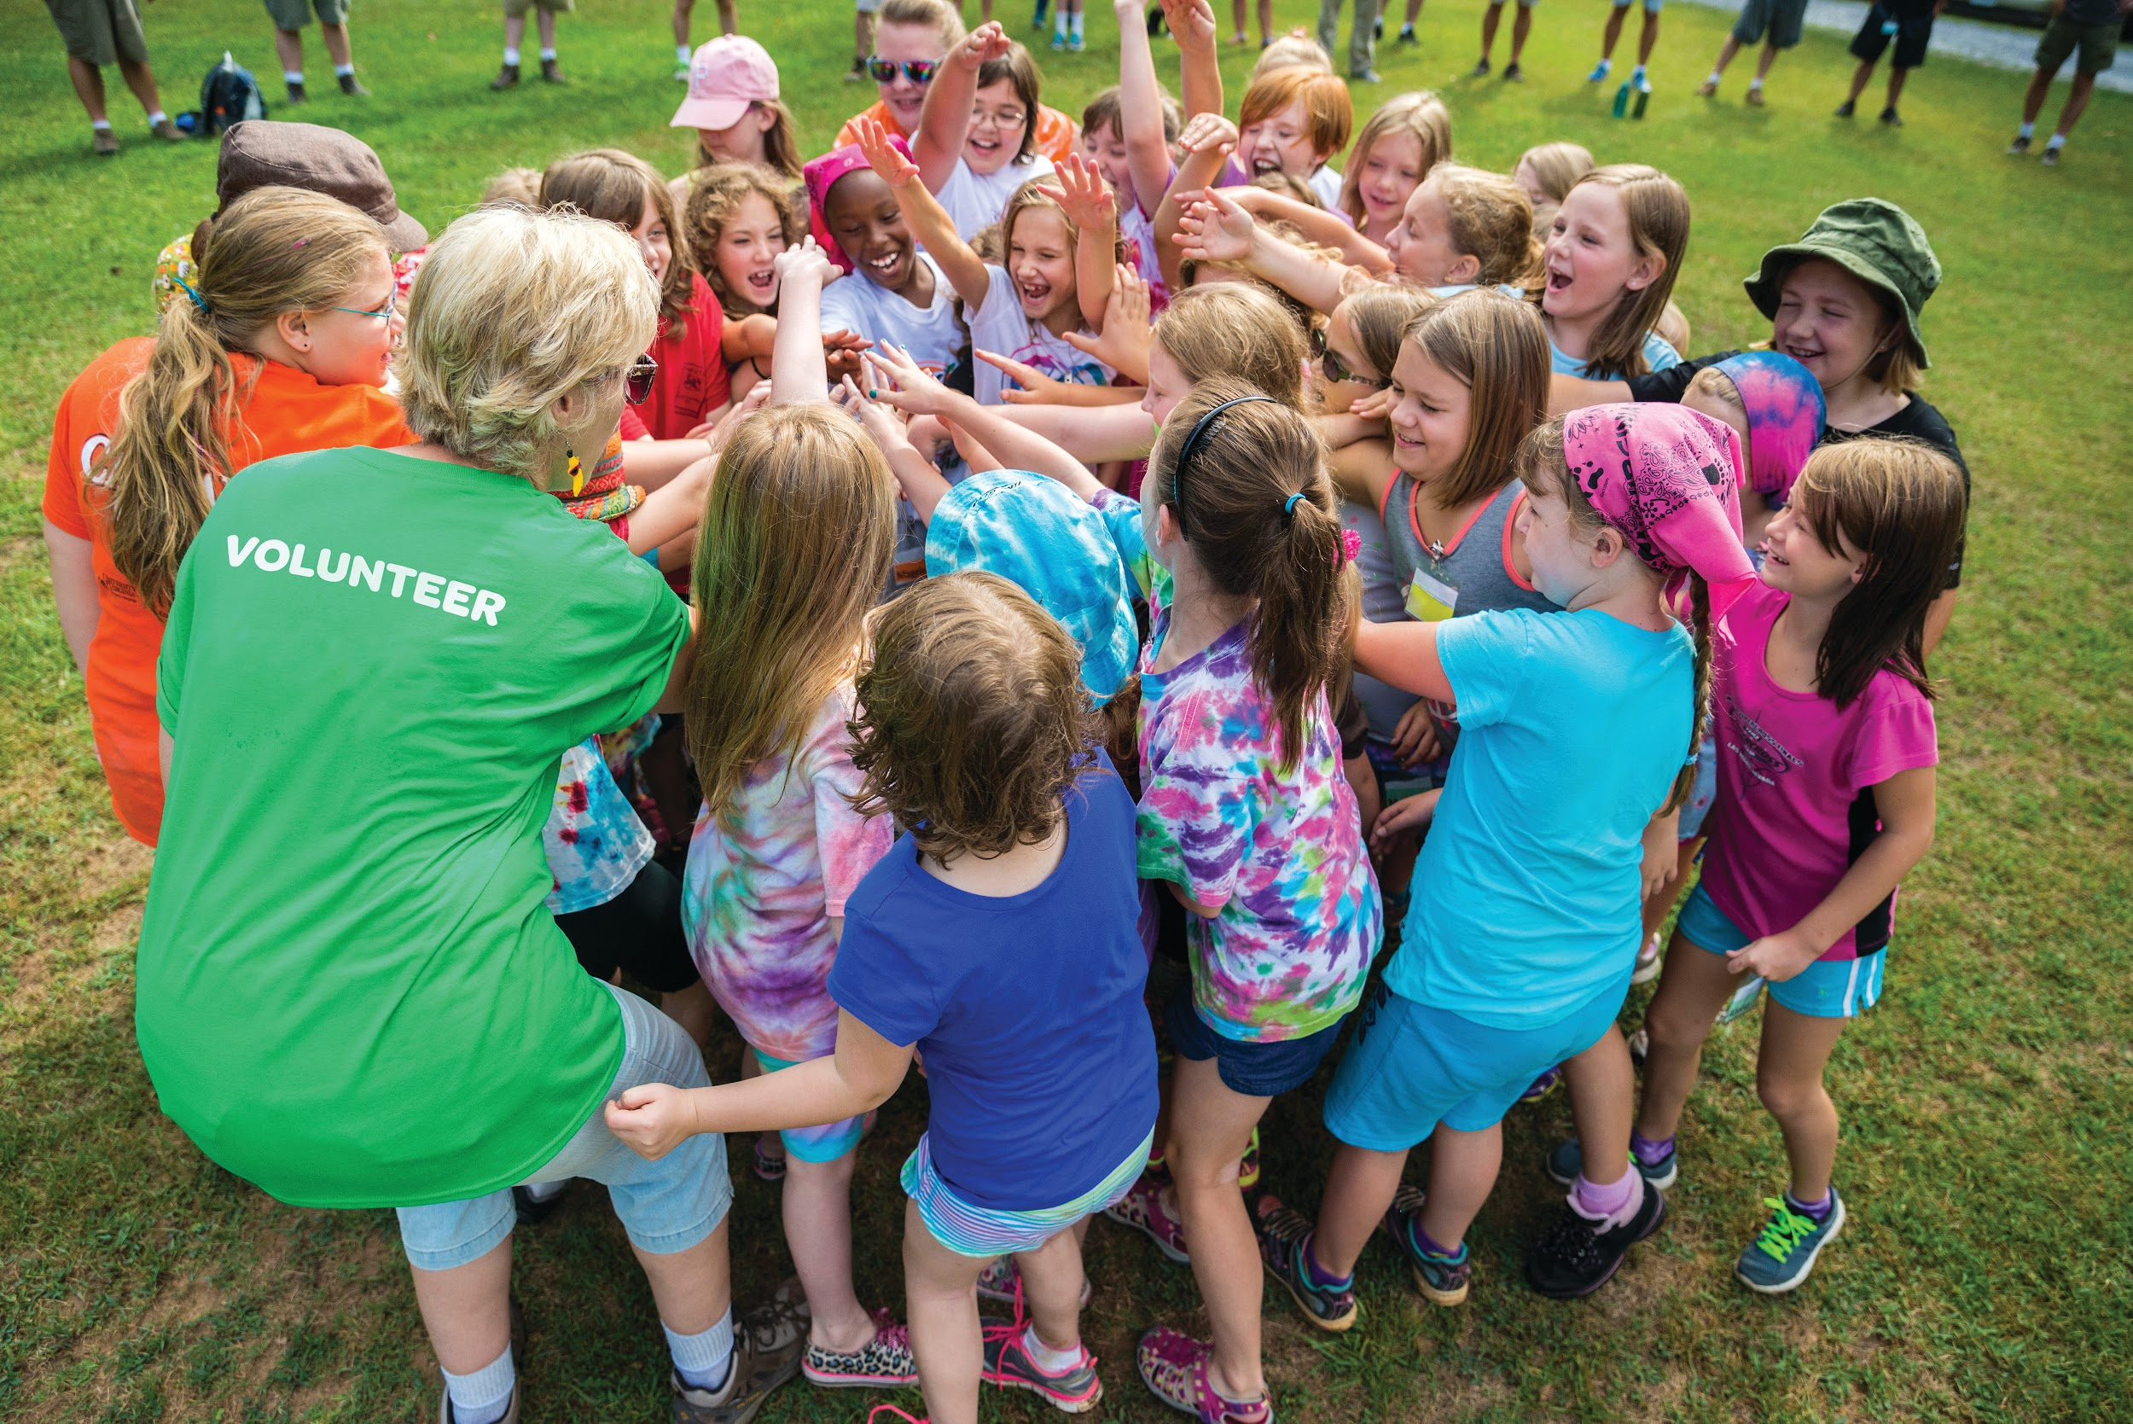
Friendly & helpful
We came up with a lot of AWESOME ways to be
Let’s do a fun project together so we can practice this at home!

Slide 16

A helpful hand was here!
Supplies needed:
Paper
Pencil
Scissors

Slide 17

When you do something friendly or helpful, secretly leave behind a cut out hand!
...psst, don’t forget to keep
it a secret!

Slide 18

Then, when someone asks
What this hand is for...
You can say...A friendly and helpful Girl Scout was here!

Slide 19

Hand trivia

Slide 20
5
19
27
34
Trivia Question!
How many bones do you think are in a human hand?

Slide 21
27
5
19
27
34
Trivia Question!
How many bones do you think are in a human hand?

Slide 22
17
23
27
31
Trivia Question!
How many muscles are in a human hand?

Slide 23
17
5
19
27
34
Trivia Question!
How many bones do you think are in a human hand?

Slide 24
A hand that can bend in different directions
A hand that has extra joints
Two hands folded together
Trivia Question!
What is a double jointed hand?

Slide 25

A hand that can bend in different directions

Slide 26

THese next two slides have some
hands on ideas for you to try at home!

Slide 27
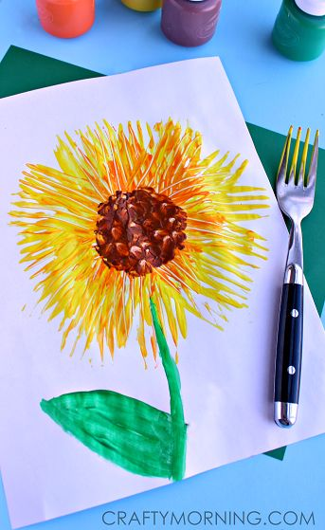
Craft time at home!
Supplies needed:
Paper
Paint
Paint brushes
Fork
Notes:
Explain to the girls what they would do.

Slide 28
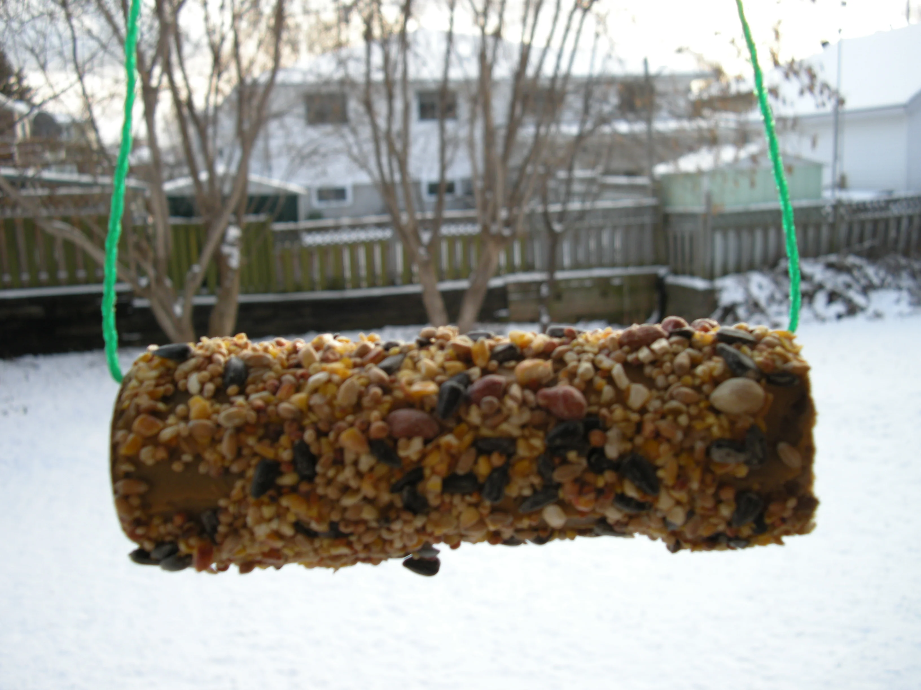
Craft time at home!
Make a bird feeder to HELP the birds.
Supplies needed:
Toilet paper roll
Peanut butter or Crisco
Bird seed
String
Notes:
Explain to the girls what they would do.

Slide 29
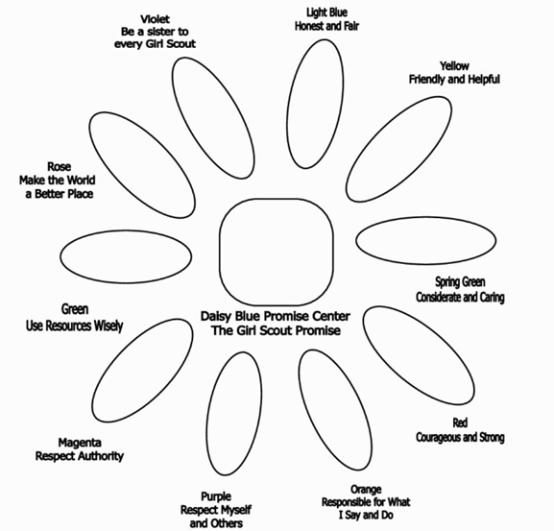



We just earned our YELLOW petal!
Great work!

Slide 30


Slide 31


See you next time Girl Scouts!

