Slide 1


Leader Instructions & Meeting Prep:
Daisy Courageous and Strong Petal
Daisy Courageous and Strong: :Petal meeting plan supply list::
White cardstock or paper
Drawing or coloring utensils
Scissors
The following slides will walk your troop through a virtual meeting to earn the Daisy Courageous and Strong Petal. When you share your screen during your meeting, be sure to click “Present” so girls see the full screen. Also, when you are sharing your screen in zoom, google meet, or another meeting app, please make sure you are sharing both picture and audio. For more information on using Zoom, visit gsnw.gl/VirtualMeetingHowTo
Many of the interactive activities included are shared through YouTube videos. Just click on the arrow in the center of the image to play the video, and the girls can see it too! You should try to review the slides before your meeting if possible, so you are familiar with the activities and any supplies needed.
This meeting will typically take approximately 60-90 minutes as written, depending on participation level and number of girls. As always, Girl Scouting is flexible, and troops may select the activities interest them most, add their own activities, or have girls do some of the steps afterward as “homework”.
When you send out your meeting invitation, be sure to let girls and parents know what supplies they should have on hand for the online troop meeting. They are things most girls likely have at home.

Slide 2



Courageous & strong
Brought to you by Girl Scouts of the Northwestern Great Lakes

Slide 3
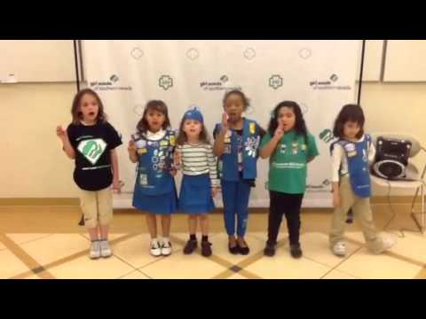
Girl scout Promise:
On my honor, I will try,
To serve God and my Country.
To help people at all times,
And to live by the Girl Scout Law.

Slide 4


Let’s Say the Pledge

Slide 5

About Tula’s Story Petal
When I’ve earned my Tula petal,
I will know how to be
Courageous and strong,
Just like Tula the Tulip.

Slide 6

Step One:
Grace For President By Kelly Dipucchio

Slide 7

Talk about “Grace For President” Story:
What does it mean to be courageous? Can anyone be courageous?
We usually think of your body being strong, but today we’re talking about a different kind of strength. What does it mean for someone to be strong?
When did the character show that she was courageous and strong?
How do you think she felt when she acted courageously? Do you think she was scared?
Can you be scared and courageous at the same time?
How can a girl your age show that she is courageous and strong?

Slide 8
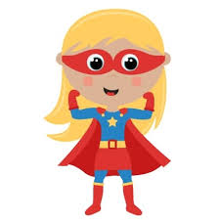
Step Two: Superhero Me
Materials Needed:
White cardstock or paper
Drawing and coloring utensils
Scissors (one for each girl)

Slide 9
Explore Your own Personal Characteristics that represent courage:
Draw your superhero selves on paper.
What power does your superhero self have?
What does your superhero self have the power to do?
Any other qualities that your superhero self have?
How does your superhero self show that she is courageous and strong?
When girls are done drawing and coloring their superheroes, ask them to share their superhero selves with everyone, talking about what makes their superhero selves courageous and strong.

Slide 10
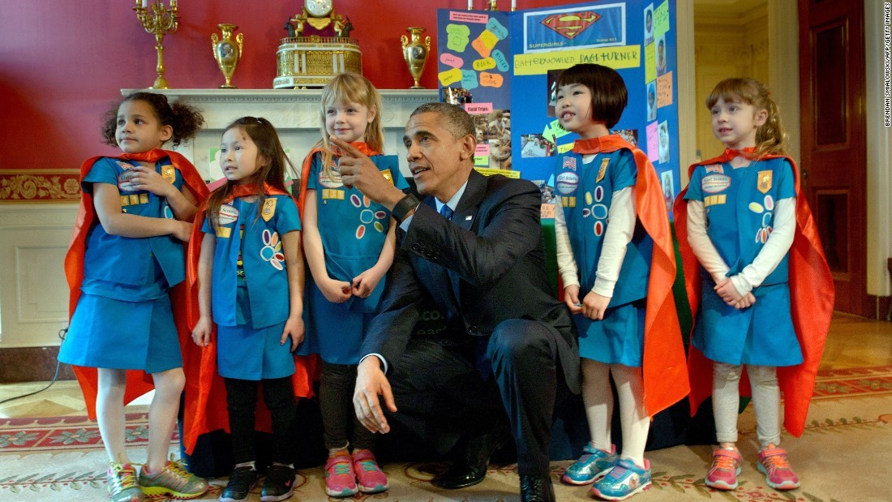

Slide 11

Step 3:
Who do you think is courageous and strong in your life?
Share with your family who you think is courageous and strong in your life?
Is it you?

