Slide 1


Leader Instructions & Meeting Prep:
Daisy Considerate and Caring Petal
Daisy Considerate and Caring: Petal:meeting plan supply list::
A show and tell item: Something that is special to you because someone kind and caring gave it to you. (favorite stuffed animal or toy, photograph, book….whatever you wish!
Room to dance or move
Paper plate
Paints/paintbrushes or markers
Cotton balls or stuffing
Glue
The following slides will walk your troop through a virtual meeting to earn the Daisy Considerate and Caring Petal. When you share your screen during your meeting, be sure to click “Present” so girls see the full screen. Also, when you are sharing your screen in zoom, google meet, or another meeting app, please make sure you are sharing both picture and audio. For more information on using Zoom, visit gsnw.gl/VirtualMeetingHowTo
Many of the interactive activities included are shared through YouTube videos. Just click on the arrow in the center of the image to play the video, and the girls can see it too! You should try to review the slides before your meeting if possible, so you are familiar with the activities and any supplies needed.
This meeting will typically take approximately 60-90 minutes as written, depending on participation level and number of girls. As always, Girl Scouting is flexible, and troops may select the activities interest them most, add their own activities, or have girls do some of the steps afterward as “homework”.
When you send out your meeting invitation, be sure to let girls and parents know what supplies they should have on hand for the online troop meeting. They are things most girls likely have at home.

Slide 2



Considerate
& Caring
Earn the Zinni Daisy Petal
Brought to you by Girl Scouts of the Northwestern Great Lakes

Slide 3

Girl scout Promise:
On my honor, I will try,
To serve God and my Country.
To help people at all times,
And to live by the Girl Scout Law.

Slide 4


Let’s Say the Pledge

Slide 5
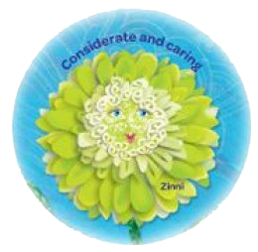
Show and tell
Tell us your name, then show us something that is important to you because a caring person gave it to you! Tell us about it.

Slide 6
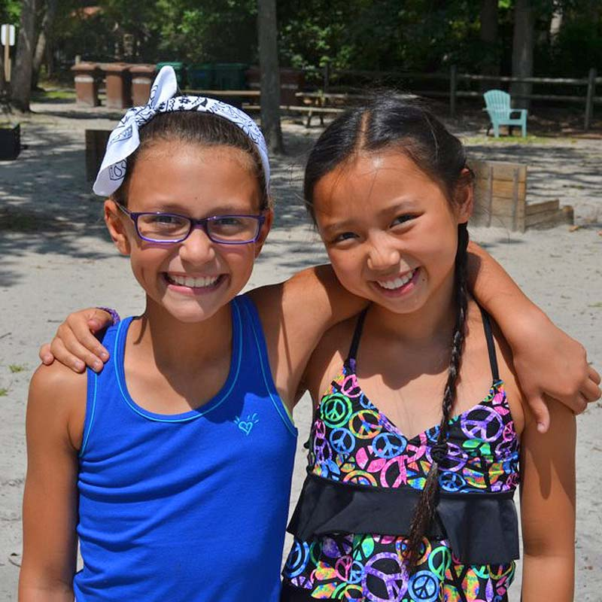
Today we are earning the
Considerate & Caring Petal
Does anyone know what considerate means?

Slide 7

It’s just a fancy way to say that you are being kind, and showing that you care about others feelings!

Slide 8
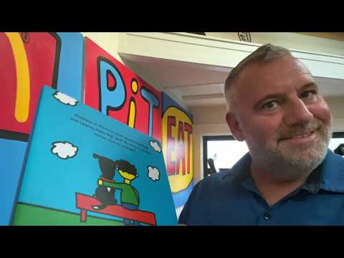
The Kindness Book
By: Todd Parr

Slide 9

In the Kindness Book, Todd showed us all kinds of ways to show caring. How many ways can we think of?
Dance until the music stops. When it says freeze, we will pause the music, and each try to say a way that we can be considerate and caring to other people. How many ways can we think of?

Slide 10
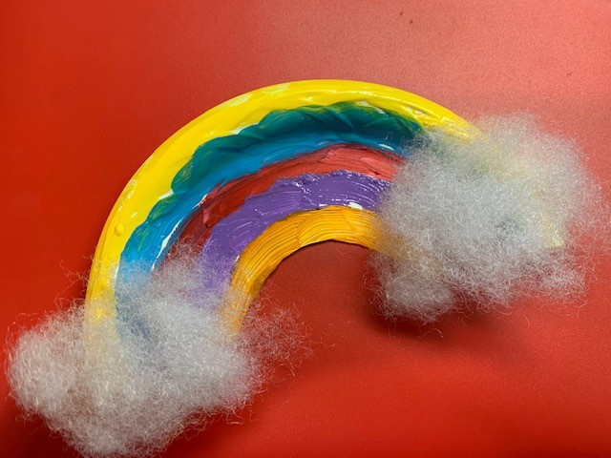
Use a paper plate, paint or markers, cotton balls and glue to make to make this cute rainbow craft. Then, give it to someone who needs some good cheer!
Cut paper plate in half.
Cut a half-circle from center, to make a rainbow shape.
Use paint or markers to add rainbow color.
Stretch and glue cotton balls at each side, to make clouds
Optional: punch a hole through top and tie a string to hang.
For complete
instructions go to:
https://www.artycraftykids.com/craft/easy-paper-plate-rainbow-craft/
Be Considerate & Caring - Spread some Cheer!

Slide 11
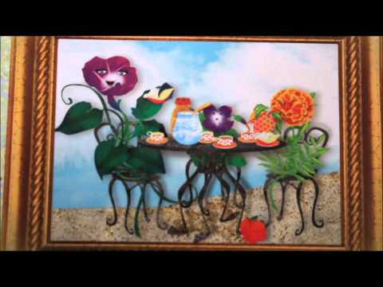
Now, let’s end
with a Daisy Flower Friends story! What was the problem in the story?
How did the Flower
Friends show that they were considerate and caring?

Slide 12

Great Job Girl Scouts!
You have earned the Considerate and Caring Petal!
Thank you for being kind and thinking about other people’s feelings!

