Slide 1
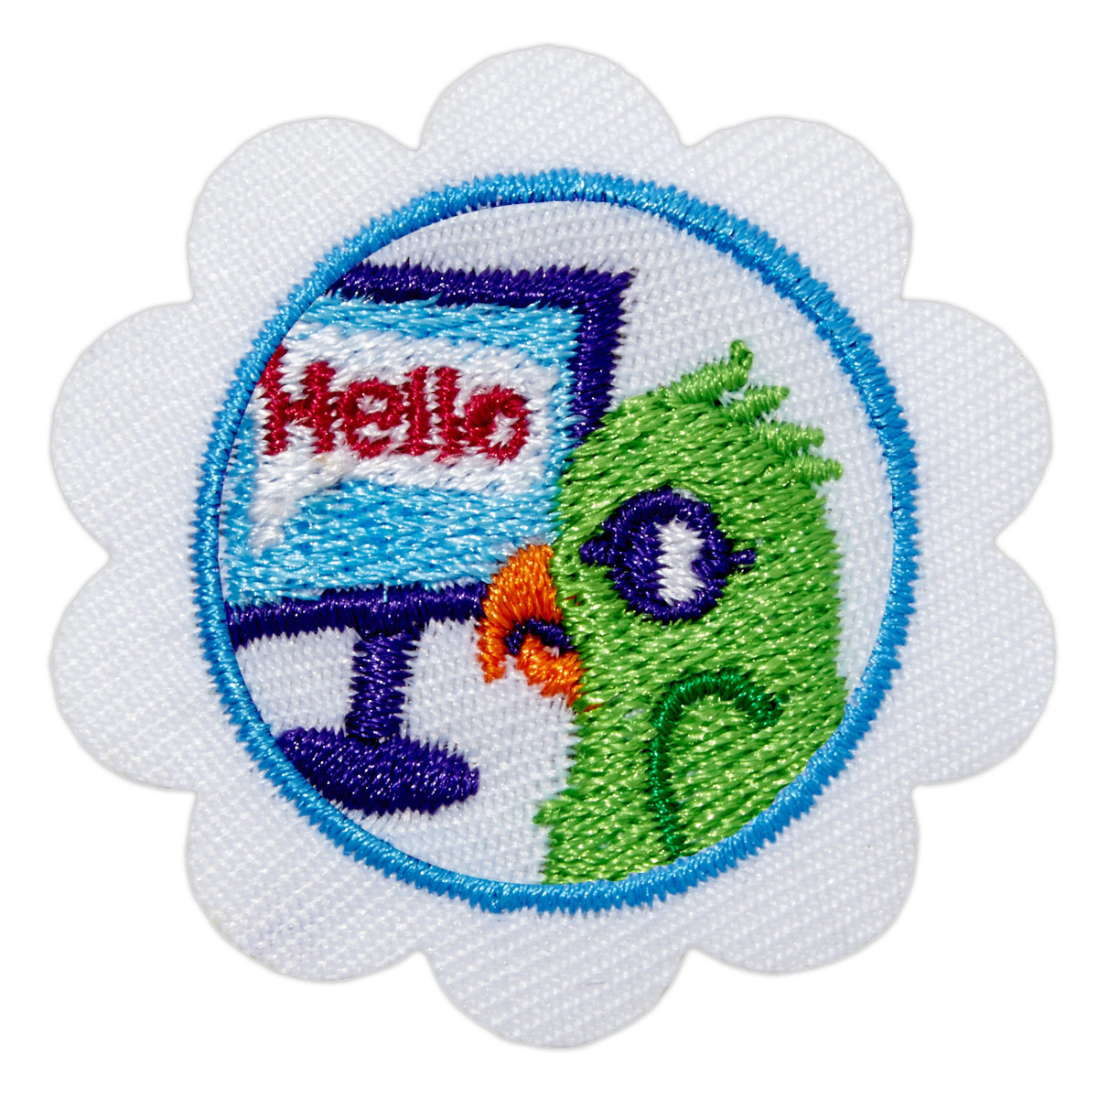

Daisy Cybersecurity Basics

Slide 2

Daisy Cybersecurity Basics
Computers are machines. They are made up of different parts that work together to allow you to look at pictures, play games, watch movies, and send messages.
Computers can connect to other computers all over the world. Computers are fun to explore with, but you need to know how to be safe while you do it.

Slide 3
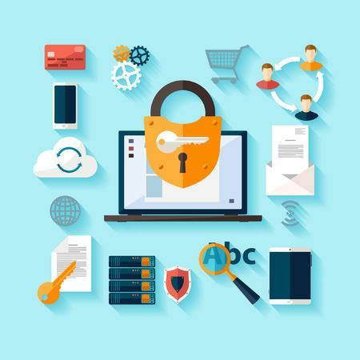
Daisy Cybersecurity Basics
You’ll complete the following steps:
1. Find out how computers work
2. Find out how to protect something valuable
3. Discover how you are connected, just like computers!
When you’ve earned this badge, you will know how computers work and
how to stay safe online.

Slide 4
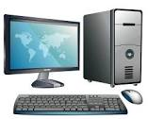


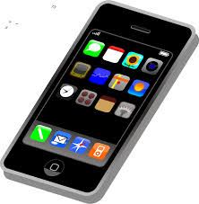

Step One: Find out how computers work
Find out about the parts of a computer and how they help you connect to the internet, watch videos, send messages, and much more!
Which one of these is a computer?

Slide 5
Step One: Find out how computers work
ALL OF THEM!

Slide 6
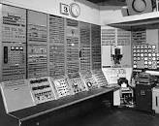
From Your Room to Your Pocket
The first computers were so big that just one would fill up a whole room! They were mostly used to help people with numbers.
Now, you can hold a computer in your hand! A smartphone is a pocket-sized computer. You can do a lot more with today’s computers.
You can take pictures, make movies, mix music, write stories, send messages, play games, and watch videos.

Slide 7
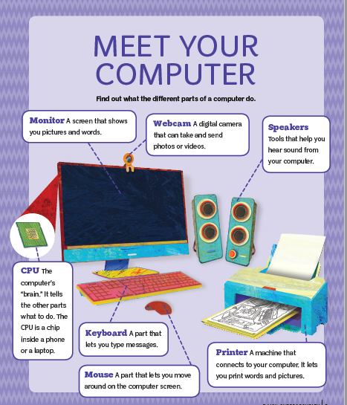

Slide 9

Step 2: Find out how to protect something valuable
Gather these materials:
• A small toy, coin, or something else girls can think of as “treasure” to put in a box
• Material to wrap the box: wrapping paper, bubble wrap, duct tape, regular tape, rope or string
• Crayons, markers
• Decorating materials like stickers and glitter

Slide 10

Step 2: Find out how to protect something valuable
Now that you have a beautiful box with all your treasures inside, how will you protect the box? To protect means to keep something from getting broken, hurt, or taken away.
Look at the materials you can use to wrap and protect your box. You can use wrapping paper or bubble wrap.
You can tie a string or rope to make sure no one else will take it.
Do whatever you think will protect your treasure.

Slide 11



Step 2: Find out how to protect something valuable
What are some ways you protect yourself from getting wet when you go outside and it’s raining? Maybe you use an umbrella or wear a raincoat or hat?
What are some ways you protect yourself from getting sunburn when you play outside? You could wear sunscreen, long sleeves, and a hat.
Sometimes you do more than one thing to protect yourself. When it’s cold, you wear sweaters, gloves, hats, jackets, socks, and boots, right?
What did you use to protect your treasure box? Did you find more than one way to protect it?

Slide 12

Step 3: Discover how you are connected, just like computers!
Think about how you communicate …
Communicate is a big word for telling somebody something. There are a lot of ways to do this.
You can talk to them:
• in person • over the phone • over the computer
You can send a message by:
• texting on your phone • emailing a message through your computer
• posting a picture or a message online

Slide 13

Step 3: Discover how you are connected, just like computers!
You are connected.
You spend time with and talk to your family and friends every day.
Computers are connected too. A group of computers that are all connected is called a network. People can send messages to other people over networks.
Computers help us to stay connected to one another when THEY are connected to one another through networking!

Slide 14

Now that I’ve earned this badge:
I can give service by:
• Telling my family and friends what I learned about how computer parts work together.
• Showing my family and friends how we’re connected in person and through computers.
• Sharing what I learned about safety and protection with my friends or class at school.

Slide 15

You Did It!
Congrats! You have earned your Daisy Cybersecurity Basics 1 badge!

