Slide 1
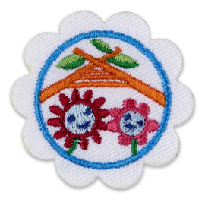
Daisy buddy Camper
Girl Scouts of Central Illinois Home Edition 2020

Slide 2
Camping is an adventure! You can play in nature, eat outside, and sleep under the stars with your family and buddies - your buddies could be the girls in your troop, friends or family.
Isn’t it exciting what nature brings?
-Marilyn Lott

Slide 3

Step 1. Help plan a camping Trip
When you find out you are going on a camping trip,
you might have some of these questions:
⚘ Where are we going?
⚘ What we will eat?
⚘ Where will we sleep?
⚘ What will I need to bring on our trip? ⚘ What will I do when we get there?
Find out the answers to your questions and be part of planning your trip. It will make it so much more fun!

Slide 4
Step 1 Activity: Choose one of these two options:
Make a camping kaper chart. At camp, everyone has chores and jobs to do. A kaper chart is a way to keep track of who is doing what. With a parent or another adult, draw a kaper chart with a list of all the things you can do on a camping trip.
Plan a simple meal. Be in charge of planning one dish for your camping trip. With an adult, decide what you want to make. Write out a list of what you’ll need to make it. Find out how to pack the food for your trip. Will any of your items need to be washed and cut, like fruits and vegetables?

Slide 5
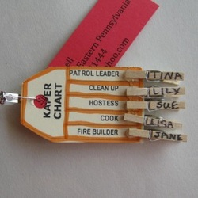
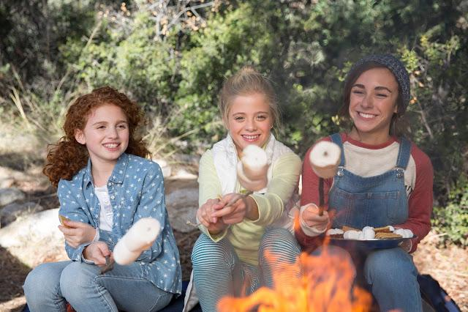
Find Girl Scout Camping Kaper Chart here .
Find Easy Campfire Meals here .
Kaper Chart
Easy Campfire Meals

Slide 6
Be Prepared! Prepared campers don’t leave home without these things. What are they?
⚘ What will you drink?
⚘ What gives light at night?
⚘ What will keep you dry when it rains?
⚘ What will protect you from the sun?
⚘ What kind of snacks can you eat?
⚘ What can you use to find your way on a trail?
⚘ What will keep bugs away?
⚘ What can you use to make a sound in an emergency?

Slide 7
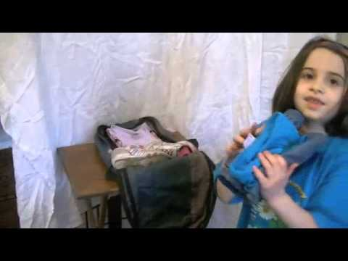
Be Prepared! Prepared campers don’t leave home without these things. What are they?
⚘ What will you drink?
⚘ What gives light at night?
⚘ What will keep you dry when it rains?
⚘ What will protect you from the sun?
⚘ What kind of snacks can you eat?
⚘ What can you use to find your way on a trail?
⚘ What will keep bugs away?
⚘ What can you use to make a sound in an emergency?

Slide 8
Step2. Help pack for your trip
“Be prepared” is the Girl Scout motto.
This means finding out what you will bring
on your camping trip. What will you wear if it rains?
How will you make sure you don’t get a sunburn?
Will you bring your books or favorite stuffed animal?

Slide 9
Step 2. Activity - Choose one of these two options:
Pack a bag. Ask a family member to help you make a list of what clothes and things you will need for your trip. Collect all the things, and then pack them into a bag. If you’re camping with friends, pack together and make it a race!
Get help from a camping expert or an older Girl Scout. With a family member, go to a sporting goods store and talk to an expert about all the different things you need while camping. You can also ask an older Girl Scout who has done a lot of camping.
Questions you can ask: ⚘ Where do I sleep at a campsite? ⚘ How will I carry water and keep it cool?
⚘ What will I need to wear for cold days? Hot days? ⚘ How are meals made?

Slide 10
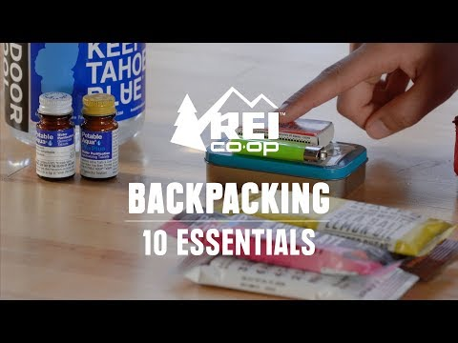
Camping can be as simple as in your backyard or As advanced as a
remote location off the Grid. The most experienced campers have evolved with every new outdoor adventure.

Slide 11
Step 3. Go Camping!
Now that you’re at the campsite or set up
in a backyard, practice a new camp skill
or go on a hike!

Slide 12
Step 3 Activity - Choose one of these two Activities:
Learn to tie a square knot and have a knot-tying contest. Tying a square knot is a lot like tying your shoes. If you can’t tie your shoes, that’s ok! You can still learn to tie a square knot. Then have a contest to see who can tie a square knot the fastest!
Take a hike on a trail. But before you do, make sure you know all the “Safe Camp Rules.” Also learn how to protect nature while you’re on your hike.

Slide 13
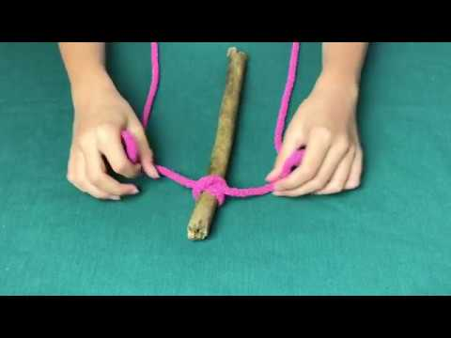
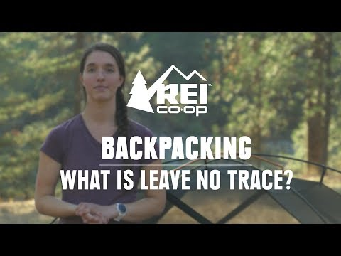
Learn New Camping Skills
Knot Tying
Leave No Trace

Slide 14
Safe Camp Rules
Poison Ivy and Poison Oak have three leaves— so to be safe, stay away from plants with three leaves. Leaves of three, let it be! Choose a buddy and stay with her at all times. Never walk alone. Drink lots of water, especially when you go on a hike! Wear sunscreen and hats to protect from the sun. Wear shoes with closed toes to protect your feet. Wear light-colored clothing and long pants to protect from ticks. If you can, tuck your pants into your socks. Be careful around a campfire. Never step over a fire or on top of the logs around it. Know what’s in a first aid kit and why you need it.

Slide 15
Now that you know the basics of camping, You are ready to experience a GSCI Day Camp or GSCI community Day Camp. Find Girl Scouts of Central Illinois Summer Camp Information here

Slide 16


